Slide 2
strategic ip management
dr joanne van harmelen

Slide 3
Types of IP/intellectual assets:
What do we focus on?
intellectual assets
Intellectual Property (IP) are assets protected by statute and include:
Intellectual Assets are a broader class of intangible asset that are protected by common law and include:
Patents which protect technology assets such as products, apparatus and processes
Trade Marks which protect symbols, names and phrases
Registered domain names which protect internet domains
Copyrights which are unregistered and protect aesthetic creations and computer software and
Database rights, which are unregistered.
IP
Licensing which entitles use of IP
Trade Secrets and Know How which includes:
  Material protected by confidentiality and non-disclosure agreements and
  Documented processes, models or techniques not otherwise protected.

Slide 4
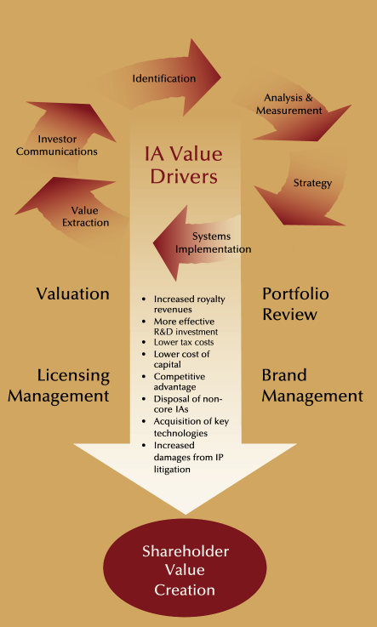
why do you need an IP strategy?
Aligning Board and Business Unit management
Creating an IP mindset
Exploring IP opportunities and risks
Knowing what to protect
Knowing where to invest
Defining the major IP activities and processes
Establishing / improving your IP-Function

Slide 5
what comprises a good IP strategy?
It is based on:
an understanding of the current state of thinking about IP within the company
the business strategy
the technology / marketing strategy
the existing IP portfolio
the strategic IP goals
It consists of:
a view on the role of IP in increasing shareholder value
primary goals for managing IP
criteria for IP protection
measurable goals for IP management:
  operational
  financial
  competitive
  tax
  legal
description of the IP function and processes
It allows you to:
educate management on the importance of IP
decide on what IP to create, protect, exploit and enforce
allocate investments in IP
migrate from the current to the future state
evaluate the performance of the IP portfolio and IP Function

Slide 6
the IP management value hierarchy
many leading companies have implemented successful intellectual asset management programs that have enhanced shareholder value
visionary
(drive growth)
integrated
(manage for growth)
profit centre
(manage for profitability)
cost control
(control costs, improve productivity)
defensive
(build portfolio, protect markets and technology)

Slide 7
level 1 - defensive
defensive
objectives
  IP viewed as a legal asset
  to create a defensive position and capability
  obtain access to the technology of others
best practices
  consolidate internal and external management of IP
  audit: take stock of what you own
  register IP (patents, trade marks, domain names)
  begin freedom to operate studies
  enforce your IP (implement watching service)
  training of key management

Slide 8
level 2 – cost control
objectives
  IP still viewed as a legal asset
  organised ownership structures of IP across
  group companies
  reduce IP costs
  refine and focus on both IP creation and
  portfolio
best practices
  relate IP portfolio to business use
  establish IP committee
  create screening criteria
  establish IP filing, maintenance and renewal guidelines
  IP holding company structuring (centralised ownership vs. devolved ownership)
cost control

Slide 9
level 3 – profit centre
profit centre
objectives
  view IP as business asset
  begin to monetise IP
    tactical (non-core, non strategic)
    low-hanging fruit
best practices
  obtain management buy-in
  optimise use of R&D tax credits
  organise to extract value
  develop advanced screening criteria
  ensure appropriate transfer pricing of IP assets between international operating companies

Slide 10
level 4 - integrated
integrated
objectives
  view IP as a business asset
  utilise IP across the organisation
  utilise IP more strategically
best practices
  align corporate and IP strategies
  manage IP across multiple functions
  conduct competitive assessment
  codify knowledge and share IP across company
  focus on strategic value extraction

Slide 11
level 5 - visionary
visionary
objectives
  use IP to stake a claim to the future
  embed IP into the corporate culture
best practices
  strategic patenting
  measurement and reporting

Slide 12
types of value that can be extracted from IP assets
DEFENSIVE | Patents | Trade marks | Know-how
Conflict avoidance /resolution | protection (exclude others) design freedom cross-licensing (defensive) litigation bargaining power | protection (exclude others) | protection (trade secret)
OFFENSIVE | Patents | Trade marks | Know-how
Revenue Generation | Products and Services: sales, licensing, joint venture, strategic alliance, optimisation of core technology, integration, donations Patents: sales, licenses, donations, infringement policing Increase bargaining power (e.g. suppliers, consumers, affiliates, joint venture, alliance partners) Market penetration Increased speed to market | Products and Services: sales, licensing, joint venture, strategic alliance Trade marks: sales, licenses, co-branding, infringement policing | Sales Licences Joint ventures Strategic alliance Integration Increased speed to market
Cost Reduction | Litigation avoidance Access to technology of others Improved knowledge transfer Reduced knowledge gaps | Litigation avoidance Access to technology of others | Litigation avoidance Improved knowledge transfer
Strategic Position | Reputation/image Communication to “ the markets” Competitive blocking (exclusivity) Barrier to competition Supplier control Consumer control Optimisation of core technology | Name recognition Consumer loyalty Barrier to competition Joint venture Strategic alliance | Reputation/image Barrier to entry

Slide 13
IP management – value of licensing
  After 10 years, IBM’s patent licensing program generated more than $1B annually, now that number is around $2 Billion
  Coca-Cola generates approximately $500 Million annually from licensing its trademarks
  Dow saved over $50 million by pruning its patent portfolio, and now generates more than $100 million in annual licensing revenue
  Honeywell licenses its autofocus patents broadly and collects more than $400 Million annually

Slide 14
Preferred “styles” of transaction
current preferred “styles” of transactions

Slide 15
preferred “styles” of transactions
With uncertainty about economic recovery, counterparties are looking to defer risk
  Licensing remains preferred route
  Licences are often linked to preferred rights on sale
  Any sales are generally on “stage-gated” basis
  Joint ventures are at depressed valuations for funders of technology

Slide 16
IP holding companies: e.g.
Company A
Wholly owns subsidiary A
Loan or distribution
Shares
IP Rights assigned
Licence
IP Holding Company
Subsidiary A
Royalty

Slide 17
IP holding companies
Typical reasons for establishing an IP holding company:
Limit liability and risk created from IP commercialisation activities to the IP holding company
Provide the university via the IP holding company with the flexibility to deal with IP commercial transactions
Tax planning
Simplified, consolidated, management of IP portfolio and IP commercial transactions

Slide 18
IP holding companies
Issues to consider when establishing a holding company:
Tax – including ensuring that any tax exempt status of a university is not compromised and that transfer of IP to the IP holding company is handled tax efficiently
IP – including ensuring that the university’s indirect ownership and commercialisation rights over the IP are not compromised,
Corporate, legislative and procurement considerations in regard to establishing an IP holding company
In South Africa, NIPMO obligations in regard to IP transactions and reporting requirements

Slide 19
how can ens help you?
in africa
for africa
ENS is Africa’s largest law firm, with established offices and a growing footprint across sub-Saharan Africa
We are a full-service law firm and can provide comprehensive legal assistance in a number of fields including:
IP
Corporate and commercial, banking and finance
Tax and exchange control
Regulatory affairs
Employment

