Slide 1

VUT SG STP
From Ivory Tower to Engagement – Creating the Bridge
Deon de Beer
IASP Africa 2013

Slide 2

The VUT adopted the mission for the Science and Technology Park to serve as a bridge between VUT and the Southern Gauteng¹ Region’s Community ²
¹ Including parts of North West and Northern Free State,
& Northern Cape where applicable…
² Community also includes commerce and industry…

Slide 3
Early Foci:
Advanced Manufacturing
Renewable Energy
Water Quality and Resource Management
Waste & Wastewater Management
Sustainable Livelihoods, Nutrition & Food Valley
Chemical- and Biotechnology

Slide 4
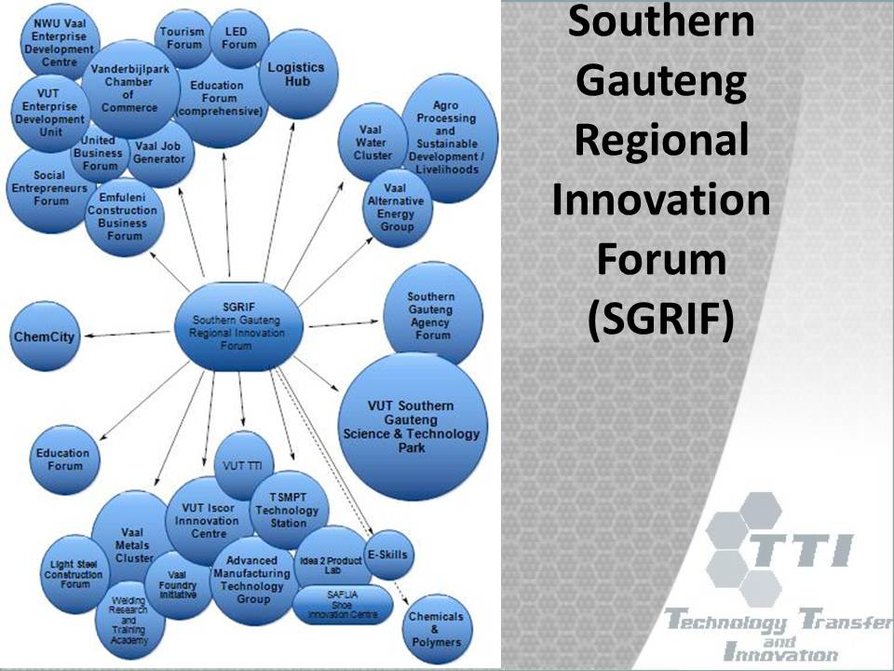
The Innovation Hub
DST, dti, IDC, TIA, NFTN, seda, etc.

Slide 5
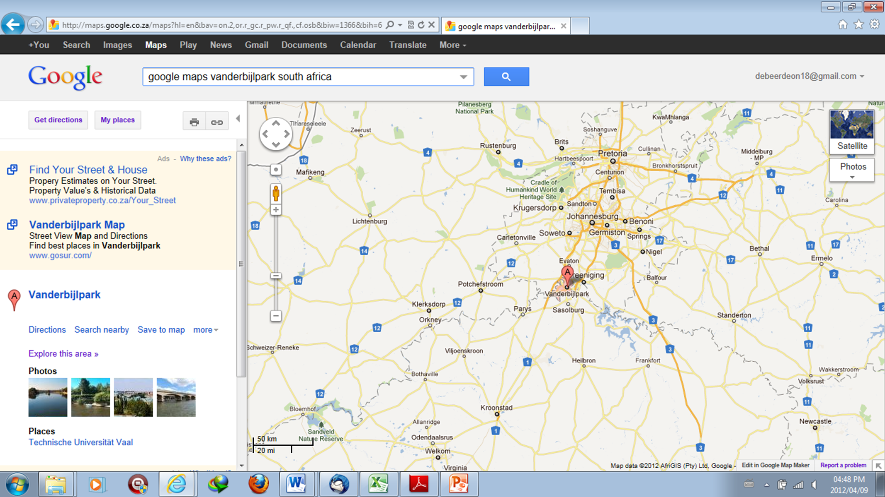
VUT SG STP
VUT STP – to bring Southern Gauteng into the S&T Picture

Slide 9
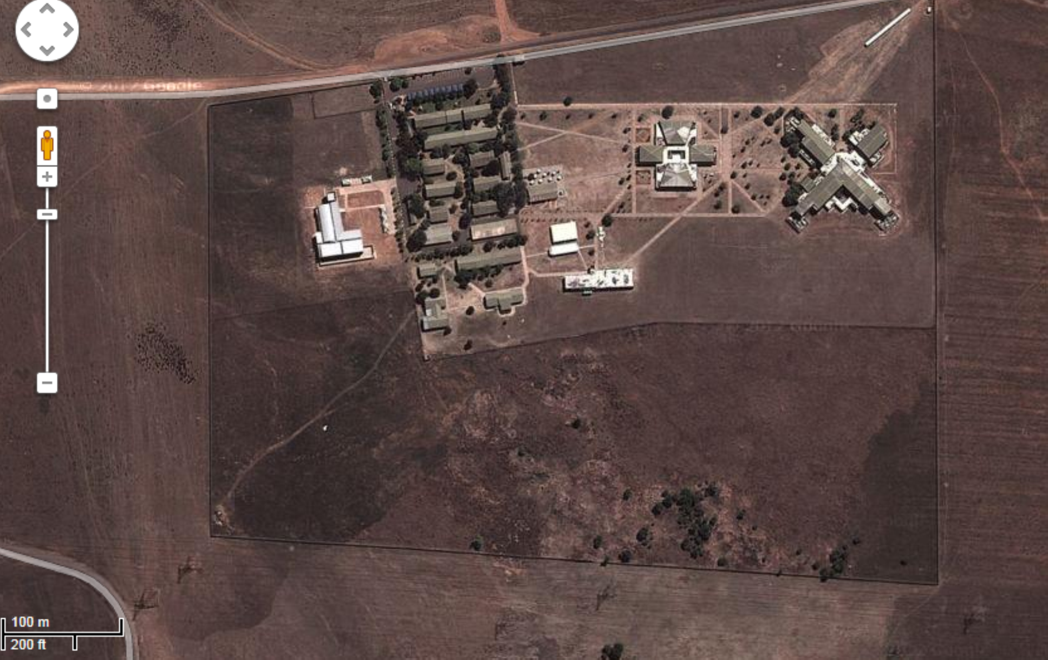

f
c
d
b
e
a
g

Slide 10
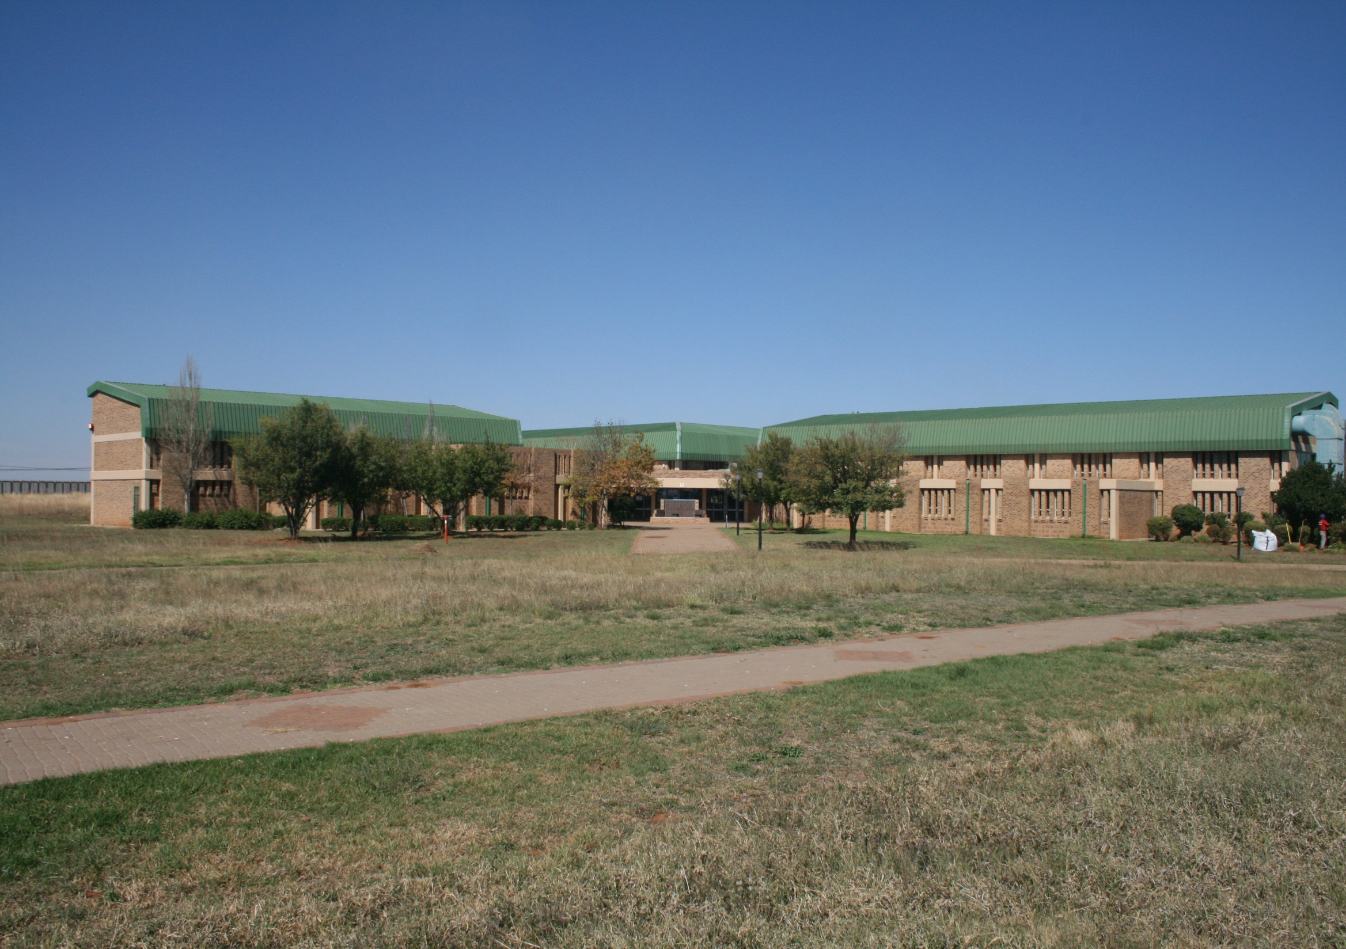

Slide 11
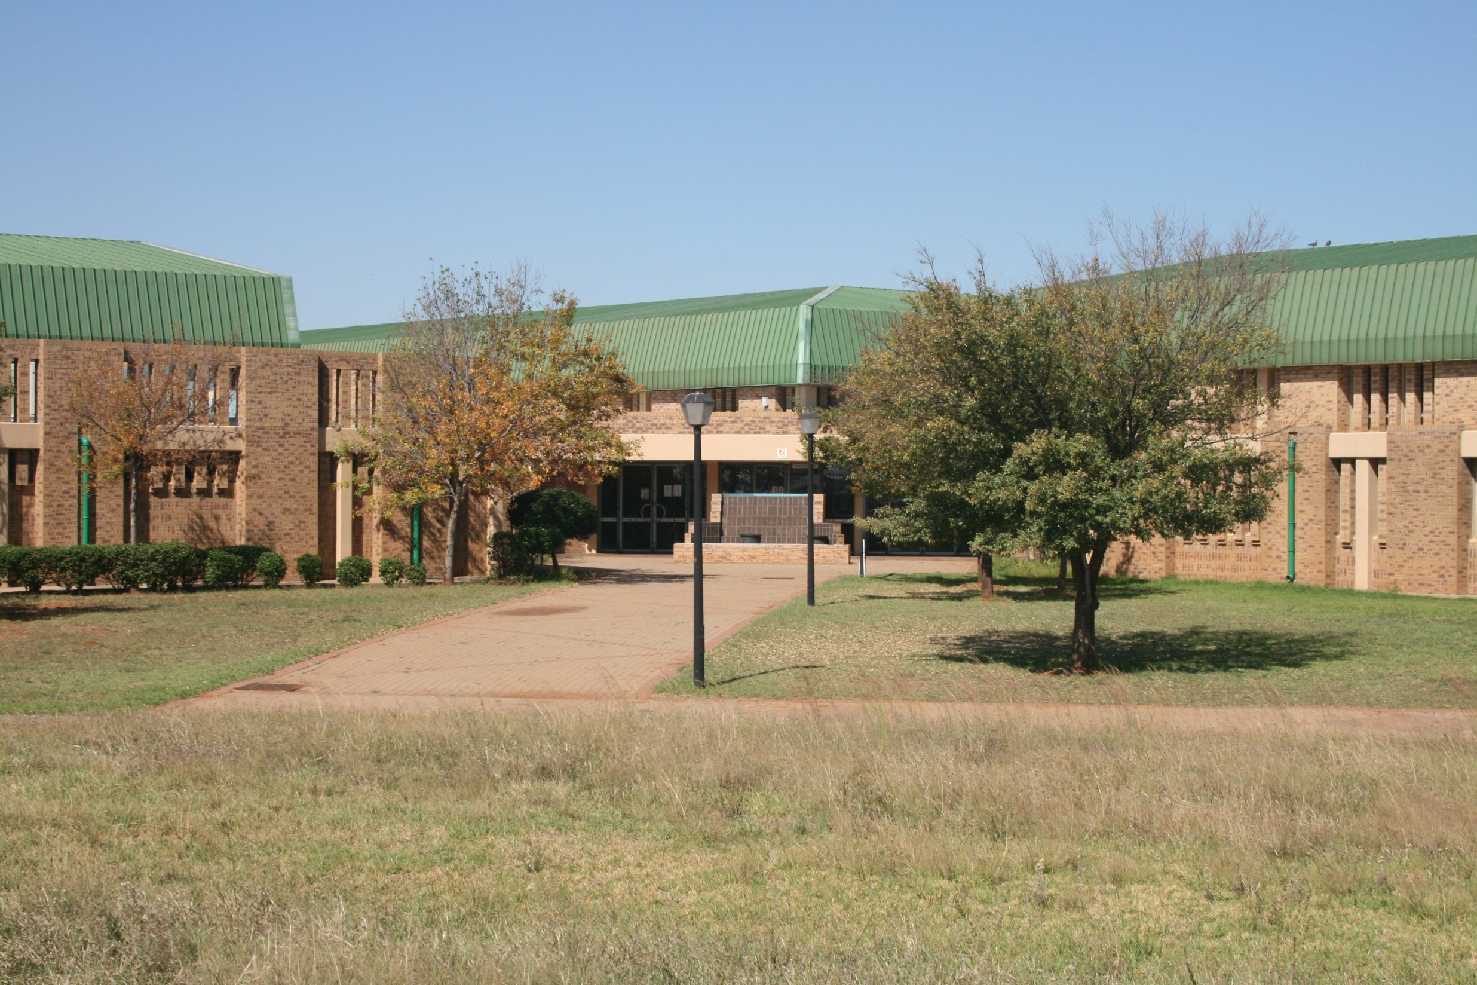

Slide 12
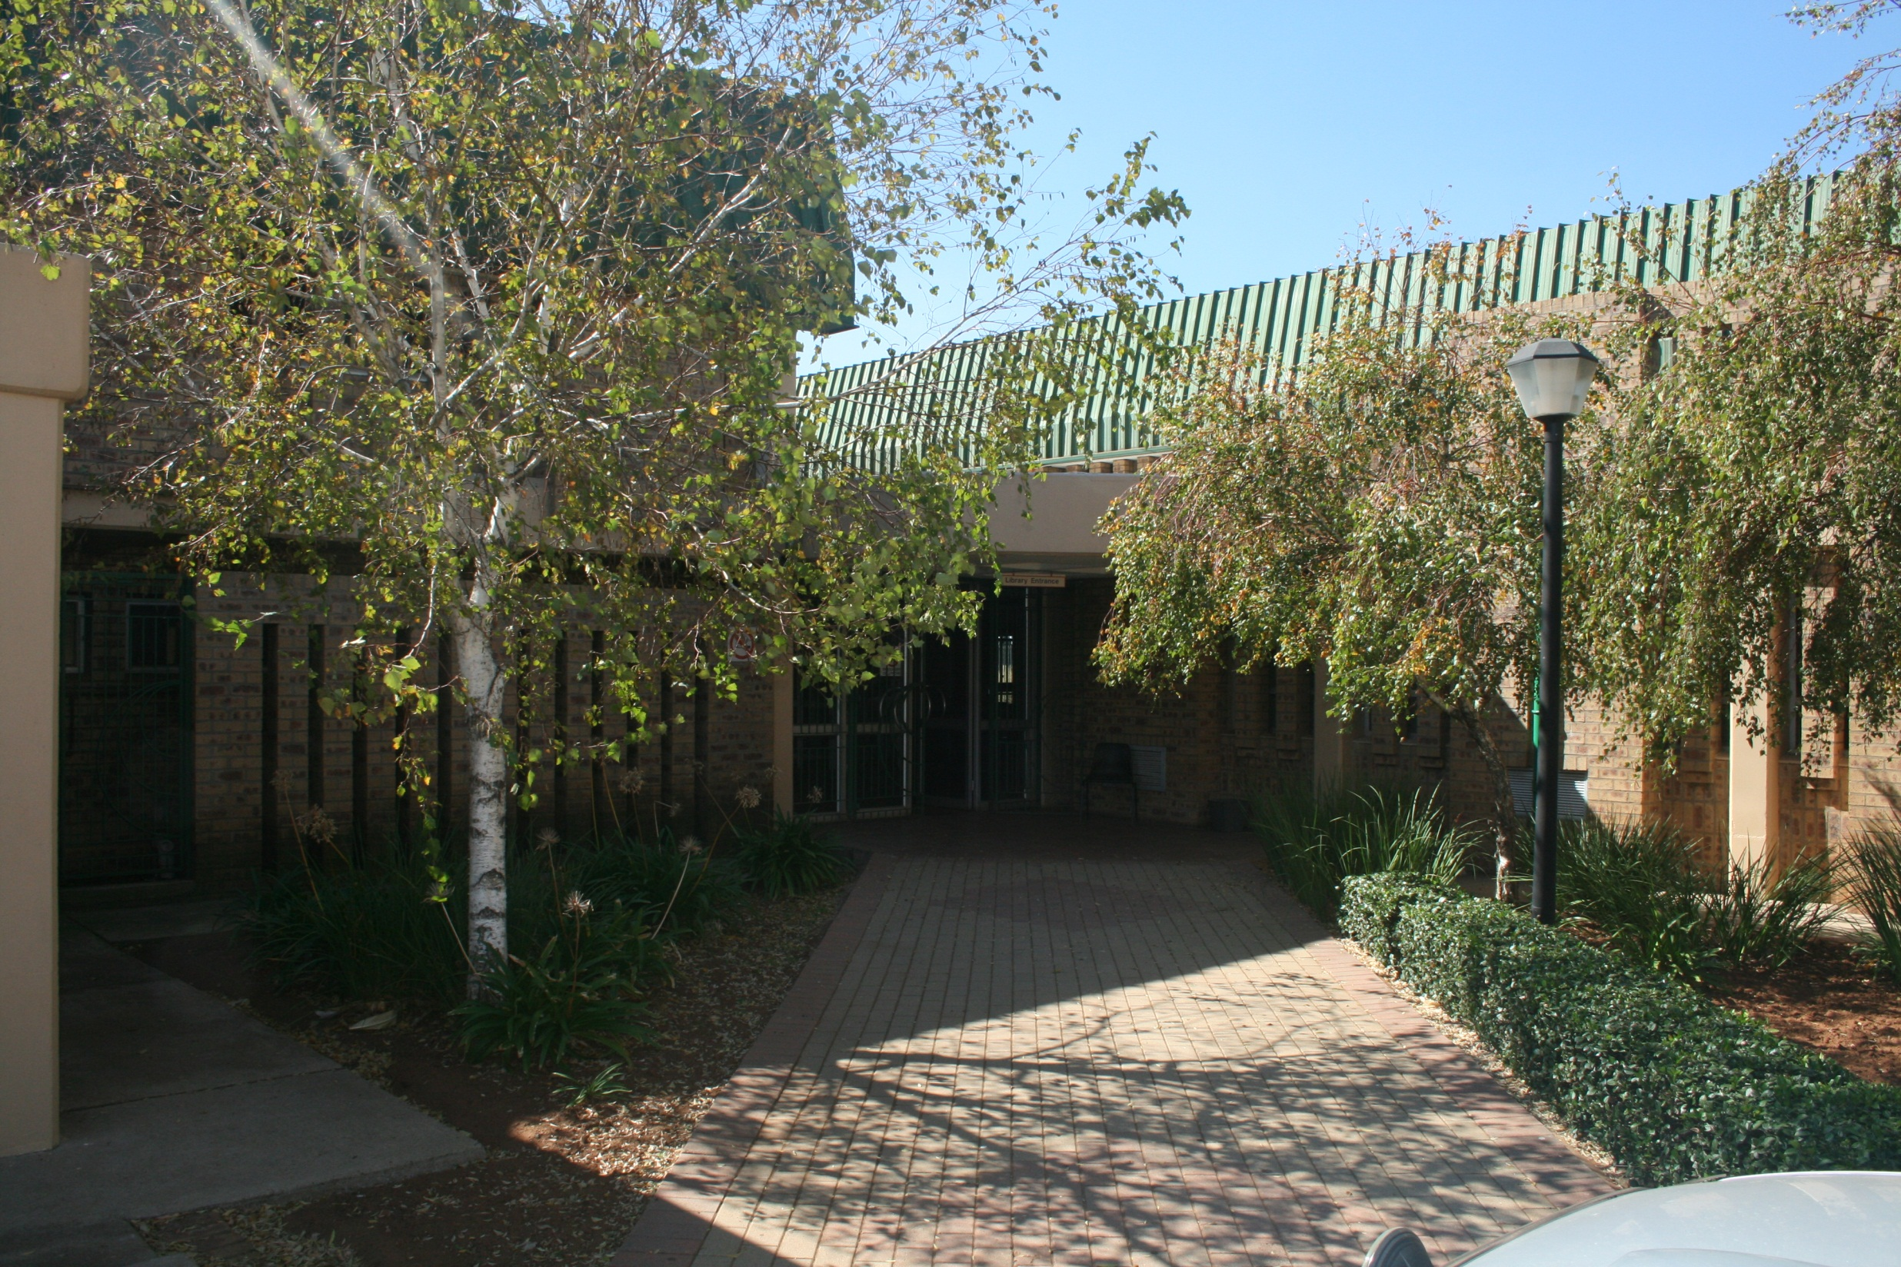

Slide 13
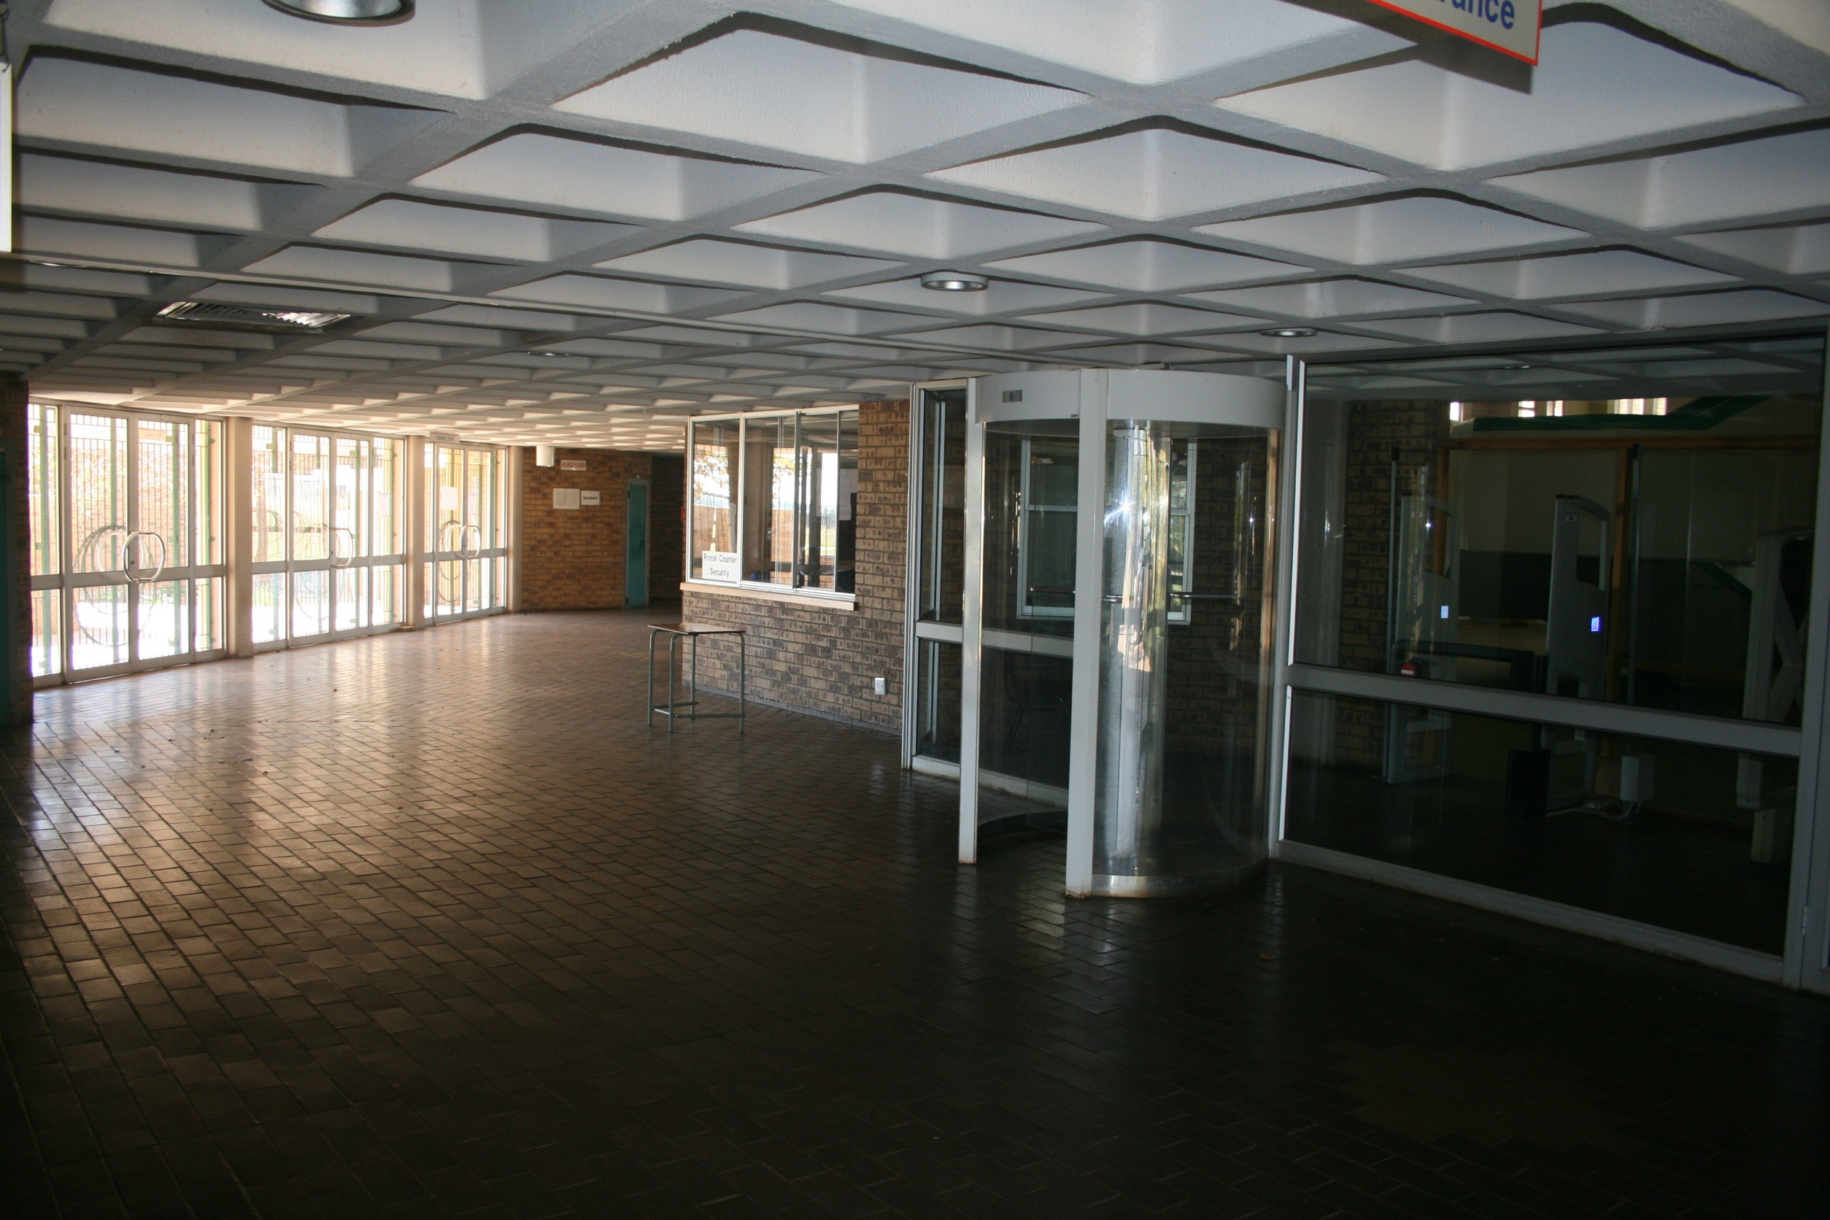

Slide 14
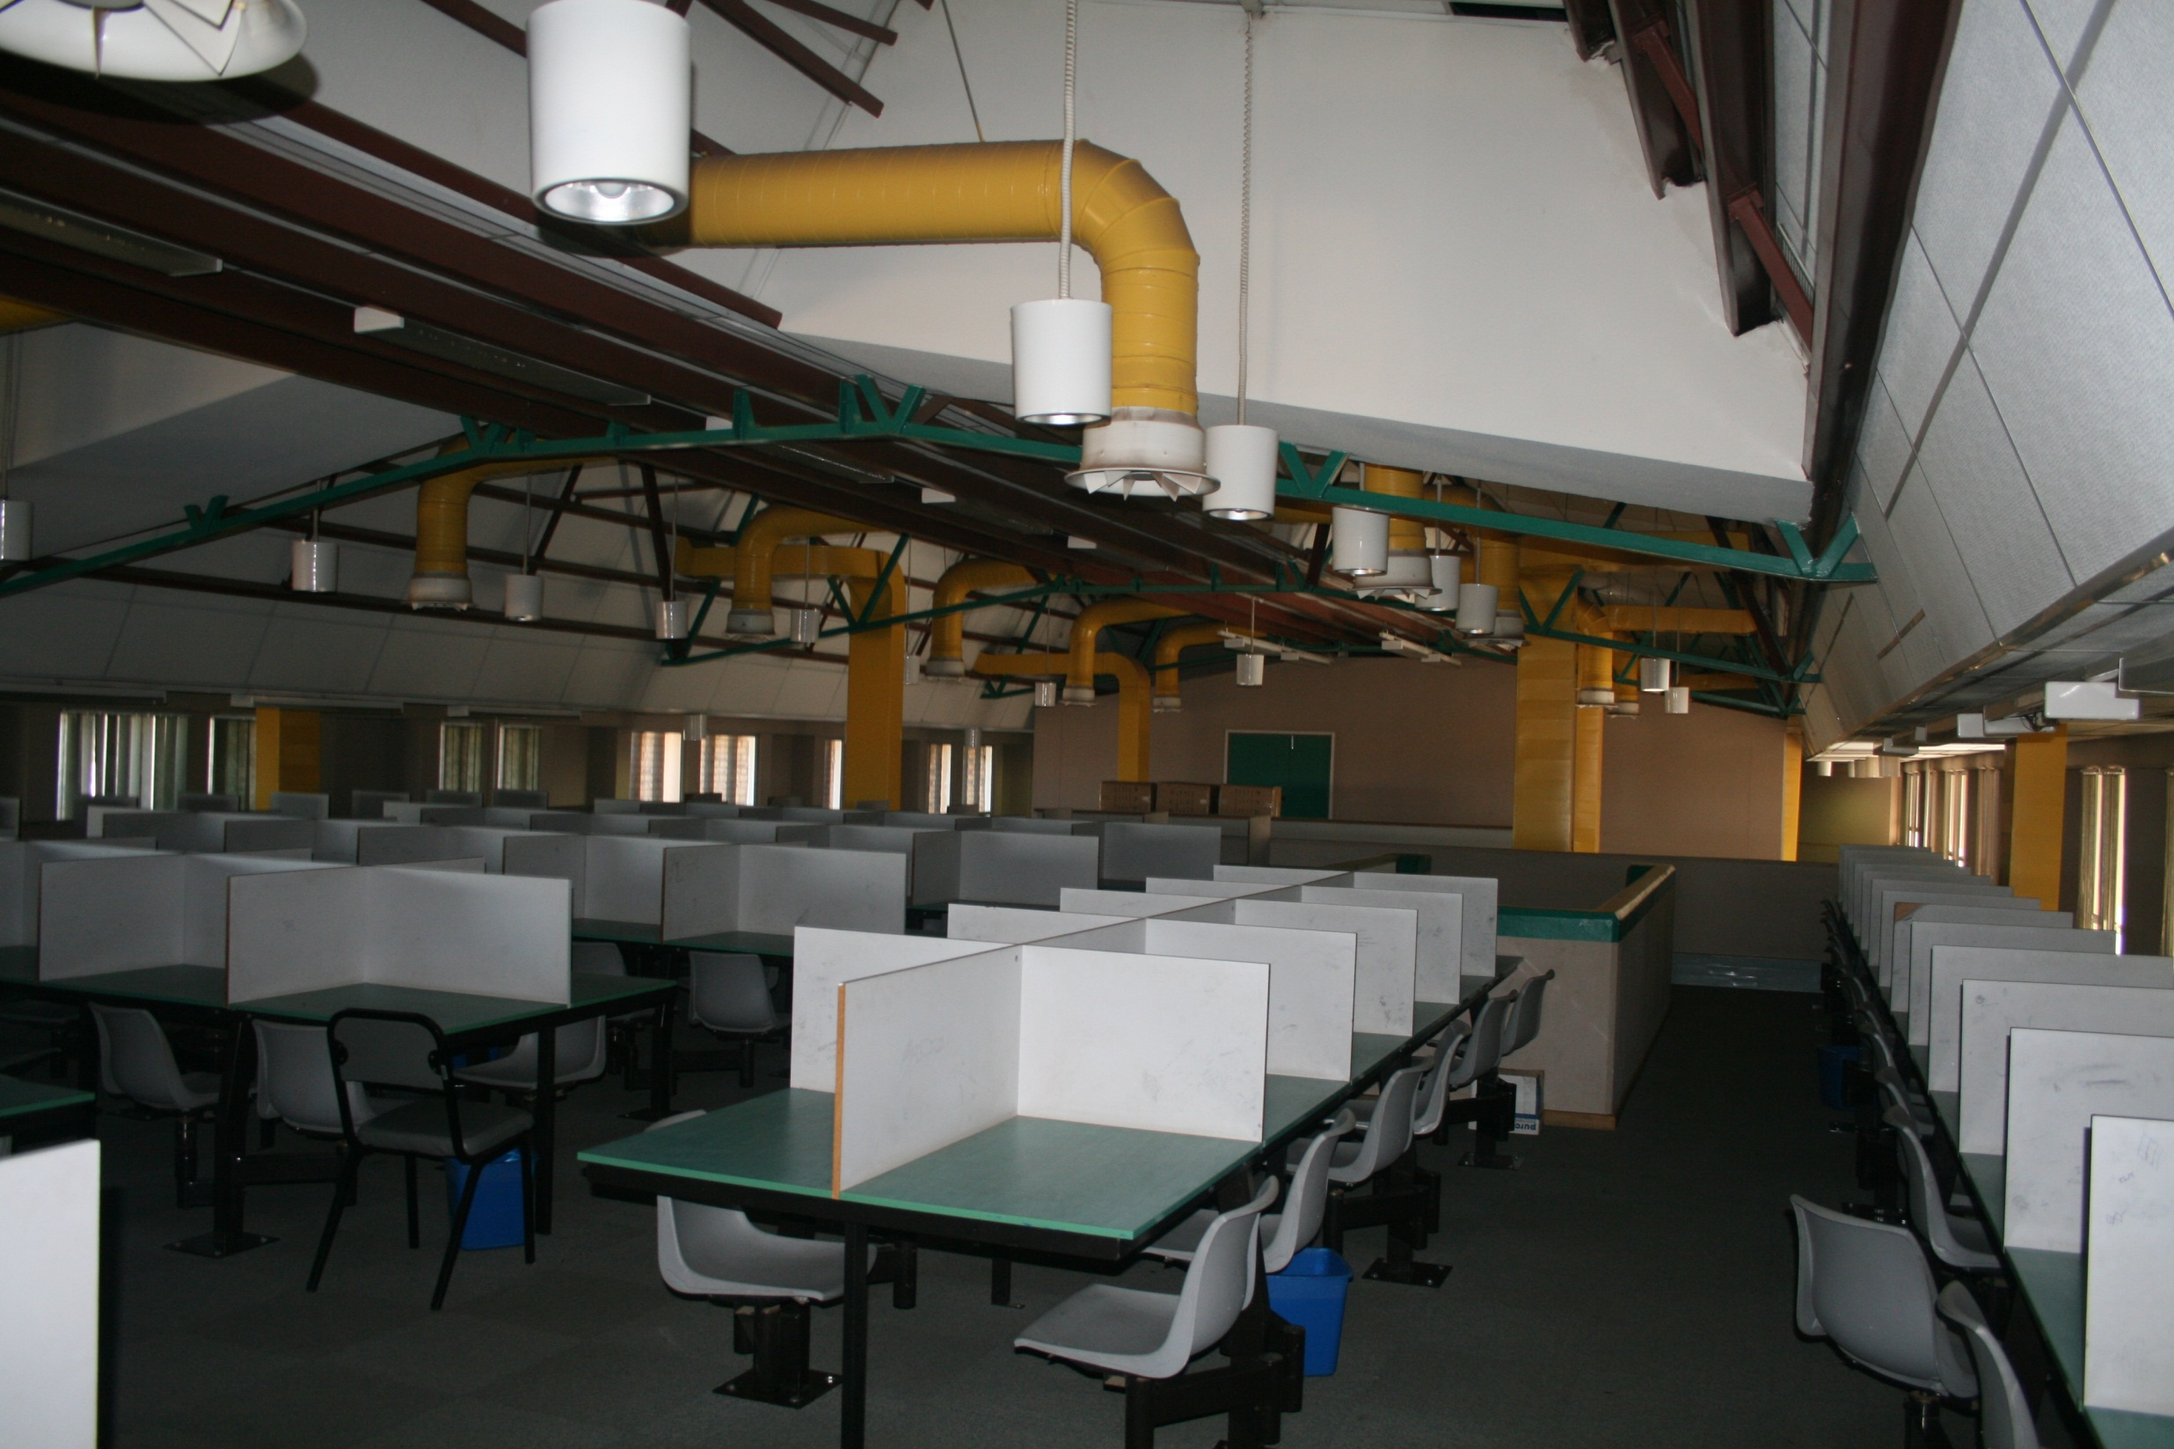

Slide 15
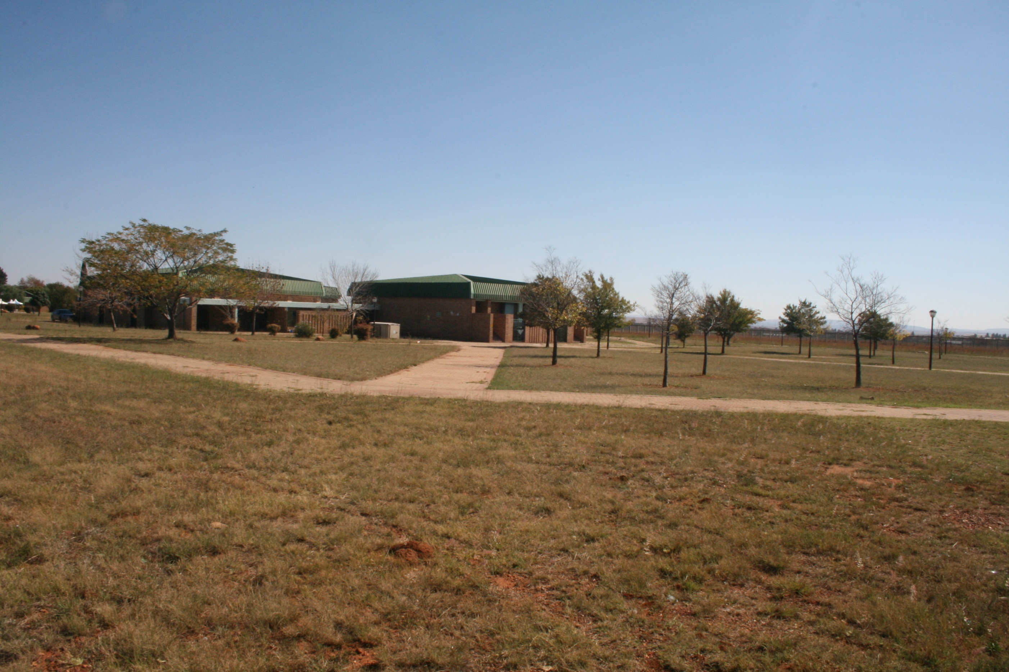

Slide 16
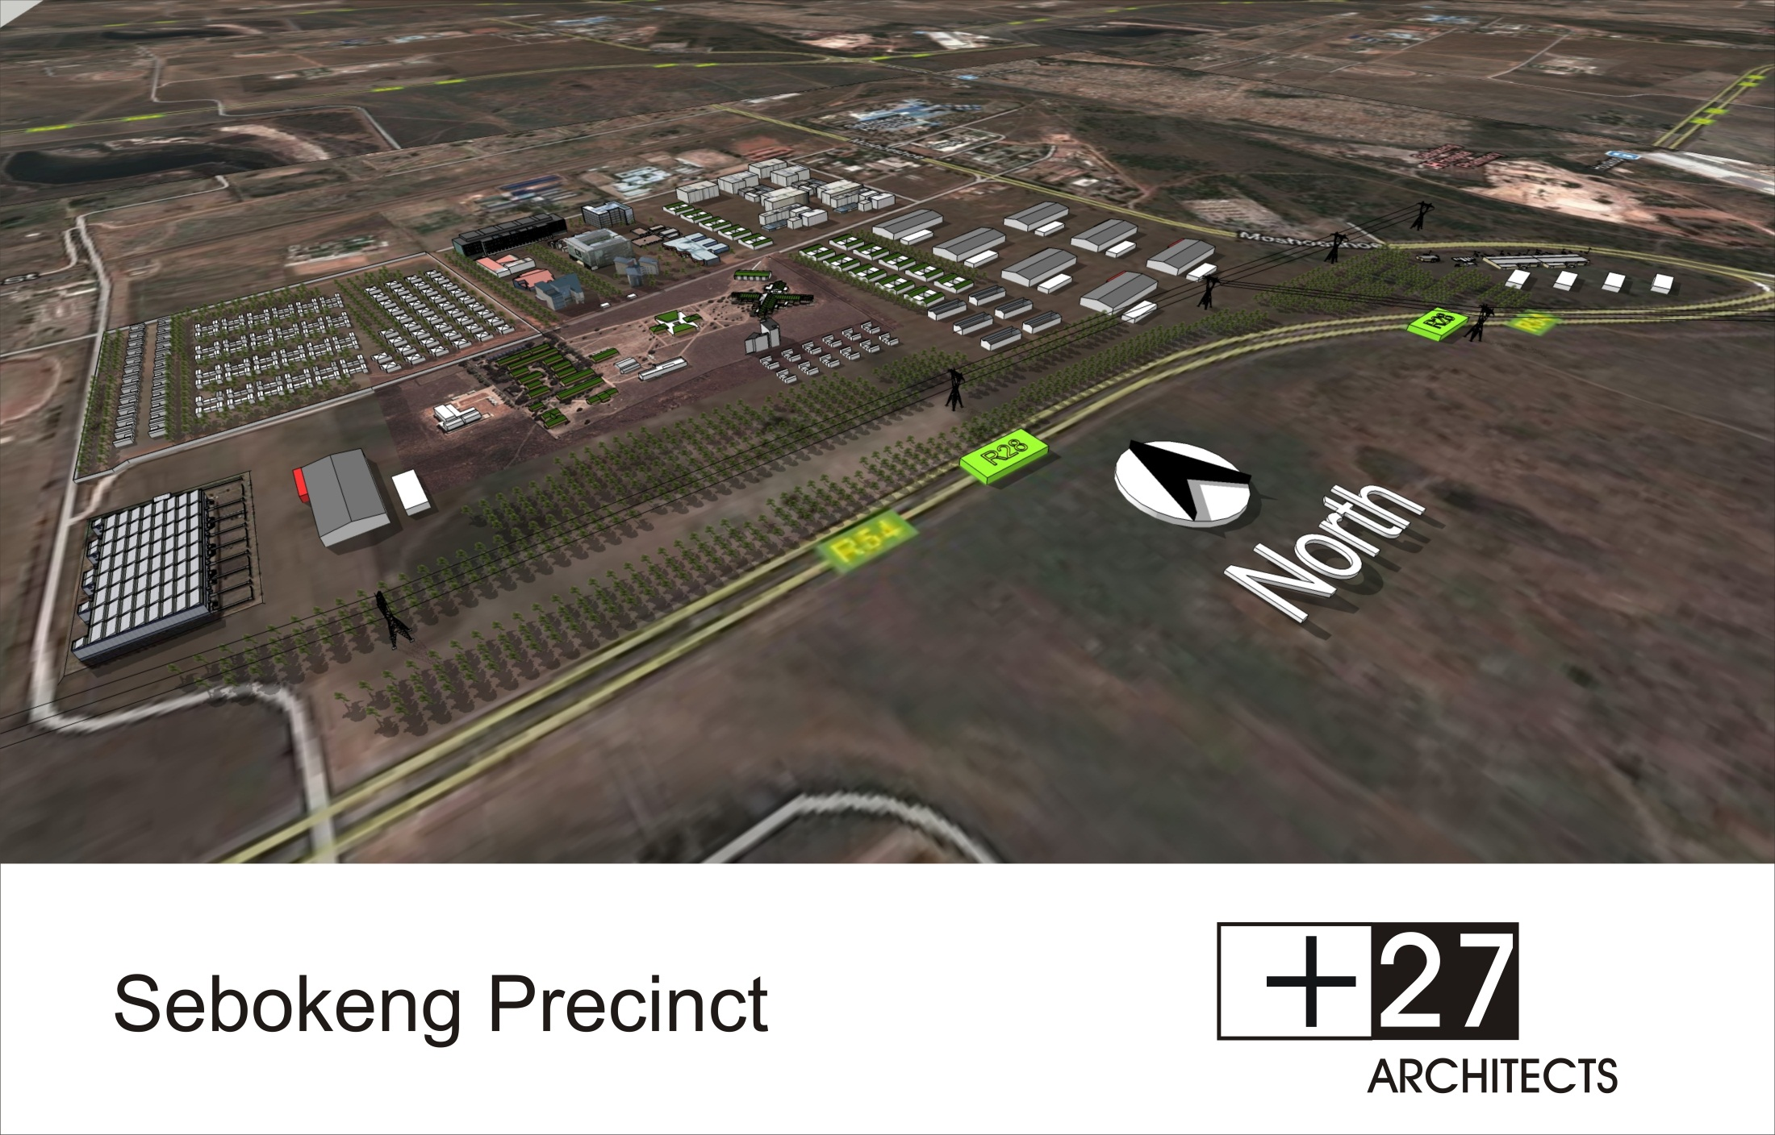

Slide 17
TTI Organogram
DVC:
Academic and Research
Research
TTI
Faculties
Academic
Support
Functions.
Backroom Office
Project Initiation
& Management
IDC PMU
Institute for
Chemical
and
Bio-Technology
Engineering
Manufacturing
Centre
Iscor
Innovation
Centre
Enterprise
Development
Unit
(NIPMO TTO)
Technology
Station
VdBP & Upington
VUT SG STP
SAFLIA
Cluster
Project
SATA VAAL
Welding
Institutes
Light Steel Construction
Initiative
Vaal
Foundry Initiative
Vaal
Metals Cluster
Schneider Electric Training Centre
AMBIO
SediChem Incubator
I2P
3G SPs
DOWA DoEA

Slide 18

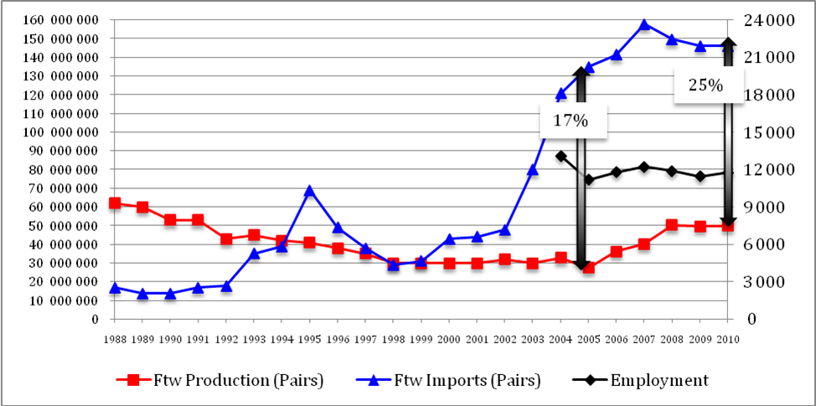
Example of success – NFLC Project:
3rd most labour intensive sector in SA Industry
Current estimated consumption:
250 million pairs / annum

Slide 19
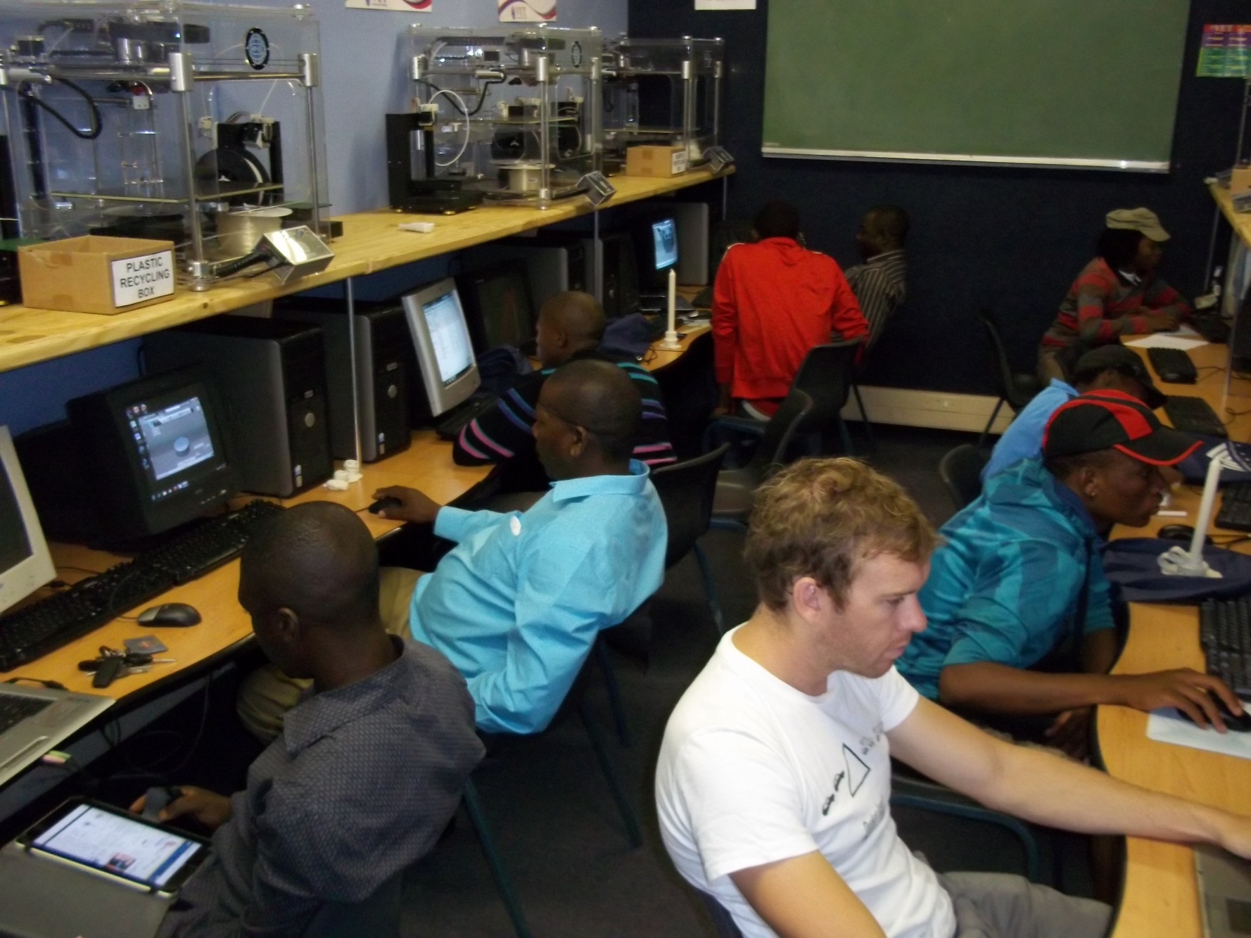
I2P Lab™

Slide 20

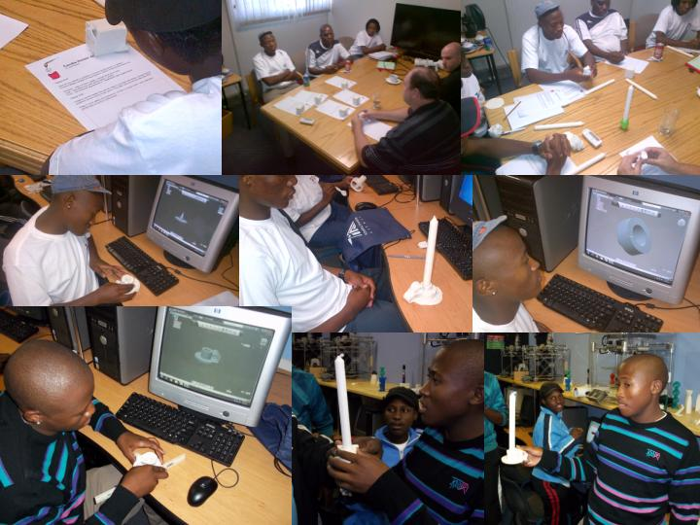
Project Examples & Successes

Slide 21

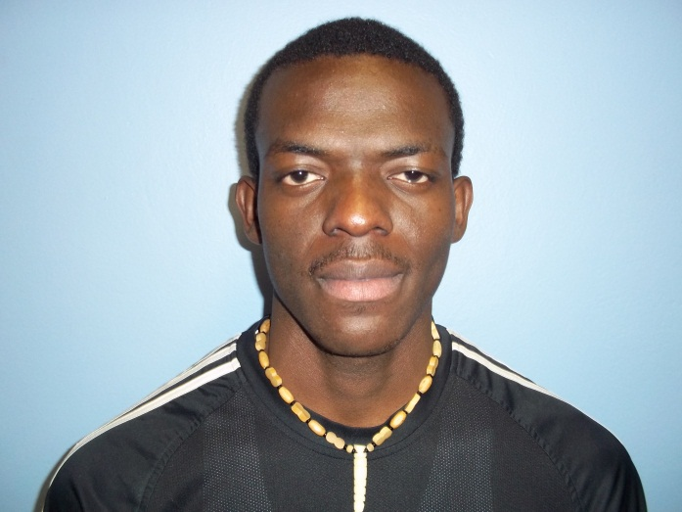
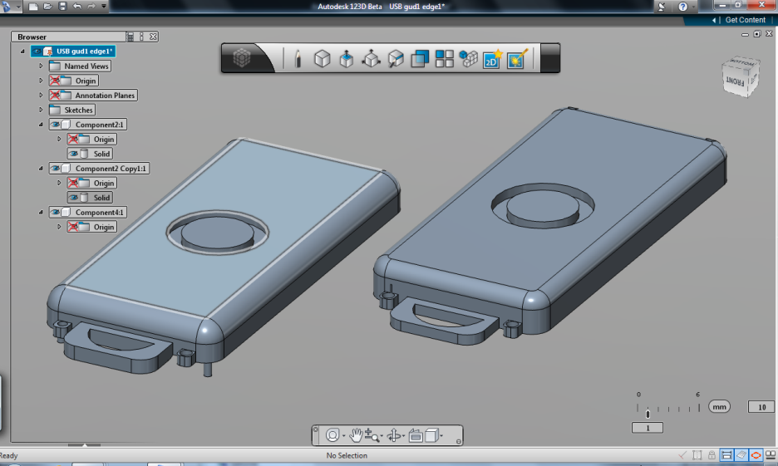
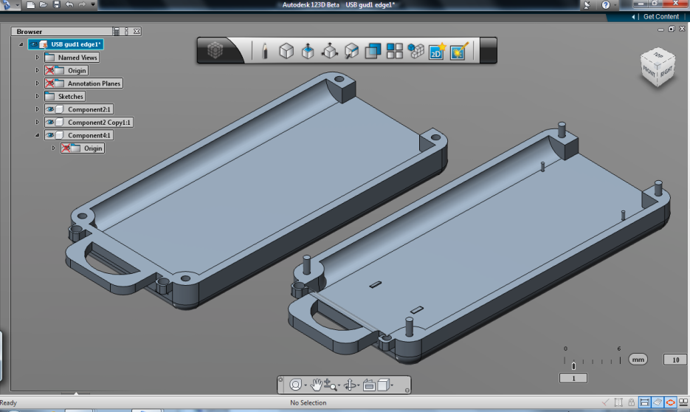
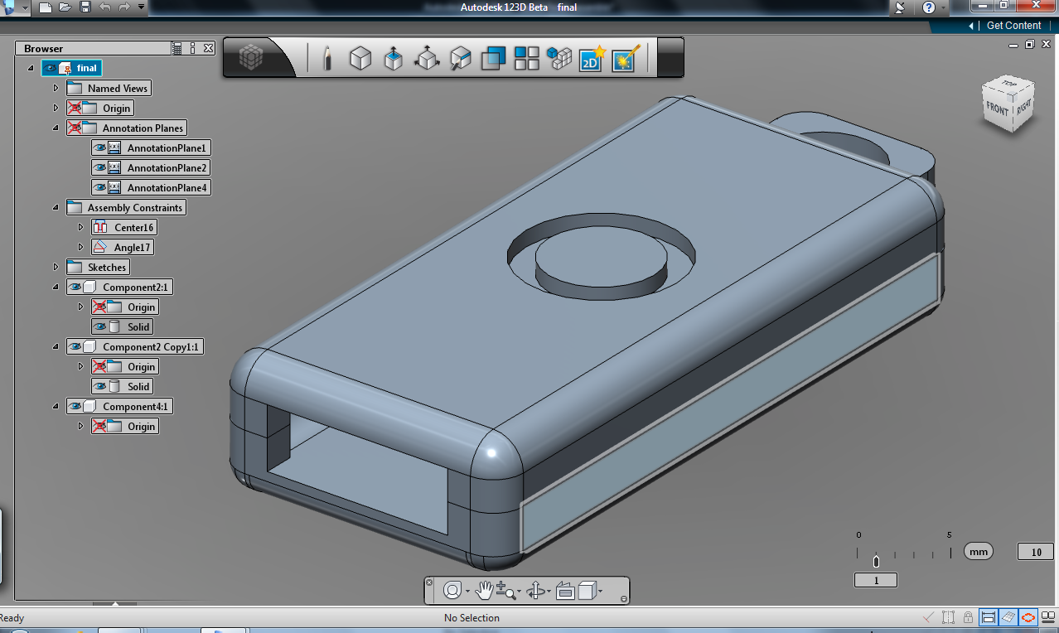
Success Stories

Slide 22
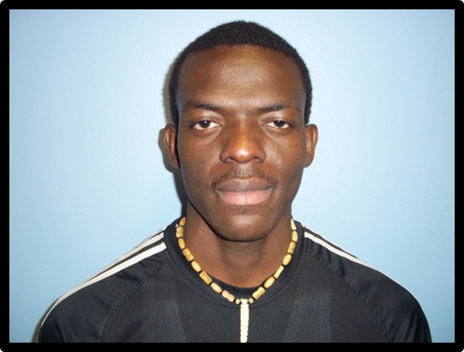
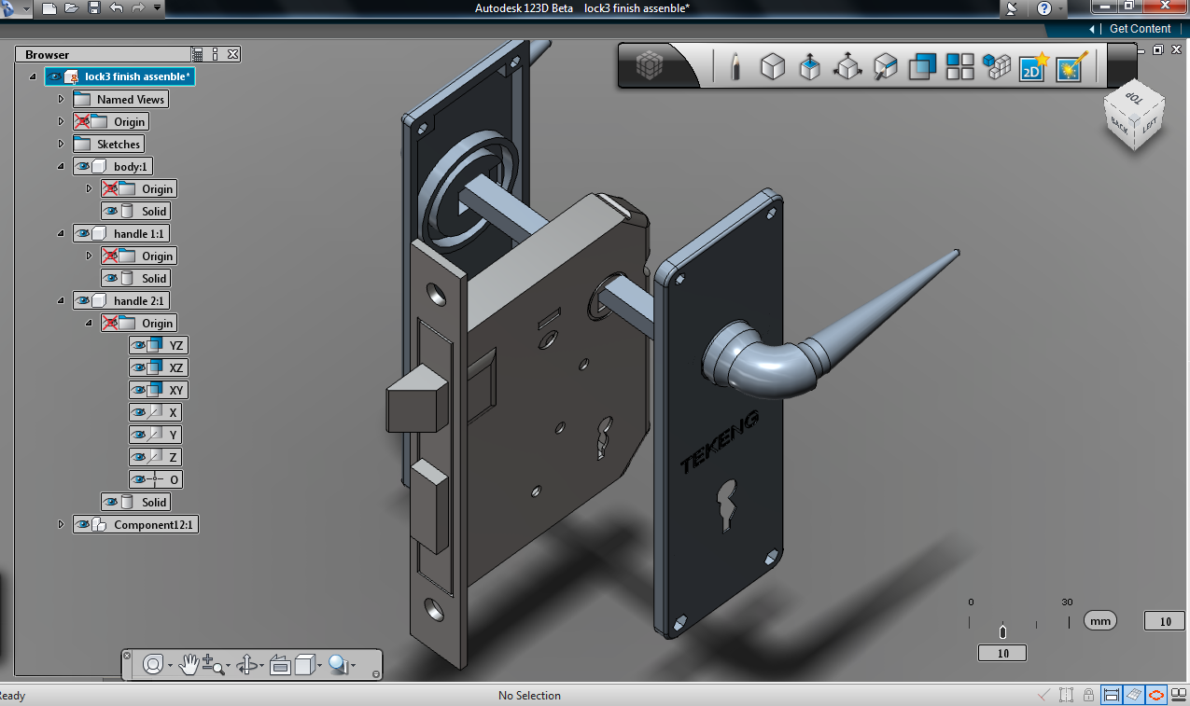
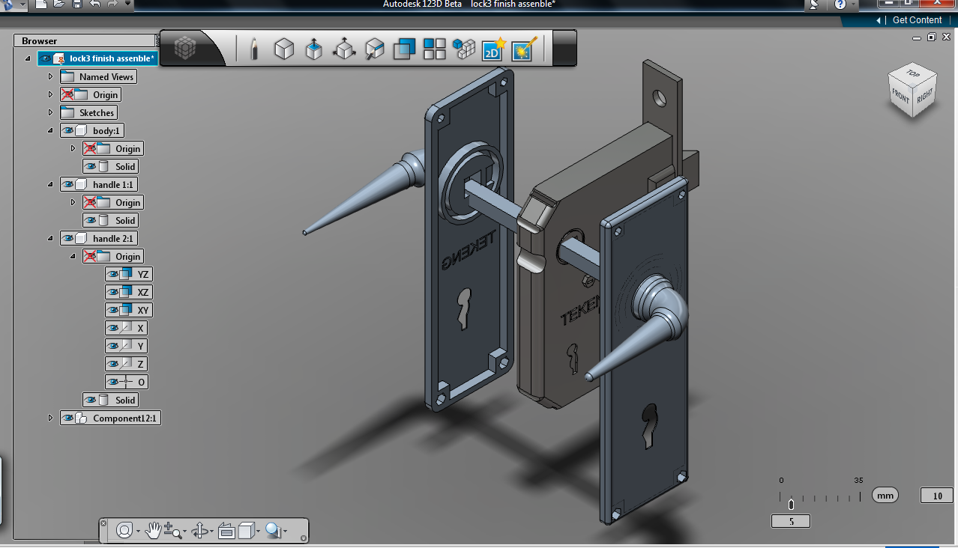
Project Examples & Successes

Slide 23

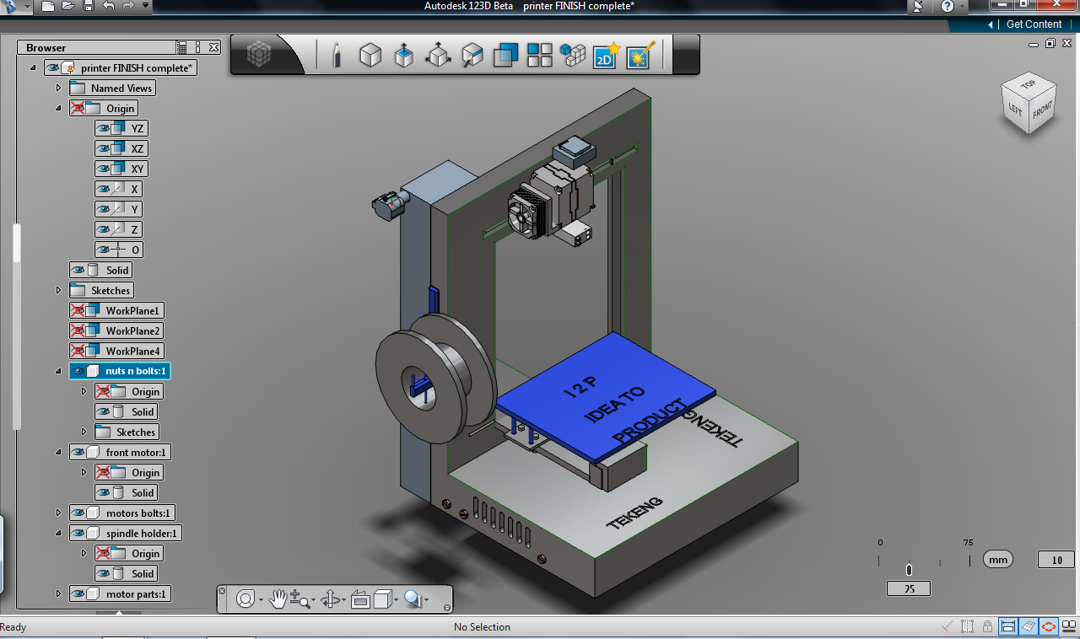
Project Examples & Successes

Slide 24
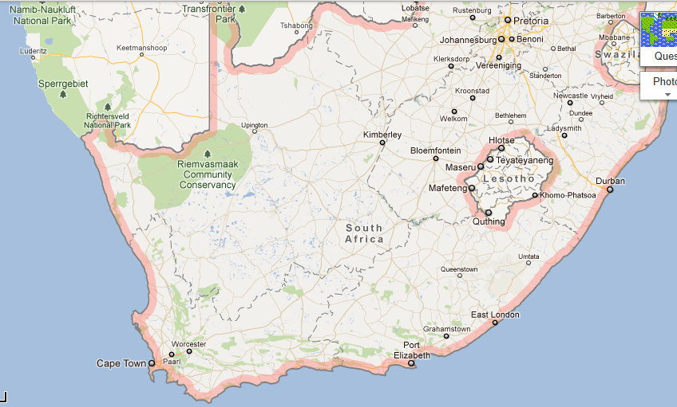
Way Forward
Use
I2P Labs
to create local
3G SP
Concepts

Slide 25
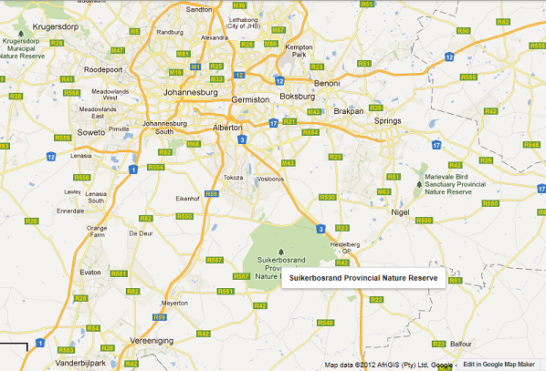
Way Forward

Slide 26
Extensions:
Boschpoort – Wohlers Associates
Colorado State University
Massey University
NUS
Loughborough University (DreamLab)
Benin – Materialise & EADS
Senegal – EADS

Slide 27
Conclusions:
Unleash potential through synergistic relationships.
Using above-mentioned to establish platforms for sustainable development based on cutting edge research, innovation, technology transfer and demonstration, focusing on real needs.
Use research, innovation, technology transfer and demonstration to stimulate regional innovation and economic development.
Modern buildings only do not play a leading role to attract tenants, activities or users.
Well-utilised facilities, irrespective of its “high-tech”-rating or aesthetic appearance, can become instruments to showcase unique local technology- or development platforms and products, in addition to attracting or developing
knowledge-based companies as tenants.
Through an appropriate approach, a rural science park
model can serve as bridge between the communities,
industry and university.

Slide 28
Acknowledgements:
DST for Regional Innovation Forum and SP Feasibility plan support.
(Special mentioning of Johann Strauss’s efforts)
VUT Executive Management for buy-in.
Consultant team – helping is to achieve full membership of IASP.
Special greetings from Dr Neville Comins, one of our consultants and mentor
Neville is writing a chapter in a book entitled’ Innovation Africa’ and is
focusing on ‘Emerging Innovation Hubs/Centres’.
The aim is to learn from projects South Africa and other Southern African
countries involved, such as Namibia, Botswana, etc. , and he would like
to hear from you to get your inputs:
nrc.innovate@mweb.co.za.

Slide 29
