Slide 1

SCIENCE PARKS: a global perspective
IASP African Division workshop
Luis Sanz – IASP Port Elizabeth, April 2013

Slide 2

STP
What
Where from
Where to
How
Mistakes
Main choices

Slide 3
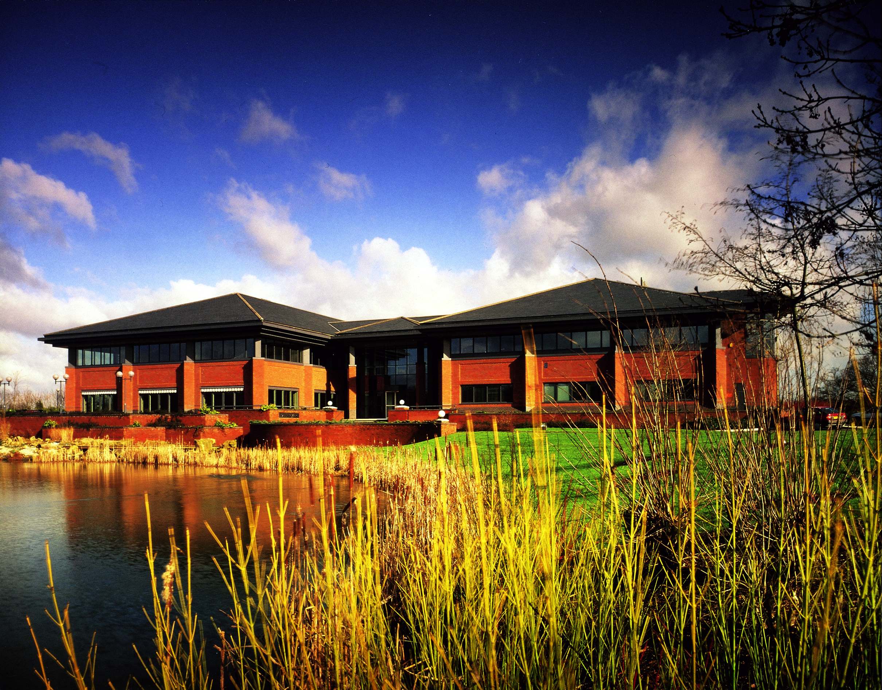

About IASP
Breaking a record!
388 members
In 70 countries
3

Slide 4

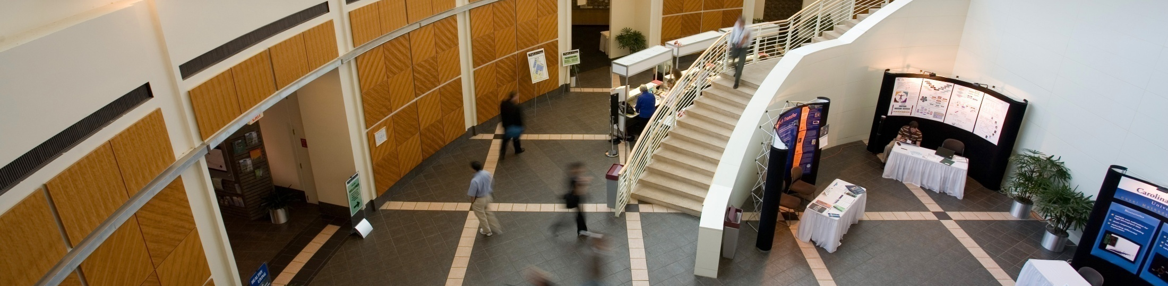
About IASP
>128,000
companies
4

Slide 5
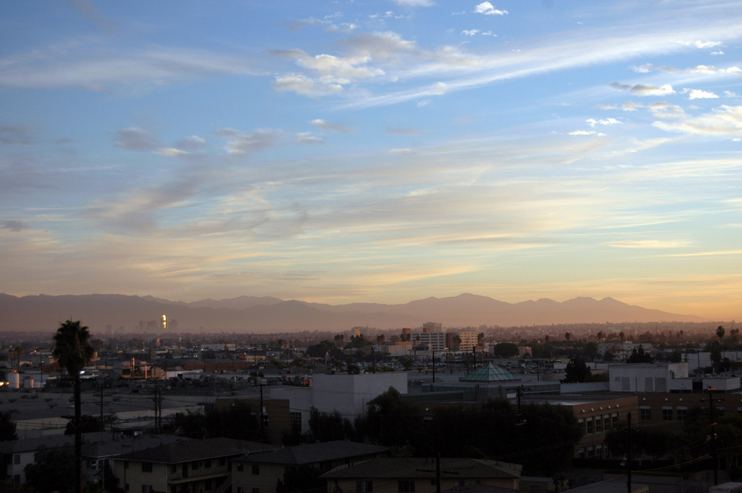

About IASP
6 regional divisions
5

Slide 6
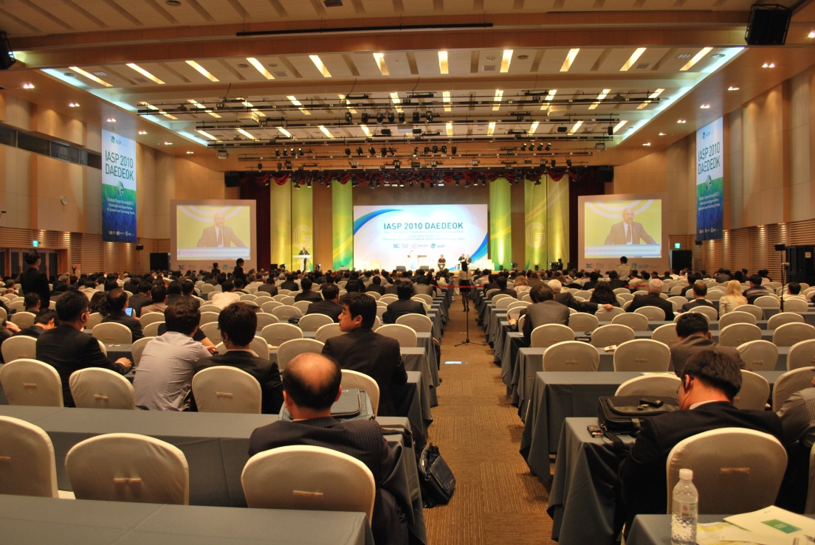
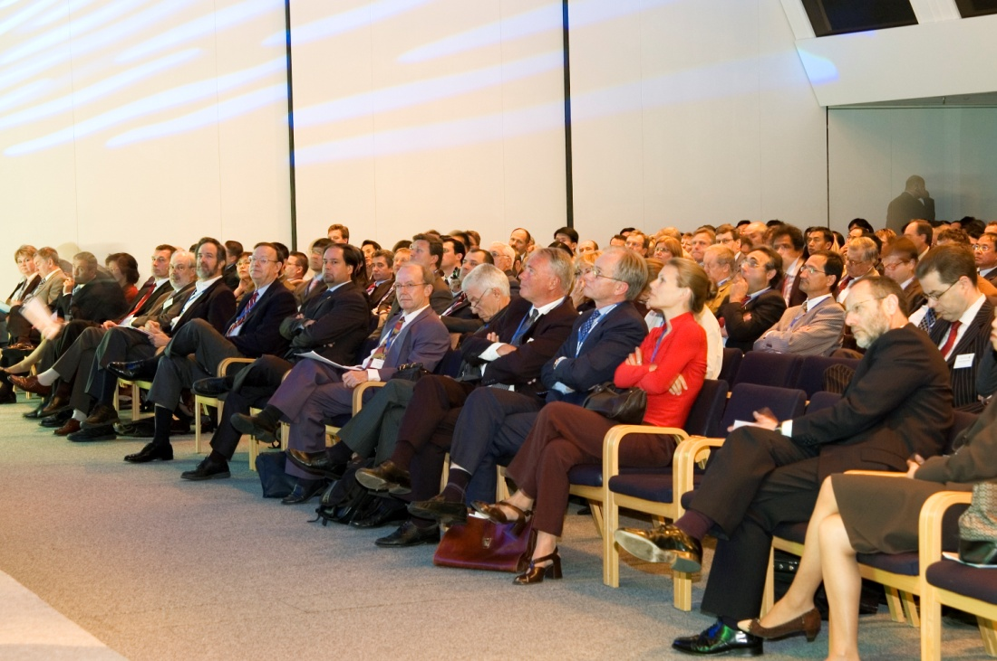
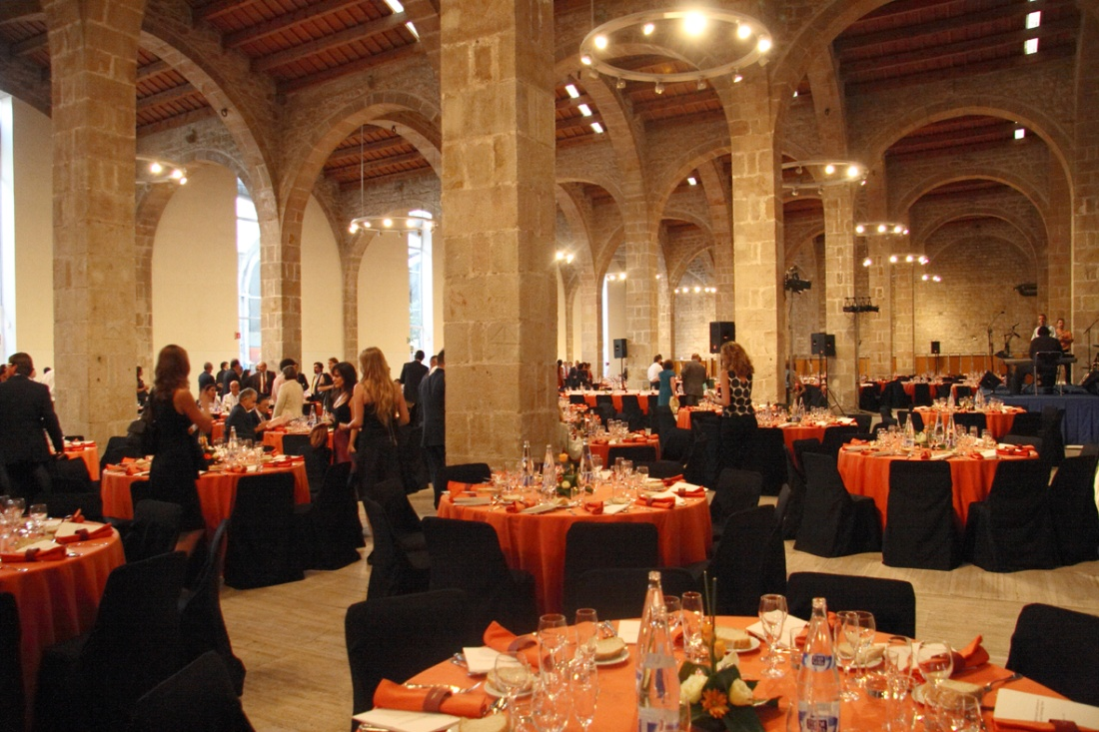
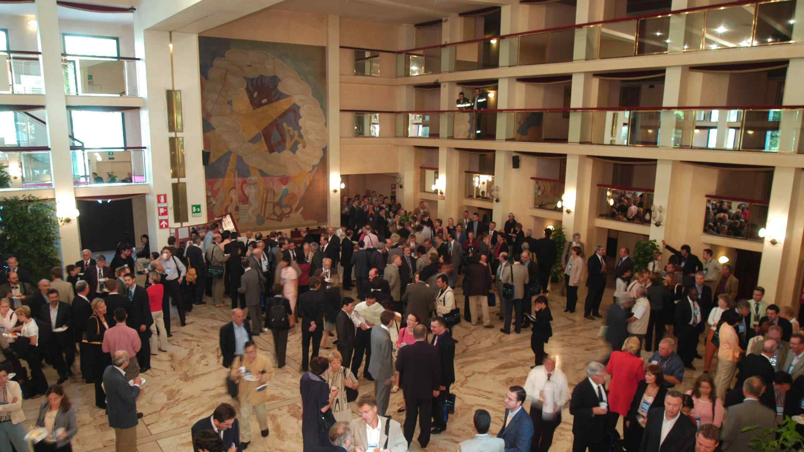
Coming soon…

Slide 7
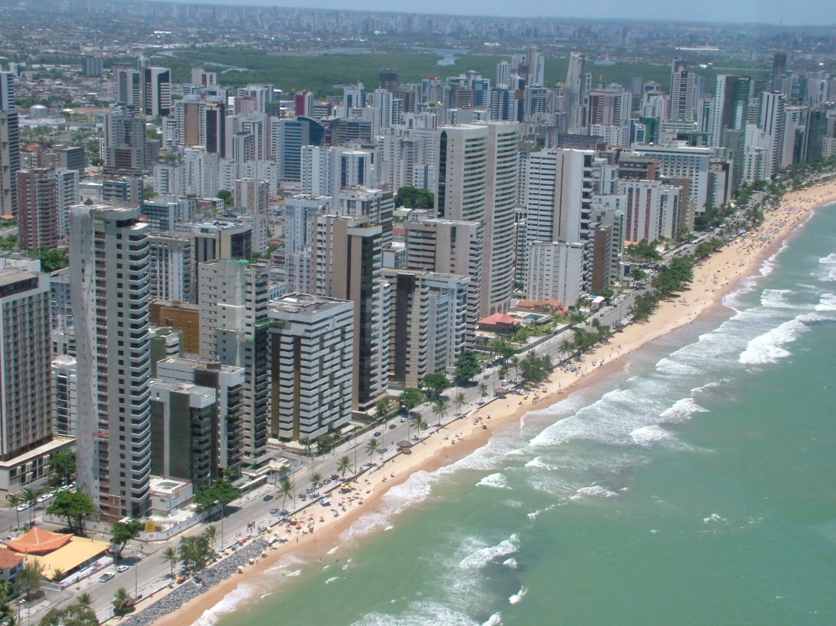
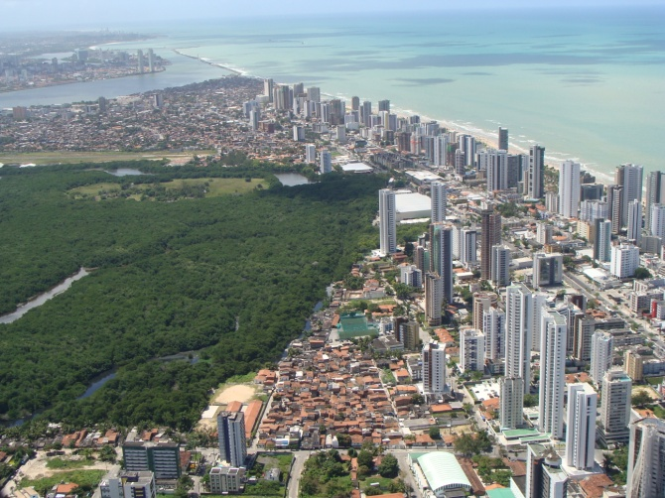
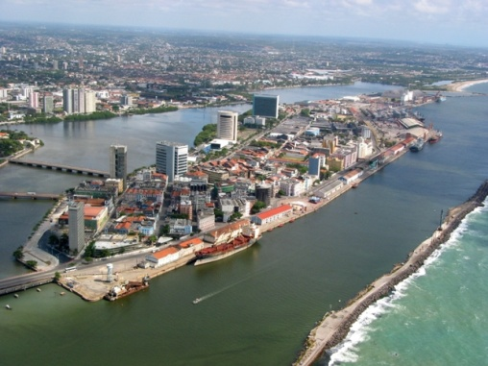

IASP 2013 World Conference
Science Parks shaping new cities
13-16 October 2012
Recife, Brazil
Organised by

Slide 8

Argentina, Australia, Austria, Belgium, Botswana, Brazil, Canada, China, Colombia, Costa Rica, Croatia, Cuba, Cyprus, Czech Republic, Denmark, Ecuador, Estonia, Finland, France, Germany, Greece, India, Iran, Ireland, Italy, Japan, Jordan, Kenya, Korea, Latvia, Lithuania, Luxembourg, Malaysia, Mexico, Namibia, New Zealand, Nigeria, Norway, Oman, Pakistan, Panama, Paraguay, Peru, Poland, Portugal, Qatar, Romania, Russia, Saudi Arabia, Serbia, Singapore, Slovakia, Slovenia, South Africa, Spain, Sweden, Switzerland, Syria, Taiwan (China), Thailand, The Netherlands, Trinidad and Tobago, Tunisia, Turkey, United Arab Emirates, United Kingdom, Uruguay, USA, Venezuela

Slide 9
Botswana Innovation Hub | Botswana | Affiliate
Measurement Technology Park (Pty) | Botswana | Affiliate
Egerton University | Kenya | Associate
Namibia Business Innovation Centre (NBIC) | Namibia | Full
Abuja Technology Village Free Zone Company | Nigeria | Affiliate
University of Port Harcourt Technology Park | Nigeria | Affiliate
eMonti Science and Technology Park | South Africa | Affiliate
Vaal University of Tech.: VUT S. Gauteng Science Park | South Africa | Affiliate
Free State University | South Africa | Associate
Nelson Mandela Metropolitan University | South Africa | Associate
North-West University | South Africa | Associate
The Innovation Hub | South Africa | Full
BiotechPole Sidi Thabet | Tunisia | Affiliate
Pôle de Compétitivité Monastir-El Fejja la Manouba | Tunisia | Affiliate
Elgazala Pole of Communication Technologies | Tunisia | Full
Sfax Technopark Management Company | Tunisia | Full

Slide 10
STP
What
Where from
Where to
How
Mistakes
Main choices

Slide 11
STP
What
Where from
Where to
How
Mistakes
Main choices

Slide 12
STP
What
Where from
Where to
How
Mistakes
Main choices
Biz!, not science or technology
A network on its own +
a node of broader networks
Global projects
with local roots
A bridge between 2 systems
and 2 mentalities

Slide 13
STP
What
Where from
Where to
How
Mistakes
Main choices

Slide 14
STP
What
Where from
Where to
How
Mistakes
Main choices
From a set of new needs:
All of the sudden knowledge is everybody’s main asset
Companies: better access to technology, knowledge and skilled people
Universities: increasing income, finding clients
Graduates: finding better jobs
Governments: securing the competitiveness of nations

Slide 15
STP
What
Where from
Where to
How
Mistakes
Main choices
USA
´60
W. Europe, Canada & Japan
80
Asia Pacif. ‘90
L. America
’95
W. Asia & Africa ´20

Slide 16
STP
What
Where from
Where to
How
Mistakes
Main choices
Let’s keep this one for later on

Slide 17
STP
What
Where from
Where to
How
Mistakes
Main choices

Slide 18
STP
What
Where from
Where to
How
Mistakes
Main choices
A few keywords throughout our history
Technology
Crossed fertilisation
Entrepreneurship
Innovation
Environmentalism } sustainable dev.
Glocal

Slide 19
STP
What
Where from
Where to
How
Mistakes
Main choices
We accomplish our mission by providing:
Quality (an indivisible concept)
Privileged network
A management that “cares”
Knowledge-based services

Slide 20
A few words about networks
Elements of a network (NW):
  Nodes: individual actors within a NW.
  Ties: relationships between the actors.

Slide 21
A few words about networks
Strong ties:
  solid connections / smaller NWs / risk of redundant ties.
Weak ties:
  loose connections / larger NWs / wider range of information / more open NWs

Slide 22
A few words about networks
Strong ties
Weak ties
Joint ventures
Equity alliances
R&D partnerships
Family and close friends
Marketing agreements
Licensing agreements
Business associates
Casual friends and acquaintances
different ties for different things

Slide 23
A special kind of node
The “connectors”: nodes with a special position within networks, which mediate the connections between the vast majority of otherwise weakly-connected individuals.

Slide 24
STP
What
Where from
Where to
How
Mistakes
Main choices

Slide 25
STP
What
Where from
Where to
How
Mistakes
Main choices
Wrong model
Wrong gover-nance
Wrong location
Wrong marke-ting

Slide 26
STP
What
Where from
Where to
How
Mistakes
Main choices

Slide 27
STP
What
Where from
Where to
How
Mistakes
Main choices
5 crucial choices (to begin with)
Our focal point: upstream or downstream?
Our main target: the big guys or the small guys?
Our segment: generalists or specialists?
Glocal: how much global and how to go about it?
Ownership and governance: how much private?

Slide 28
STP
What
Where from
Where to
How
Mistakes
Main choices
Let’s come back to this one

Slide 29
STP
What
Where from
Where to
How
Mistakes
Main choices
The things that we see happening:
Relentless evolution of the concept – Areas of Innovation
Parks and / in / with the city - hybridism
Accelerating internationalisation

Slide 30
Parks and their cities
Some STPs have pushed their cities into the KE paradigm (Sherbrooke Innopole, Canada. PTA in Spain…).
Some cities have created STps to accelerate these processes (22@ à Barcelona, SHIP à Shenzhen…).
Some STPs have jumped into this processes in order not to lag behind (Manchester SP…)

Slide 31
Two final thoughts
No recipe: we learn as we move forward.
STPs have a huge role ahead of them, provided we don’t forget our essence: innovation. We must innovate ourselves before they tell us to do it.

Slide 32

Thank you!

