Slide 1
Science Park Development in Thailand
Akkharawit Kanjana-Opas
Director
Southern Thailand Science Park
Prince of Songkla University Science Park

Slide 2
Topics
Science Park Business in Thailand
Development
Ownership of the park
Business model
Linkage of between university and science park
Science park’s services
Business Incubator

Slide 3
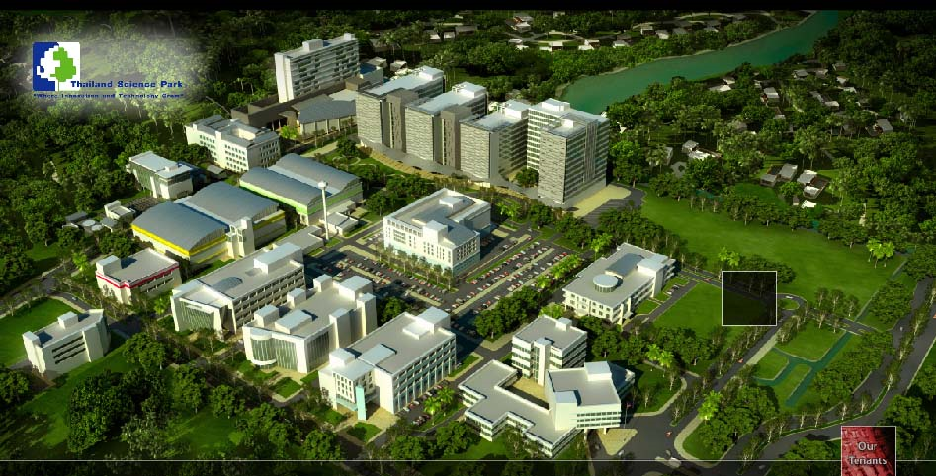
Development of Science Park in Thailand
Thailand Science Park started operation in 2002 by National Science and Technology Development Agency (NSTDA)

Slide 4
Regional Science Park Model
University Based/Supported by government
Network of supply side (University and RIs)
Cluster focus (Demand side)
North: Rice and biomedical sciences
Northeast: Poultry and starch
South: Latex and pharmaceutical products
Science Park Promotion Agency (SPA)
Ministry of Science and Technology

Slide 5
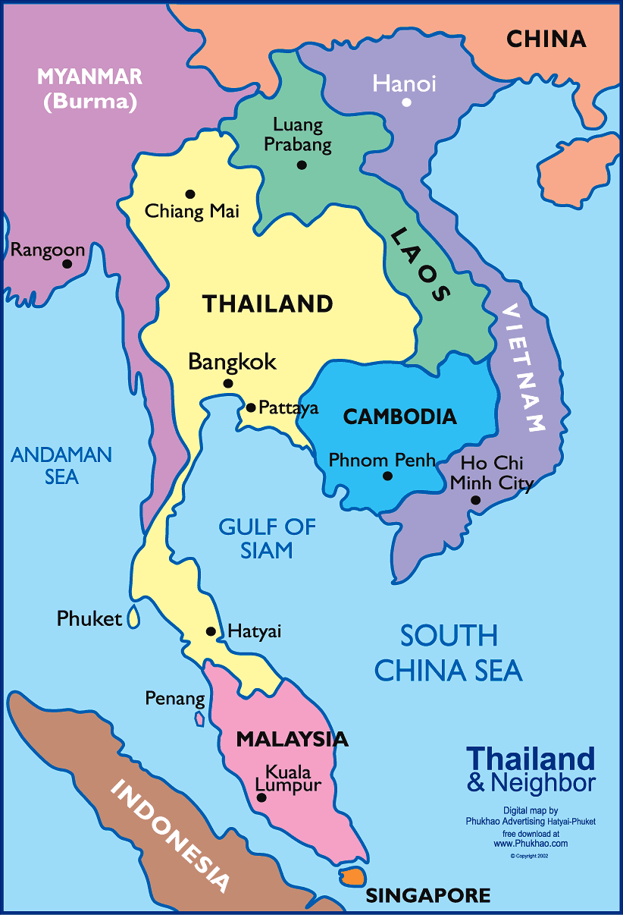
Development of Regional Science Park in Thailand
Northern Science Park
Northeastern Science Park
Southern Thailand Science Park

Slide 6
Science Park and University
Supporting
Role
Engaging/Leading role
Service Providing Role
Research
Academic services
Teaching
Cultural Preservation

Slide 7
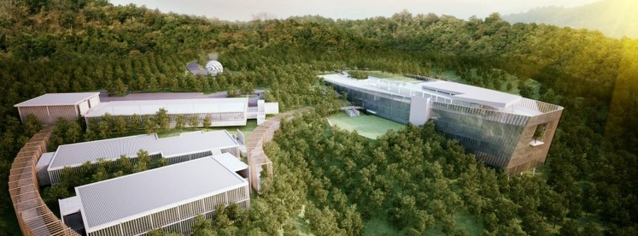
Prince of Songkla University Science Park
Independent Office Within University: University Council

Slide 8
Science Park in National Innovation System
ASEAN+
National level
Incentive for Ent. & Fast Track/Acceleration^{(WU+UBU+MSU)}
Image Company Profile^{(CMU)}
Public Procurement^{(STI)}
Ent. Mobilization^{(MFU+MJU+NU)}
Cluster Formation^{(TSP)}
University level
Sc. Park
Deregulation^{(KKU+SPA)}
Career path
Seed / Proof of Concept Translational fund & Management^{(SPA)}
National system for
Managing Sc Park.^{(SPA)}
1. Incubation
3. Infrastructure
2. Co. Research
Marketing
Services
IP service
SP cap. building^{(Thai-BISPA+SPA)}
Networking & Alumni
Talent Mobility^{(STI)}
Entrepreneurial culture^{(SUT)}
AC² like^{(PSU)}
Harmonization of public policy, strategy, promotion^{(SPA)}
Intermediary Professional^{(SPA)}
Notes:
วาดใหม่ ตาม comment อ.พิเชฐ

Slide 9
SMEs in Thailand
SMEs contribute to 98% of private sector
78% of total employment
36.6% of GDP
Service industry
Manufacturing
Agro-Processing
Textiles
Automobiles
Trading
Source: Office of SME Promotion

Slide 10
Technology Business Incubation
Mobilization and Entrepreneurial Education
Acceleration
1,000,000-3,000,000
Baht/Yr
Incubation
600,000 Baht/3Yrs
10,000,000
Baht/startup
Activities:
-Awareness raising and
Entrepreneurial culture
-Promotion
-Researcg Commercialization
Pre-Seed Fund
Seed Fund
VC
Entrepreneur
Selection
High Potential Entrepreneurs
Incubation
Start ups
Growth Acceleration
Graduate
Coaching
Training
Matching
Consulting
R&D
Scouting
Consulting/Coaching
Intensive training
Scale up/ prototyping
Networking
Investment
Follow up
EIR
Mentoring
TBI
Institutional
Regional
National
Licensing
Co-Research/Tech Transfer
Pre-seed, I2P, AC²
Idea
Product
Market
TTO/IPMO
TTO/IPMO
Valley of Death

Slide 11
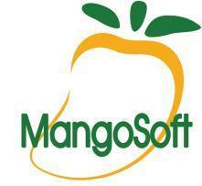
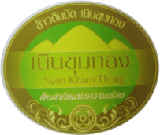
Incubatees & Startups @PSU-BIC

Slide 12
Lesson Learnt
Triple Helix or PPP Model does not fit perfectly
Local government involvement
Awareness about significance and role of SP among stakeholders
Supports from government
Services used or demanded by customers
Human resources
SP management
Service providers: IP Specialist, Business Incubation Officer, Industrial Liaison Officer

