Slide 1
Title: Botswana Science Park – An African Perspective
IASP Africa 2013, 8 – 10 April, 2013
NMU, Port Elizabeth (PE)

Slide 2
Table of Contents
Introduction To The ICON BUILDING Video
Botswana Global Competitive Index (GCI)
Botswana Innovation Hub (BIH) Genesis
Mandate
Structure
Framework/Guideline
Conclusion

Slide 3
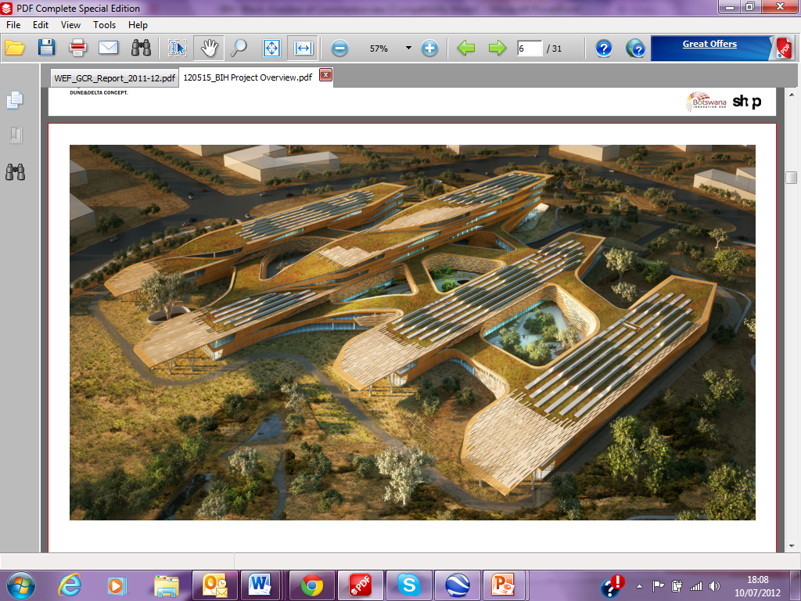
Icon Building Concept & Design
Notes:
Main Attraction Of The Park

Slide 4
Real Estate Investment
BIH Park Infrastructure factsheet
BIH Serviced land, total of 57 hectares.
Un-serviced 36 hectares
Valued at ~300 million pula (equivalent to US$42 million).
Total of 41 plots of variable sizes for long term leases demarcated with 333 380 m² available
Total land area to be developed 407 000 m²
Icon buildings space for rental is 30 000 m² gross.
Zoning is mixed use as approved by the Town and Country Planning Board under the Ministry of Lands and Housing

Slide 5
Supporting ICT Infrastructure
Government Investment on WACS & EASSy,
Investment on Fibre Optic Nteletsa 1 and 2
Market Research depicted that tenants (International and Local) require;
superior bandwidth,
Meet me Rooms (PoP) – Telco’s
Data Centres,
IP telephony , video conferencing, and telephone bridges
Skilled Manpower

Slide 6
Botswana
Population (millions) .......................................... 2.0
GDP (US$ billions) .......................................... ….17.6
GDP per capita (US$) ................................... ……9,481
GDP (PPP) as share (%) of world total ............ …0.04
Source: World Economic Forum Report 2012 - 2013

Slide 7
BIH Genesis
Cabinet Directive (Cab 34) and BIH was among other 6 Hubs but it is the only one that operates as a company outside Government
Economic Diversification and Job Creation
National Research and Technology Policy and latest RSTI Policy
Promote Research Culture

Slide 8
BIH Structure
BIH Holding Company
100 Per cent Government owned and tasked with Innovation Mandate
Board of Directors and External Auditors
CEO
Management
Staff
BIH Properties Pty Ltd
51% BIH Properties Company and 49% Private Sector
Board of Directors and Auditors
CEO
Management
Staff

Slide 9
Our Mandate
Mandate
Develop and operate a science and technology park
Promote and facilitate research, development, education and innovation activities
Diversify Economy, and Create Jobs, by Attracting Hi-Tech, knowledge Intensive Science and Technology Companies/Research Institutions in areas of ICT, Bio-Tech, Clean-Tech and Mining Technology to operate within an SEZ in Botswana.
The Hub must adapt a commercial model which must maximise the private sector participation and sustain itself.
Mission
To offer a unique platform for scientific, technological, and indigenous knowledge innovation.
Vision
To be the leading destination for innovation in Africa.

Slide 10
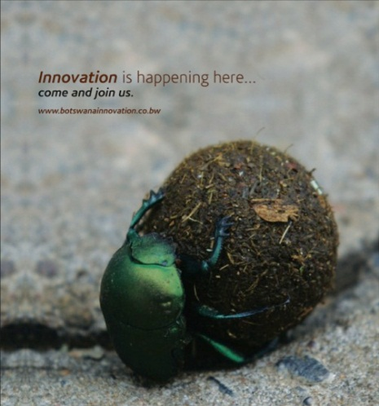
FOCUS SECTORS
Information & Communication Technologies
Mining Technologies
Knowledge Intensive Business Services
Bio Technologies
Clean Technologies

Slide 11
Our Value Proposition…
Scope is ICT, Mining, Energy/Environment, & Bio-Tech
Real Estate Services
Land for lease
Competitive Rental in Icon Building
Business Support Services
Technology Incubation
Plug and Play office Space
Business Mentoring and Coaching
Innovation Fund
Seed Funding
Research/Intellectual Property (IP) Services
Facilitate for Researchers and entrepreneurs
Strategic/
Collaboration Partnerships
COHRED
Microsoft
Incentives Registration
15% Corp Tax
Notes:
Brand Encompasses all the elements of the BIH.

Slide 12
Cluster
Defining Its Contents...!
Innovation Programmes/Pre-Incubation
Collaborations
Established Entities
FDI Leg
Technology Incubation
FSVC
Research
Bio-Tech House
Capacity Dev
Inno Culture Dev
Pre - Incubation
Objectives
Tech Transfer
Commercialisation
Econ Divers & Jobs
Objectives
Tech Stat-up Biz Mentoring & Coaching
Commercialisation
Objectives
Research Commercialisation
Groom Research Culture
Objectives
BIH Innovation Framework / Guiding Pillars
Triple Helix Approach: Researchers, Industry, and Government
Focus Sectors: ICT, Bio-Tech, Clean-Tech, and Mining Technologies

Slide 13
Cluster Development
Innovation is the central issue in economic prosperity
Professor Michael Porter, Harvard Business School.
Conducive policy framework for innovative business to thrive, incentives packages, funding support for start-up entrepreneurship, facilitate tech transfer, collaborative research
Botswana Innovation Hub – Government - Encourages, promotes, facilitates and supports innovative, scientific, technological, engineering, and industrial research applications and business development in Botswana
Commercially viable research, patents/licensing, spin out companies/start-ups
Academic/training institutes and research organization – provide the technical expertise and services to the industry in the form of solutions or new methods.
Technology entrepreneurship, business development, technology acquisition/transfer, prototype development
Companies, businesses, individuals , consortiums - optimize business by adopting new innovative products / service delivery methods in partnership with academia, public sector and funding agencies.
Finance viable projects and new ventures, provide co-funding for new initiatives that require nurturing, support training and capacity building, fund networking and knowledge sharing exercises
Funding agencies - drive national and international agendas on international best practice and supports innovative solutions development for economic growth.
The outcomes being……….benefits
Products and Services delivery with socio economic benefits benefits
Which are measurable through specific metrics unique to our STP model. Benefits

Slide 14
KEY STRATEGIC INTENT
A platform for commercialization of technology
To close the technology innovation gap
To expose local technology businesses to international markets and network
In build tenant cost recovery model
Target technology transfer companies which can provide services commonly referred to as low hanging fruits to targeted programmes such as EDD and Poverty Alleviation
The BIH will launch a technology business incubator programme (First Steps Venture Centre) during first half of 2013 that aims of identifying the most promising technology oriented entrepreneurs and giving them targeted support to grow their business.

Slide 15
FSVC Services
Source: World Bank Incubation report

Slide 16
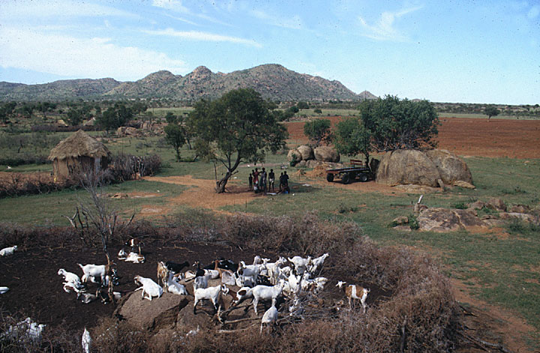
Facilitating innovative and relevant solutions for traditionally Agrarian communities - Batswana

Slide 17
Bringing a mix of innovative entities
Recent Significant Memberships and Collaborations : IT-IQ, Richold, GIA ContinuitySA, BIUST, COHRED, OrangeLabs, ICT Global Networks, Dimension Data, HP

Slide 18
© Rowan Gibson 2007

Slide 19
Thank you
Botswana Innovation Hub
Tel: +267 3913328
info@bih.co.bw
www.bih.co.bw
Let´s make it happen !

