Slide 1
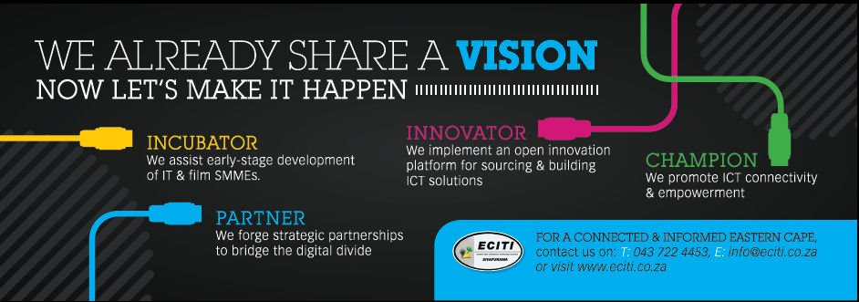
INCUBATION
THE ECOSYSTEM METHODOLOGY
Patricia Dlamini
Executive Manager – Eastern Cape Information Technology Initiative
9th April 2013
IASP AFRICAN DIVISION WORKSHOP 2013
Nelson Mandela Metropolitan University, North Campus
Conference Centre

Slide 2

PRESENTATION OUTLINE
Introduction
Entrepreneurship Ecosystems
  Definition
  Concept
  Components
Who works it? - Intelligent Evolution
  Example: Babson
Case Study – ECITI
Closing Remarks
Notes:
Champion – is defined as playing a leading advocacy role in shaping and influencing general conversations, debates and policy discussions about the use of ICT in the province.
Connected – is defined as the creation of physical connectivity that facilitate ICT access and connectivity between urban and rural, provincial and national and national and international communities offering full access to the information highway and bridging the digital divide in society at large.
Empowered – growth and development through the use of ICT that filters down to all levels of society that can contribute toward socio-economic upliftment.

Slide 3
Introduction
Building communities where everyone “Get’s it”
Political leaders get it
The market get’s it
Students get it
People in the streets get it
Notes:
Champion – is defined as playing a leading advocacy role in shaping and influencing general conversations, debates and policy discussions about the use of ICT in the province.
Connected – is defined as the creation of physical connectivity that facilitate ICT access and connectivity between urban and rural, provincial and national and national and international communities offering full access to the information highway and bridging the digital divide in society at large.
Empowered – growth and development through the use of ICT that filters down to all levels of society that can contribute toward socio-economic upliftment.

Slide 4
Definitions
Ecosystem is derived from the Greek word oikos, for “house,” eco-is the combining form meaning “environment or habitat.”
In defining a term it is always fascinating to breakdown the term etymologically, so in entrepreneurship we have the word “entrepreneur” - the one who undertakes the organization,
planning and risk of their own enterprise and is derived from the verb entreprendre used for the first time
apparently in France in 1862 and means
“to undertake” .
We also have the suffix –ship which means to create something of value, to invest and is derived from the old Gothic verb schaeppen.
Source: Cyprus Entrepreneurship Ecosystem: A Roadmap to Economic Growth, 2012
Notes:
Champion – is defined as playing a leading advocacy role in shaping and influencing general conversations, debates and policy discussions about the use of ICT in the province.
Connected – is defined as the creation of physical connectivity that facilitate ICT access and connectivity between urban and rural, provincial and national and national and international communities offering full access to the information highway and bridging the digital divide in society at large.
Empowered – growth and development through the use of ICT that filters down to all levels of society that can contribute toward socio-economic upliftment.

Slide 5

The Concept
An ecosystem is a community of living organisms (plants, animals
and microbes) in conjunction with the nonliving components of their
environment (things like air, water and mineral soil), interacting as a system.
the network of interactions among and between organisms and their environment defines ecosystems.
all linked together through the nutrient cycle and energy flow.
Notes:
Champion – is defined as playing a leading advocacy role in shaping and influencing general conversations, debates and policy discussions about the use of ICT in the province.
Connected – is defined as the creation of physical connectivity that facilitate ICT access and connectivity between urban and rural, provincial and national and national and international communities offering full access to the information highway and bridging the digital divide in society at large.
Empowered – growth and development through the use of ICT that filters down to all levels of society that can contribute toward socio-economic upliftment.

Slide 6
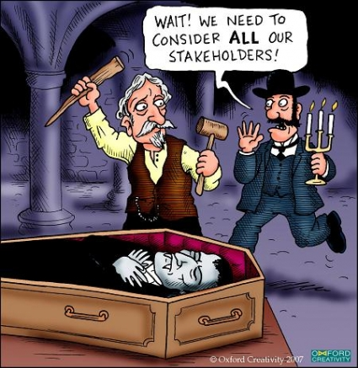

Components of an ecosystem 1- Stakeholders
the population or various stakeholders that have both developed and are the results of the ecosystem
Notes:
Champion – is defined as playing a leading advocacy role in shaping and influencing general conversations, debates and policy discussions about the use of ICT in the province.
Connected – is defined as the creation of physical connectivity that facilitate ICT access and connectivity between urban and rural, provincial and national and national and international communities offering full access to the information highway and bridging the digital divide in society at large.
Empowered – growth and development through the use of ICT that filters down to all levels of society that can contribute toward socio-economic upliftment.

Slide 7
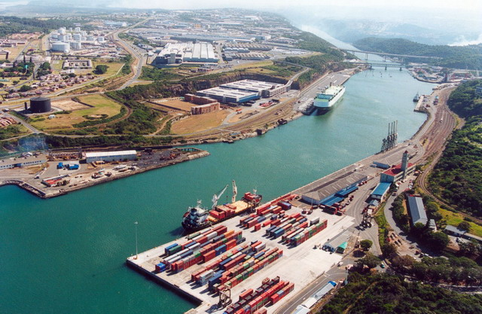
Components of an ecosystem 2- Location
the location where the ecosystem exists
Notes:
Champion – is defined as playing a leading advocacy role in shaping and influencing general conversations, debates and policy discussions about the use of ICT in the province.
Connected – is defined as the creation of physical connectivity that facilitate ICT access and connectivity between urban and rural, provincial and national and national and international communities offering full access to the information highway and bridging the digital divide in society at large.
Empowered – growth and development through the use of ICT that filters down to all levels of society that can contribute toward socio-economic upliftment.

Slide 8

Components of an ecosystem 3 - Interdependency
the broader interdependency and interaction between the various populations that constitute the ecosystem.
Notes:
Champion – is defined as playing a leading advocacy role in shaping and influencing general conversations, debates and policy discussions about the use of ICT in the province.
Connected – is defined as the creation of physical connectivity that facilitate ICT access and connectivity between urban and rural, provincial and national and national and international communities offering full access to the information highway and bridging the digital divide in society at large.
Empowered – growth and development through the use of ICT that filters down to all levels of society that can contribute toward socio-economic upliftment.

Slide 9

Intelligent evolution
Does it evolve naturally, or can we intelligently design the EEs?
It is usually the result of intelligent evolution,
  a process that blends the invisible hand of markets
  and deliberate helping hand of public leadership that is enlightened enough to know when and how to lead as well as let go the grip in order to cultivate and ensure (relative) self-sustainability.
Source: Economist - Intelligent Evolution
Notes:
Champion – is defined as playing a leading advocacy role in shaping and influencing general conversations, debates and policy discussions about the use of ICT in the province.
Connected – is defined as the creation of physical connectivity that facilitate ICT access and connectivity between urban and rural, provincial and national and national and international communities offering full access to the information highway and bridging the digital divide in society at large.
Empowered – growth and development through the use of ICT that filters down to all levels of society that can contribute toward socio-economic upliftment.

Slide 10
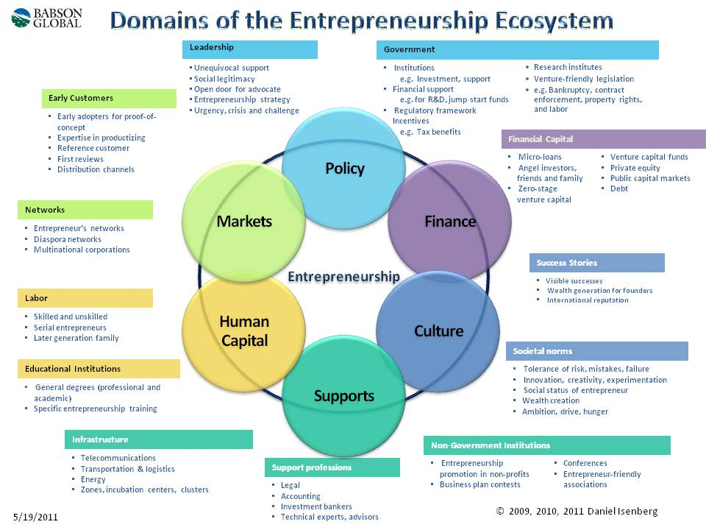
Example: The Babson EE

Slide 11
Incubation – applying EEs methodology
A healthy entrepreneurial ecosystem is a framework that enables and encourages the emergence of opportunities
Business incubation is a program designed to accelerate the successful development of entrepreneurial companies through an array of business support resources and services, developed and orchestrated by incubator management and offered both in the incubator and through its network of contacts.
a conducive culture, enabling policies and leadership, availability of appropriate finance, quality human capital, venture-friendly markets for products, and a range of institutional and infrastructural supports.
Notes:
Champion – is defined as playing a leading advocacy role in shaping and influencing general conversations, debates and policy discussions about the use of ICT in the province.
Connected – is defined as the creation of physical connectivity that facilitate ICT access and connectivity between urban and rural, provincial and national and national and international communities offering full access to the information highway and bridging the digital divide in society at large.
Empowered – growth and development through the use of ICT that filters down to all levels of society that can contribute toward socio-economic upliftment.

Slide 12
Why Incubation using EEs methodologies?
A healthy ecosystem is one that encourages and nourishes the entrepreneurial mindset.
Is tailored around its own unique environment – it does not seek to be something it isn’t, like the “next Silicon Valley”
Operates in an environment with reduced bureaucratic obstacles in which government policies support the unique needs of entrepreneurs and tolerate failed ventures
Is reinforced, not created from scratch, by government, academic or commercial organizations
Notes:
Champion – is defined as playing a leading advocacy role in shaping and influencing general conversations, debates and policy discussions about the use of ICT in the province.
Connected – is defined as the creation of physical connectivity that facilitate ICT access and connectivity between urban and rural, provincial and national and national and international communities offering full access to the information highway and bridging the digital divide in society at large.
Empowered – growth and development through the use of ICT that filters down to all levels of society that can contribute toward socio-economic upliftment.

Slide 13
Why Incubation using EEs methodologies?
A healthy ecosystem is one that encourages and nourishes the entrepreneurial mindset.
Actively encourages and invites financiers to participate in new ventures, but access to money isn’t without barriers for those planning new business ventures
Is relatively free from, or is able to change, cultural biases against failure or operating a business
Promotes successes, which in turn attract new ventures
Often is supported by dialogue among various of the entrepreneurship stakeholders
Notes:
Champion – is defined as playing a leading advocacy role in shaping and influencing general conversations, debates and policy discussions about the use of ICT in the province.
Connected – is defined as the creation of physical connectivity that facilitate ICT access and connectivity between urban and rural, provincial and national and national and international communities offering full access to the information highway and bridging the digital divide in society at large.
Empowered – growth and development through the use of ICT that filters down to all levels of society that can contribute toward socio-economic upliftment.

Slide 14

Case Study : Eastern Cape Information Technology Initiative (ECITI)
ECITI is an innovative agency that promotes the use of information and communication technologies to effect positive social change, socio-economic development, employment creation and poverty eradication...........” located in EC – (Play video clip)
© Eastern Cape Information Technology Initiative
Notes:
Champion – is defined as playing a leading advocacy role in shaping and influencing general conversations, debates and policy discussions about the use of ICT in the province.
Connected – is defined as the creation of physical connectivity that facilitate ICT access and connectivity between urban and rural, provincial and national and national and international communities offering full access to the information highway and bridging the digital divide in society at large.
Empowered – growth and development through the use of ICT that filters down to all levels of society that can contribute toward socio-economic upliftment.

Slide 15

Case Study : Eastern Cape Information Technology Initiative (ECITI)
© Eastern Cape Information Technology Initiative
Notes:
Champion – is defined as playing a leading advocacy role in shaping and influencing general conversations, debates and policy discussions about the use of ICT in the province.
Connected – is defined as the creation of physical connectivity that facilitate ICT access and connectivity between urban and rural, provincial and national and national and international communities offering full access to the information highway and bridging the digital divide in society at large.
Empowered – growth and development through the use of ICT that filters down to all levels of society that can contribute toward socio-economic upliftment.

Slide 16
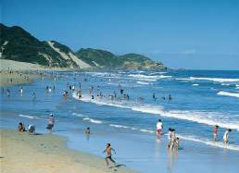
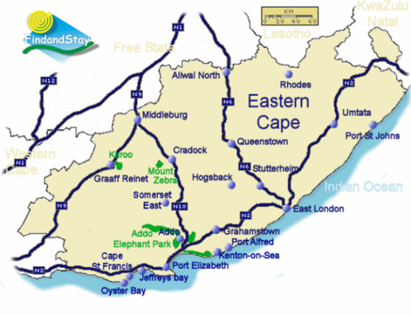

Case Study : Eastern Cape Information Technology Initiative (ECITI)
Notes:
Champion – is defined as playing a leading advocacy role in shaping and influencing general conversations, debates and policy discussions about the use of ICT in the province.
Connected – is defined as the creation of physical connectivity that facilitate ICT access and connectivity between urban and rural, provincial and national and national and international communities offering full access to the information highway and bridging the digital divide in society at large.
Empowered – growth and development through the use of ICT that filters down to all levels of society that can contribute toward socio-economic upliftment.

Slide 17
ECITI Entrepreneurship Ecosystem
Focus areas
History
ECITI
Champion
Innovator
Partner
Incubator
Non-profit company initiated by ECDC in 2004
Promote ICT as tool for socio-economic development
Facilitate development of SMMEs in ICT & Film
Part of the delivery of provincial ICT strategy
Promote ICT to achieve goals of PGDP
Source: ECITI Strategy 2012-15

Slide 18
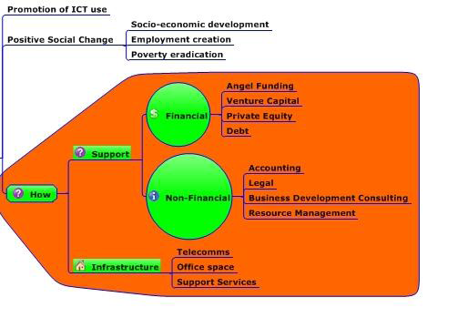
ECITI’s Incubation Services Framework
© Eastern Cape Information Technology Initiative

Slide 19
ECITI Incubation system
City-based incubation service system feeding to remote and satellite centres
The Spot : the incubators in key district nodes and satellite support centres
Service Station
EL Hub
The Circle : an incubation service network formed by the Spots to coordinate and promote the development of incubators.
Network
BI- OR Tambo
Satellite
Alfred Nzo
BI- Chris Hani
The Surface : a city-based incubation service system on the basis of Circle, to provide services for all the ICT SMMEs in EC .
City
© Eastern Cape Information Technology Initiative
www.incubator.sh.cn

Slide 20
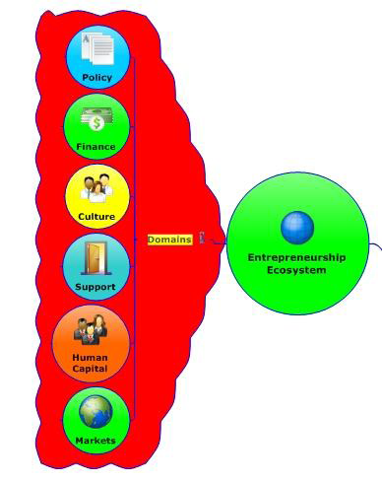
Entrepreneurship Ecosystem domains
The ECITI incubation service framework is implemented around entrepreneurship ecosystem methodology
which also aligns to the other strategic objectives of the ECITI through
© Eastern Cape Information Technology Initiative

Slide 21
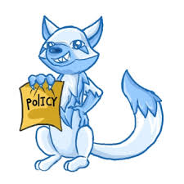
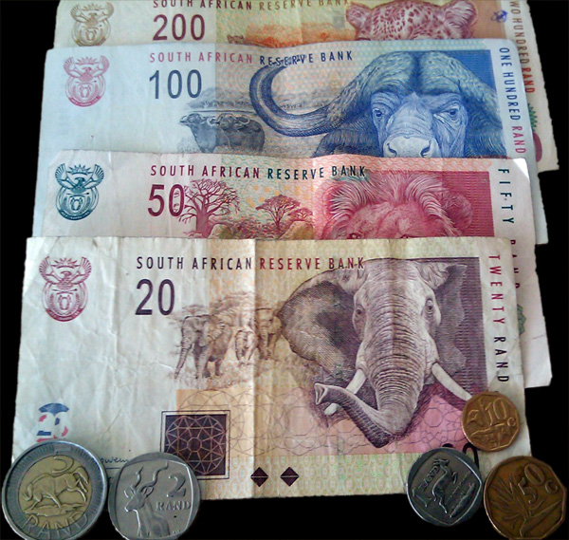
Finance – mobilisation of financial and non-financial resources in support of entrepreneurship capacity development that increases business survival and sustainability rates through angel investing, venture capital, development finance and debt.
Policy – entrepreneurship policy engagement at a national and provincial level in support of bridging the digital divide in the Eastern Cape through the use of ICT.
Culture – engagement and advocacy of ideal cultural dynamics to support holistic entrepreneurship capacity development in the Eastern Cape

Slide 22
Features ….
Human Capital – strategic partnerships and active engagement with educational institutions to include entrepreneurship training and development in curricula offerings. Active and ongoing sourcing of entrepreneurship skills training and development offerings for ECITI customers. Internal human capital capacity building to best serves the Eastern Cape and ECITI strategic objectives.
Support – collaboration with other support structures and organisations including incubators and incubation service providers, business support services such as legal, accounting, investment banking and academic institutions to offer support services and networks in the Eastern Cape
Markets – ongoing engagement on all frontiers to create and promote deep level access to markets beyond the local environment for company products and services

Slide 23
Incubating Model
Ideas
Incubating
enterprises
Support
Graduates
Start-up Grow Mature
Pre-incubation
Accelerator
Incubator
Basis
1. Resource Analysis
2.Feasibility & Viability studies
3. Mentorship & Guidance
Extending：
1.Financing/Investment
2. Globalization
3.Brand Equity & management
Ability
1.Business strategy and modeling
2. Increased sustainable revenue streams
3. Financial and Cash flow management
3. Quality Management systems

Slide 24
High level services
Business Basics
Training and Networking
Financing Services
Infrustructures
Human Resources
Incubated
Enterprises
Managment Consulting/Mentorship
Technical Development
Marketing Assistance

Slide 25
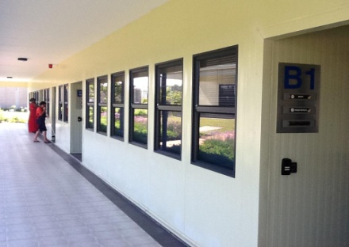
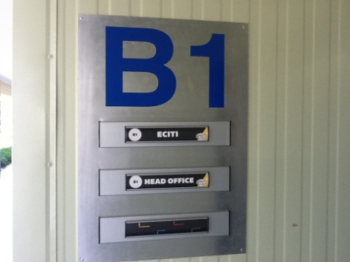
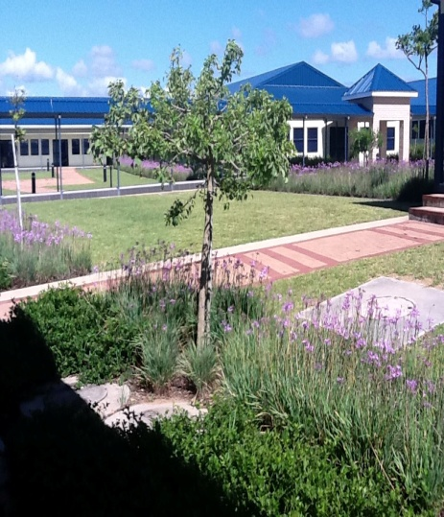
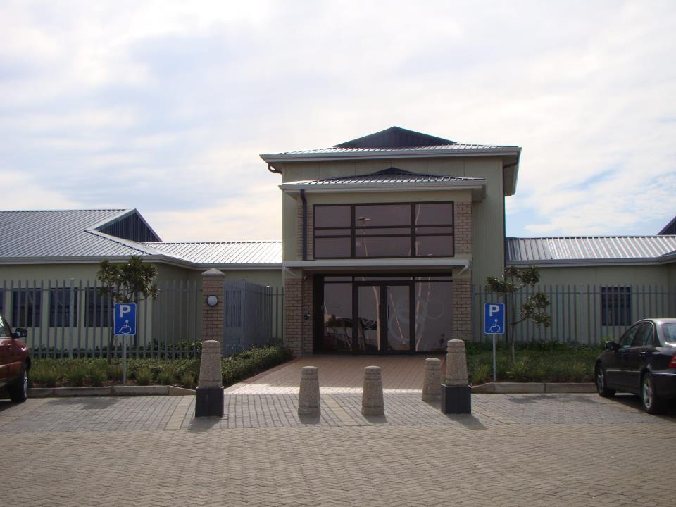

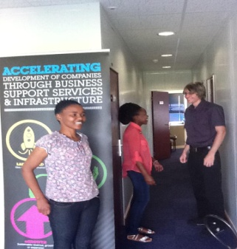
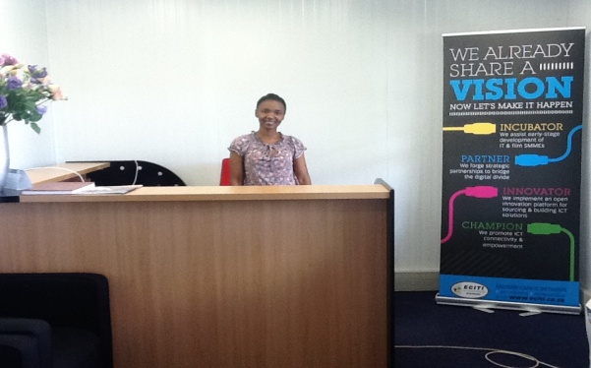
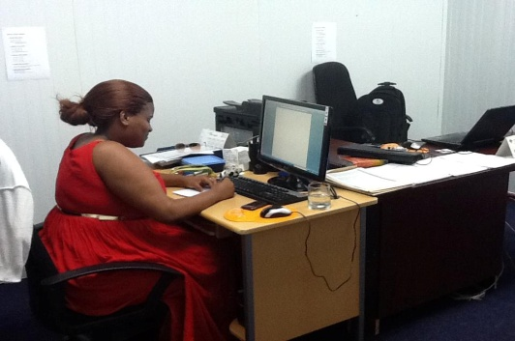
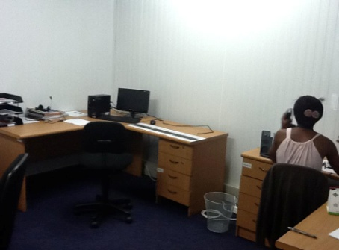
ECITI East London

Slide 26
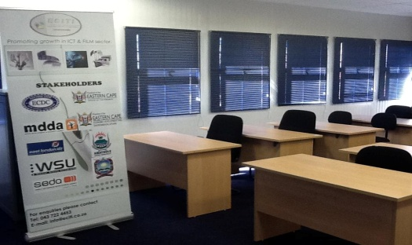
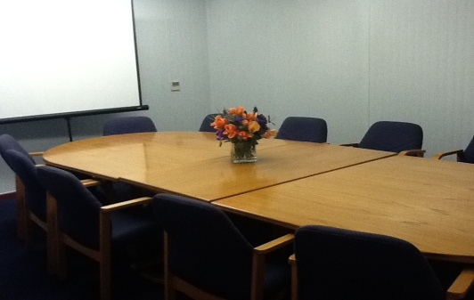
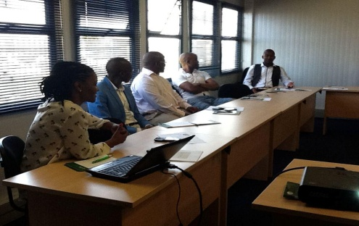
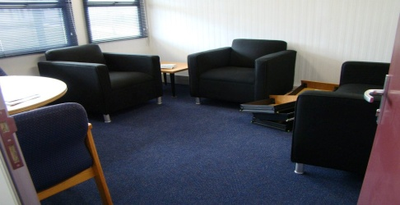
ECITI EL – Facilities for SMMEs

Slide 27
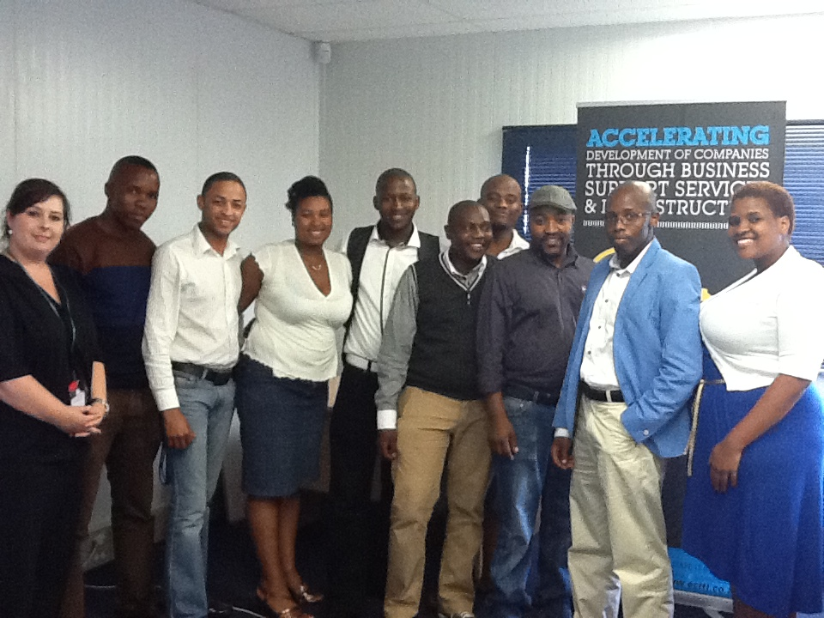
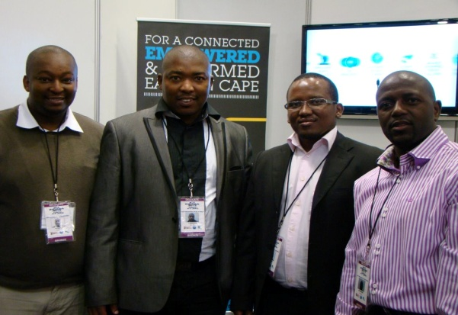
ECITI Entrepreneurs

Slide 28

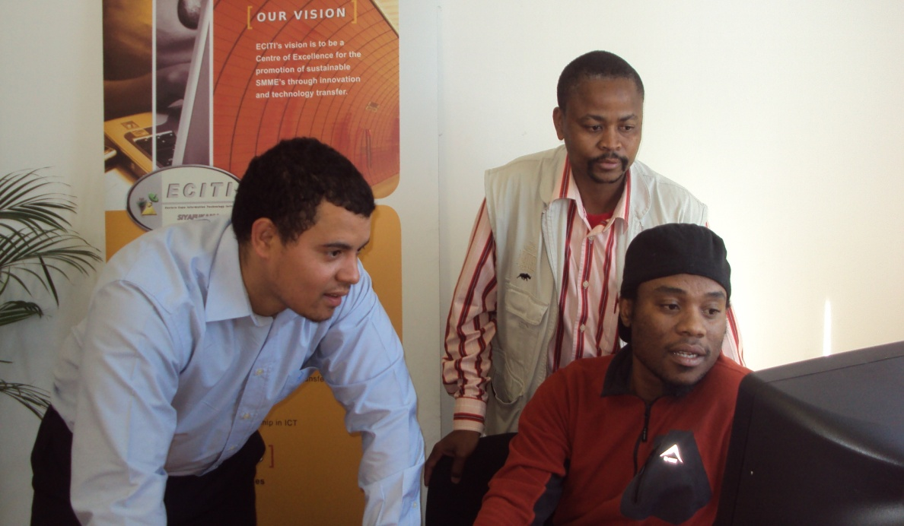
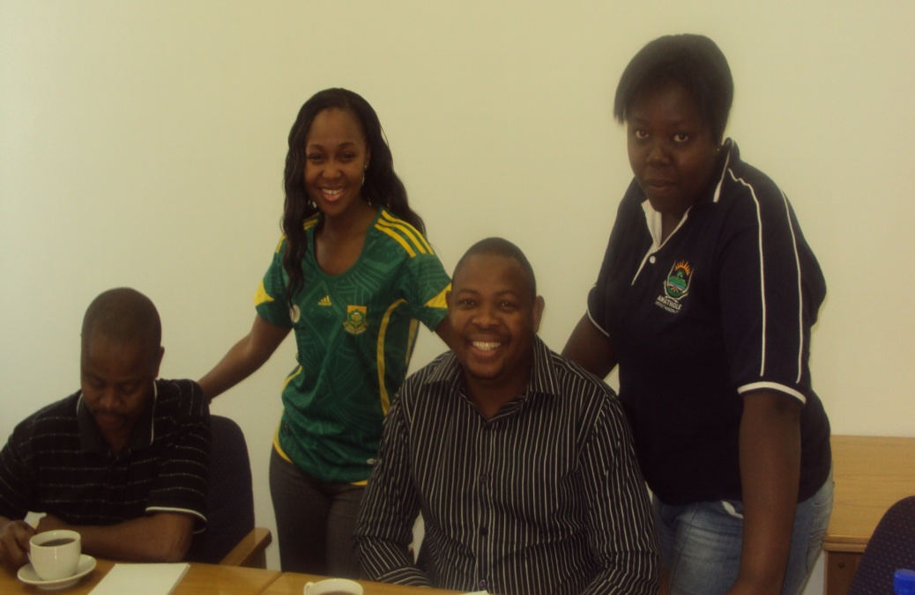
ECITI Entrepreneurs

Slide 29
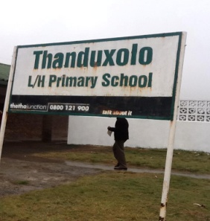
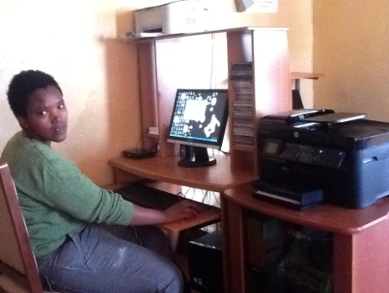
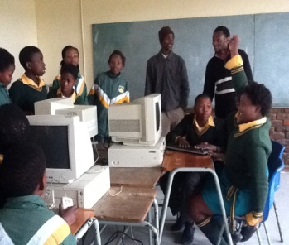
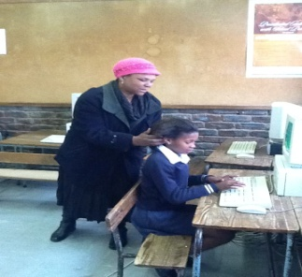
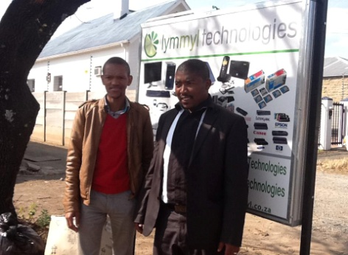
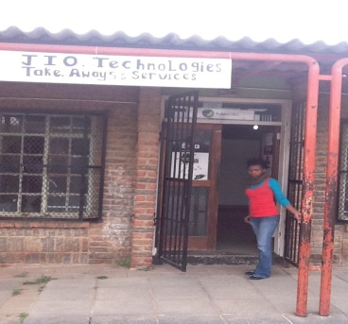
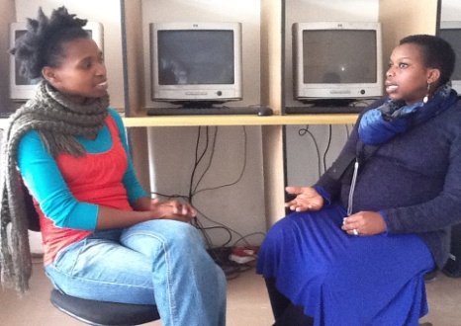
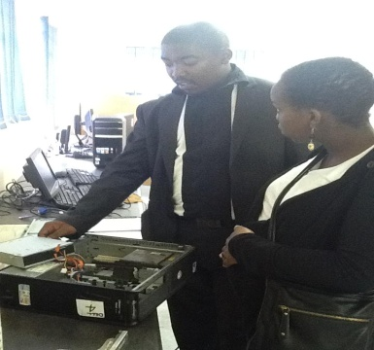
Virtual Incubation

Slide 30
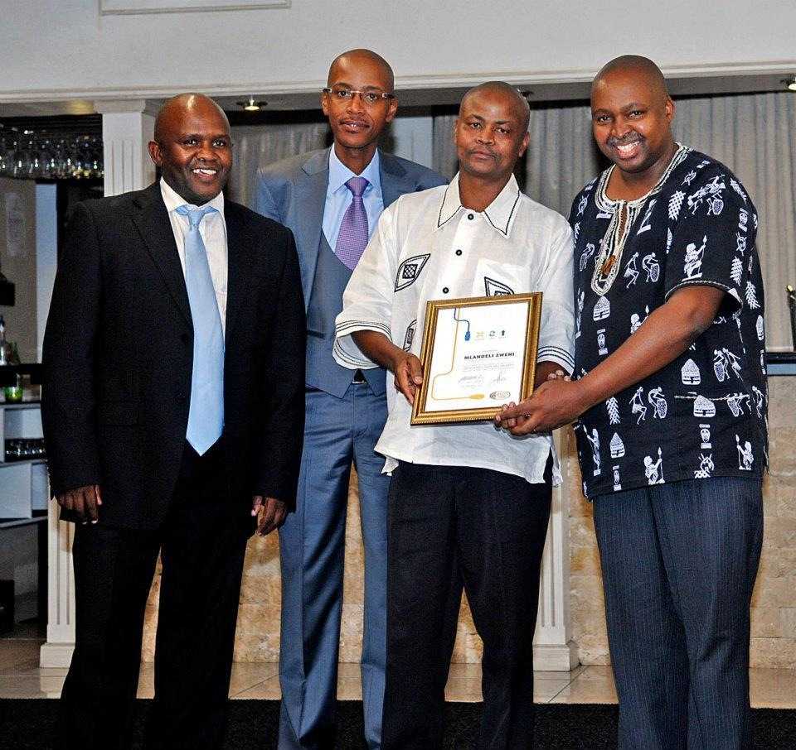
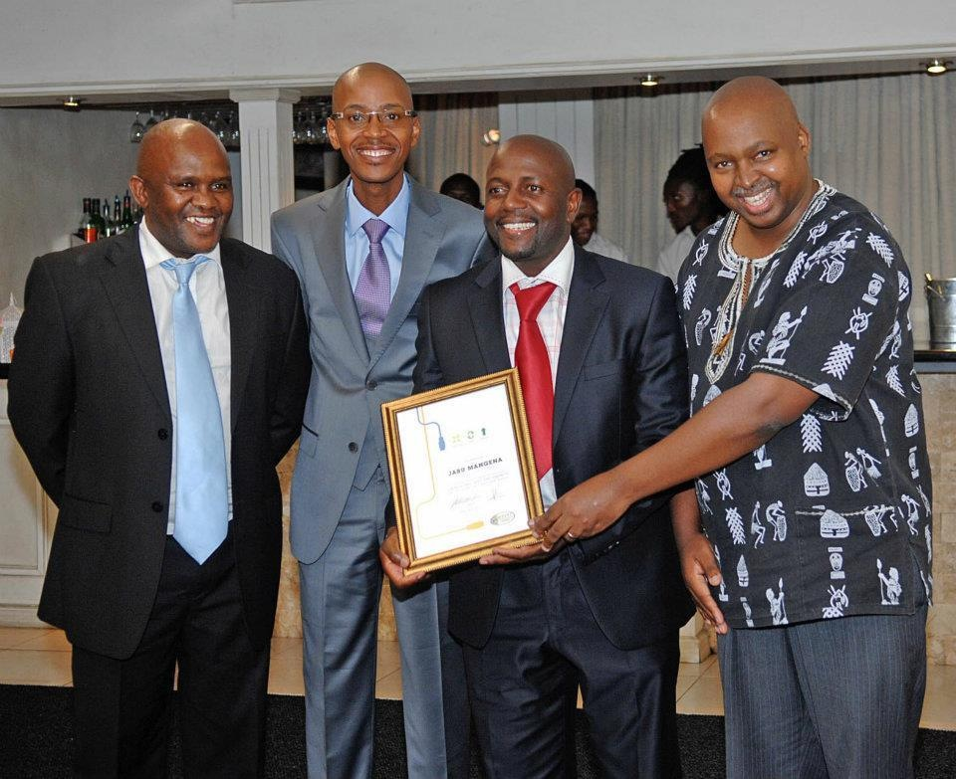
Graduating Entrepreneurs@

Slide 31
Closing Remarks
Understand and holistically enhance all relevant elements
Don’t worry about changing everything on a full scale at once
Learn from best practice around the globe, but don’t imitate other’s successes
Be local and do not target the entire country, target several regions simultaneously
Have a dedicated, independent team of entrepreneurship enablers on the ground
Success breeds success – Tell your stories…..
Notes:
Understand and holistically enhance all relevant elements of your entrepreneurship ecosystem
for example; financing without education and culture won’t lead to entrepreneurship - consider all these elements and how they drive
each other.
2. Don’t worry about changing everything on a full scale at once. When focusing on one or two domains of the ecosystem (social norms about failure, for example), you still need to address the other domains. However, we can do so on a smaller scale.
Learn from best practices from around the globe, but don’t imitate others’ successes. Silicon Valley evolved in a unique environment, completely different from Israel or Taiwan. You cannot build another Silicon Valley; rather you need to be creative and innovative with the resources, and problems, you have at hand. That, after all, is what entrepreneurship is all about.
4. Be local: don’t target the entire country, target several regions simultaneously. Only limited (but important) aspects of the entrepreneurship ecosystem, such as regulation, are handled effectively at the national level. Even in small countries, entrepreneurship tends to be localized in what we call “watering holes,” where entrepreneurs come to get access to the resources they need to survive and grow. That is why entrepreneurship-related portals, or incubators, usually don’t work, and when they do, it is when they are supported by a broad group of local stakeholders, including successful entrepreneurs.
5. Have a dedicated, independent team of entrepreneurship enablers on the ground. This new professional role, conceived of and pioneered by BEEP, consists of a team with the skills to activate the local stakeholders by impacting, in a coordinated manner, all six of the domains of the ecosystem. This project team or agency must be supported by committed stakeholders, but be able to act independently of them.
6. Success breeds success. Entrepreneurship is a “positive addiction” and successful entrepreneurs like to help others be successful. Often they help with their expertise and capital. That means that anything we can do to accelerate specific success stories helps stimulate broad based entrepreneurship. And, in the “law of small numbers,” it only takes a few, local successes to change the whole game.

Slide 32
Q & A
Thank you !
Eastern Cape Information Technology Initiative (ECITI)
East London IDZ, Zone 1C, eMonti Science & Technology Park
Block B. Off Lower Chester Road, Sunnyridge, 5208
Tel: +27 43 702 8200 (switchboard)
Fax: 0866816321
Email:
www.eciti.co.za
FACEBOOK: https://www.facebook.com/pages/Eastern-Cape-IT-Initiative/208721962558213

Slide 33


SECTORS OF FOCUS
Nature of Businesses @ ECITI
ICT
Software Developers
Hardware and Networking
System Integration
Firewall and security maintenance
Licenses and reselling
Film and Media
Content generation (Script writing)
Filming and documentary
Editing
Production & Directing
ECITI focuses in Information &Communication Technology (ICT) and the Film & Media Industries

Slide 34
INCUBATION @ECITI
ECITI
Pipeline Development | Launch Pad | Seed | E-Client(Growth)
Ongoing as per Ops Plan | 3-6 months | 6-18 months | 6-12 months
Focus: Building the Pipeline, awareness and outreach initiatives & recruitment | Focus: Developing Business Plans & Business Registration | Focus: Business Model Building and establishing revenue streams | Focus: Increased sustainable revenue streams and positioning for growth and expansion

Slide 35
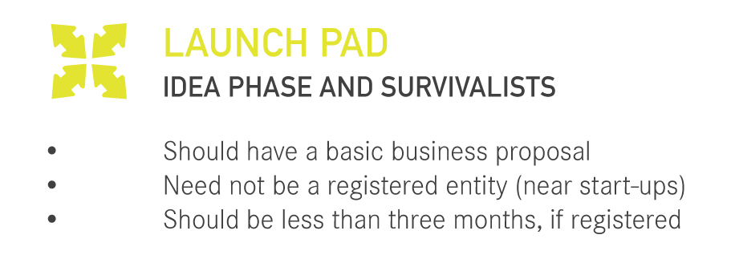
Incubation Stages

Slide 36
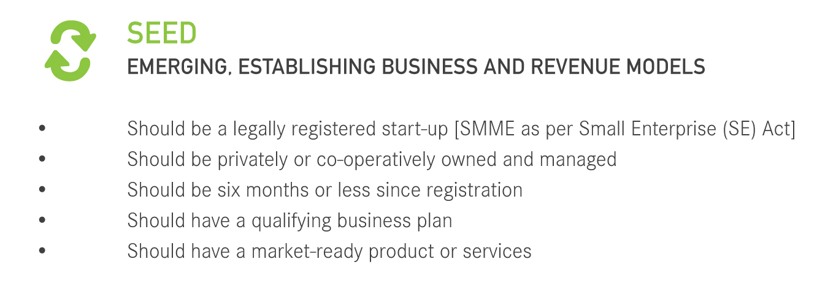
Incubation Stages

Slide 37
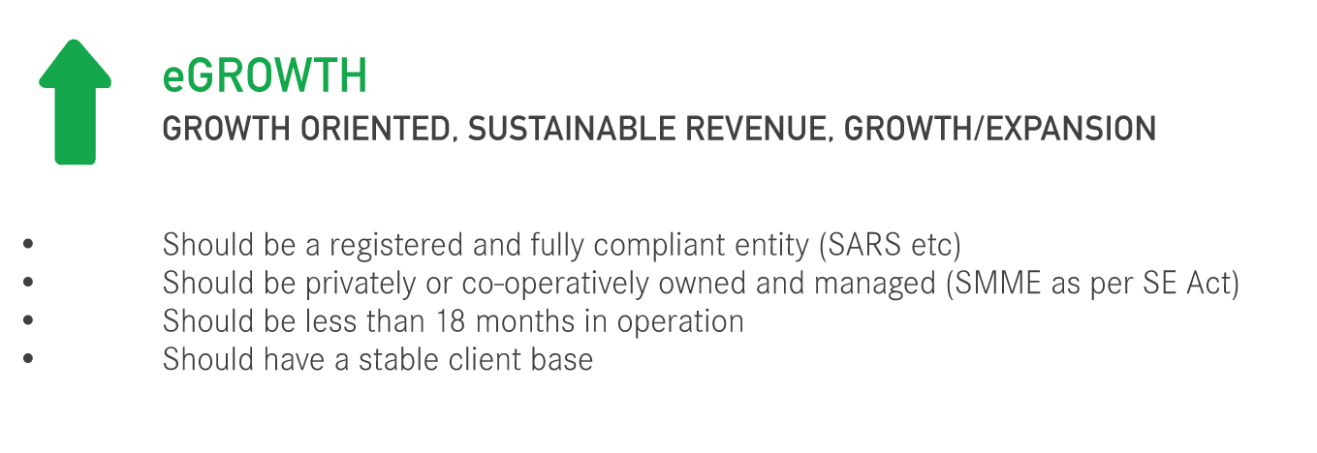
Incubation Stages

Slide 38

ICT Entrepreneurs

Slide 39

Film Entrepreneurs

Slide 40

CONTACT US:
Eastern Cape Information Technology Initiative (ECITI)
3 Elton Street, Southernwood East London, 5201
Tel: +27 87 373 0975
Fax: 0866816321
www.eciti.co.za
+2743702 8200 or info@eciti.co.za

