Slide 1






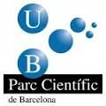
The Barcelona Model of University Science Parks
Fernando Albericio

Slide 2
Contents
Framework
Barcelona Science Park
STIP – University of KwaZulu-Natal
Conclusions

Slide 3
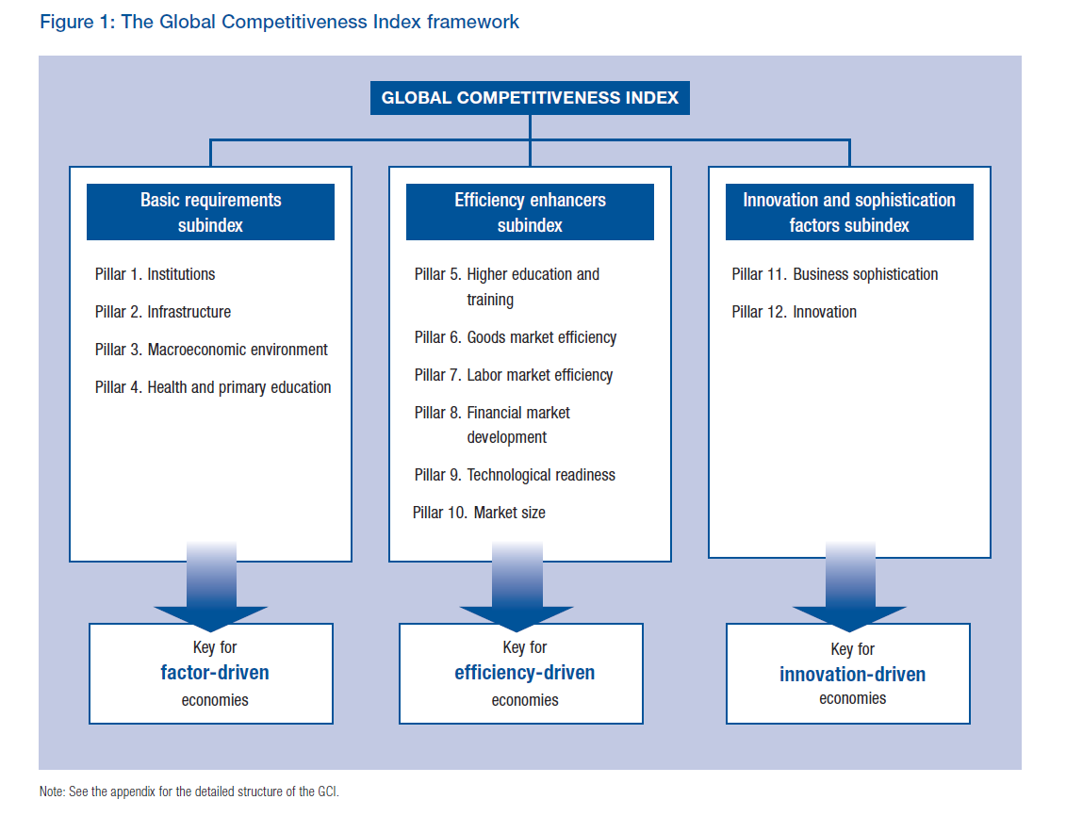

Slide 4
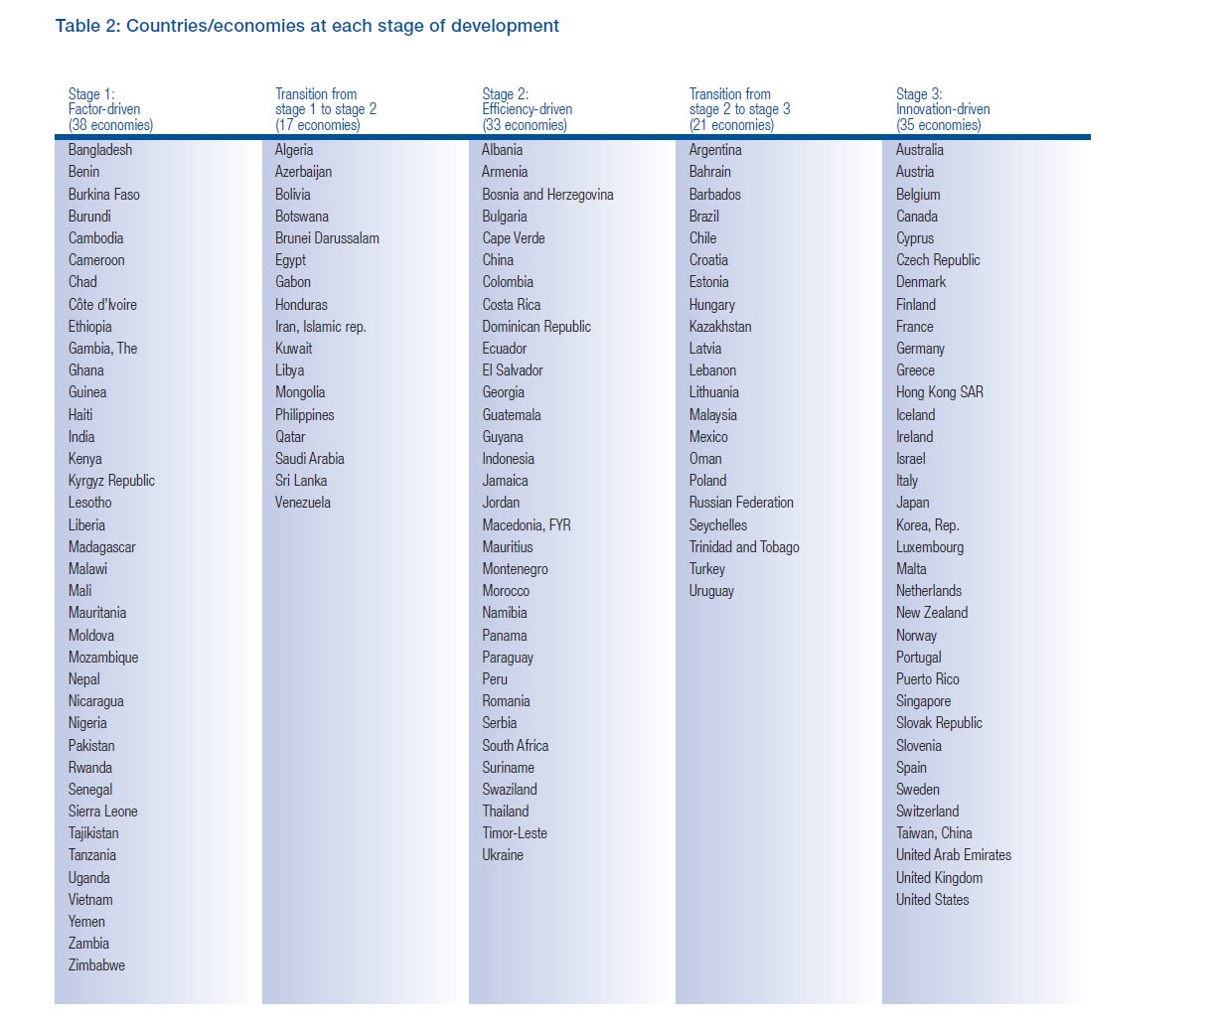



Slide 5
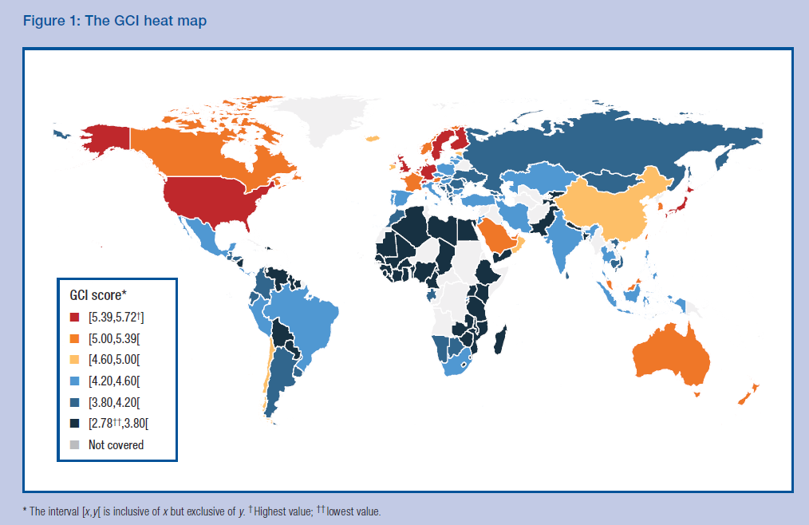
Competitiveness Global Index

Slide 6
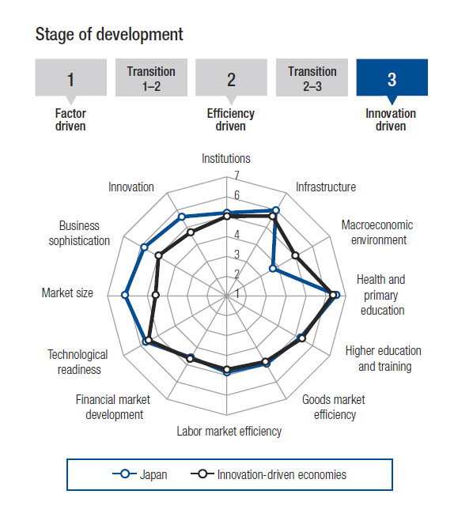
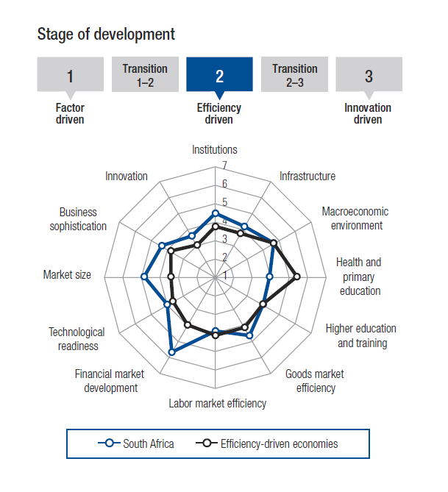
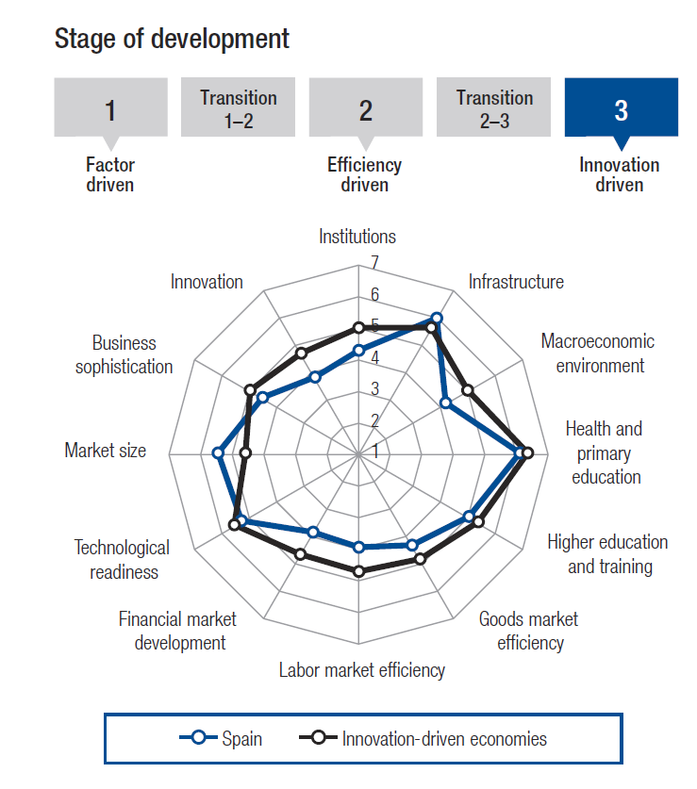
Japan
South Africa
Japan
Spain

Slide 7
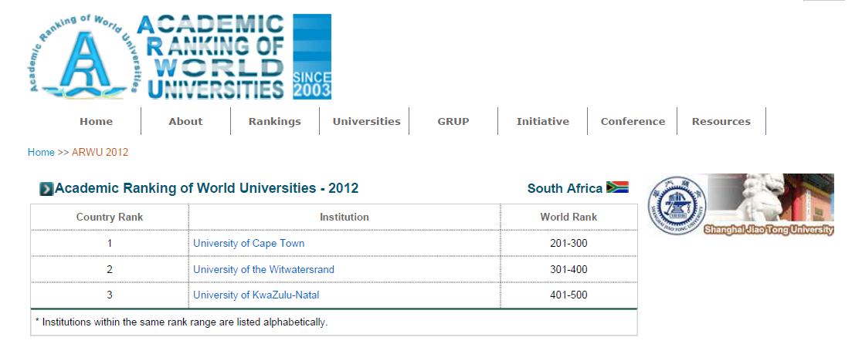
Sophisticate and Innovative Business and Modernization of the University should come together

Slide 8
Triple Helix
An important part of the success of this will depend upon the strength and equilibrium of the interactions between the three agents and with the instruments and structures of intermediation and interrelation that are created to improve the cohesion of the system

Slide 9
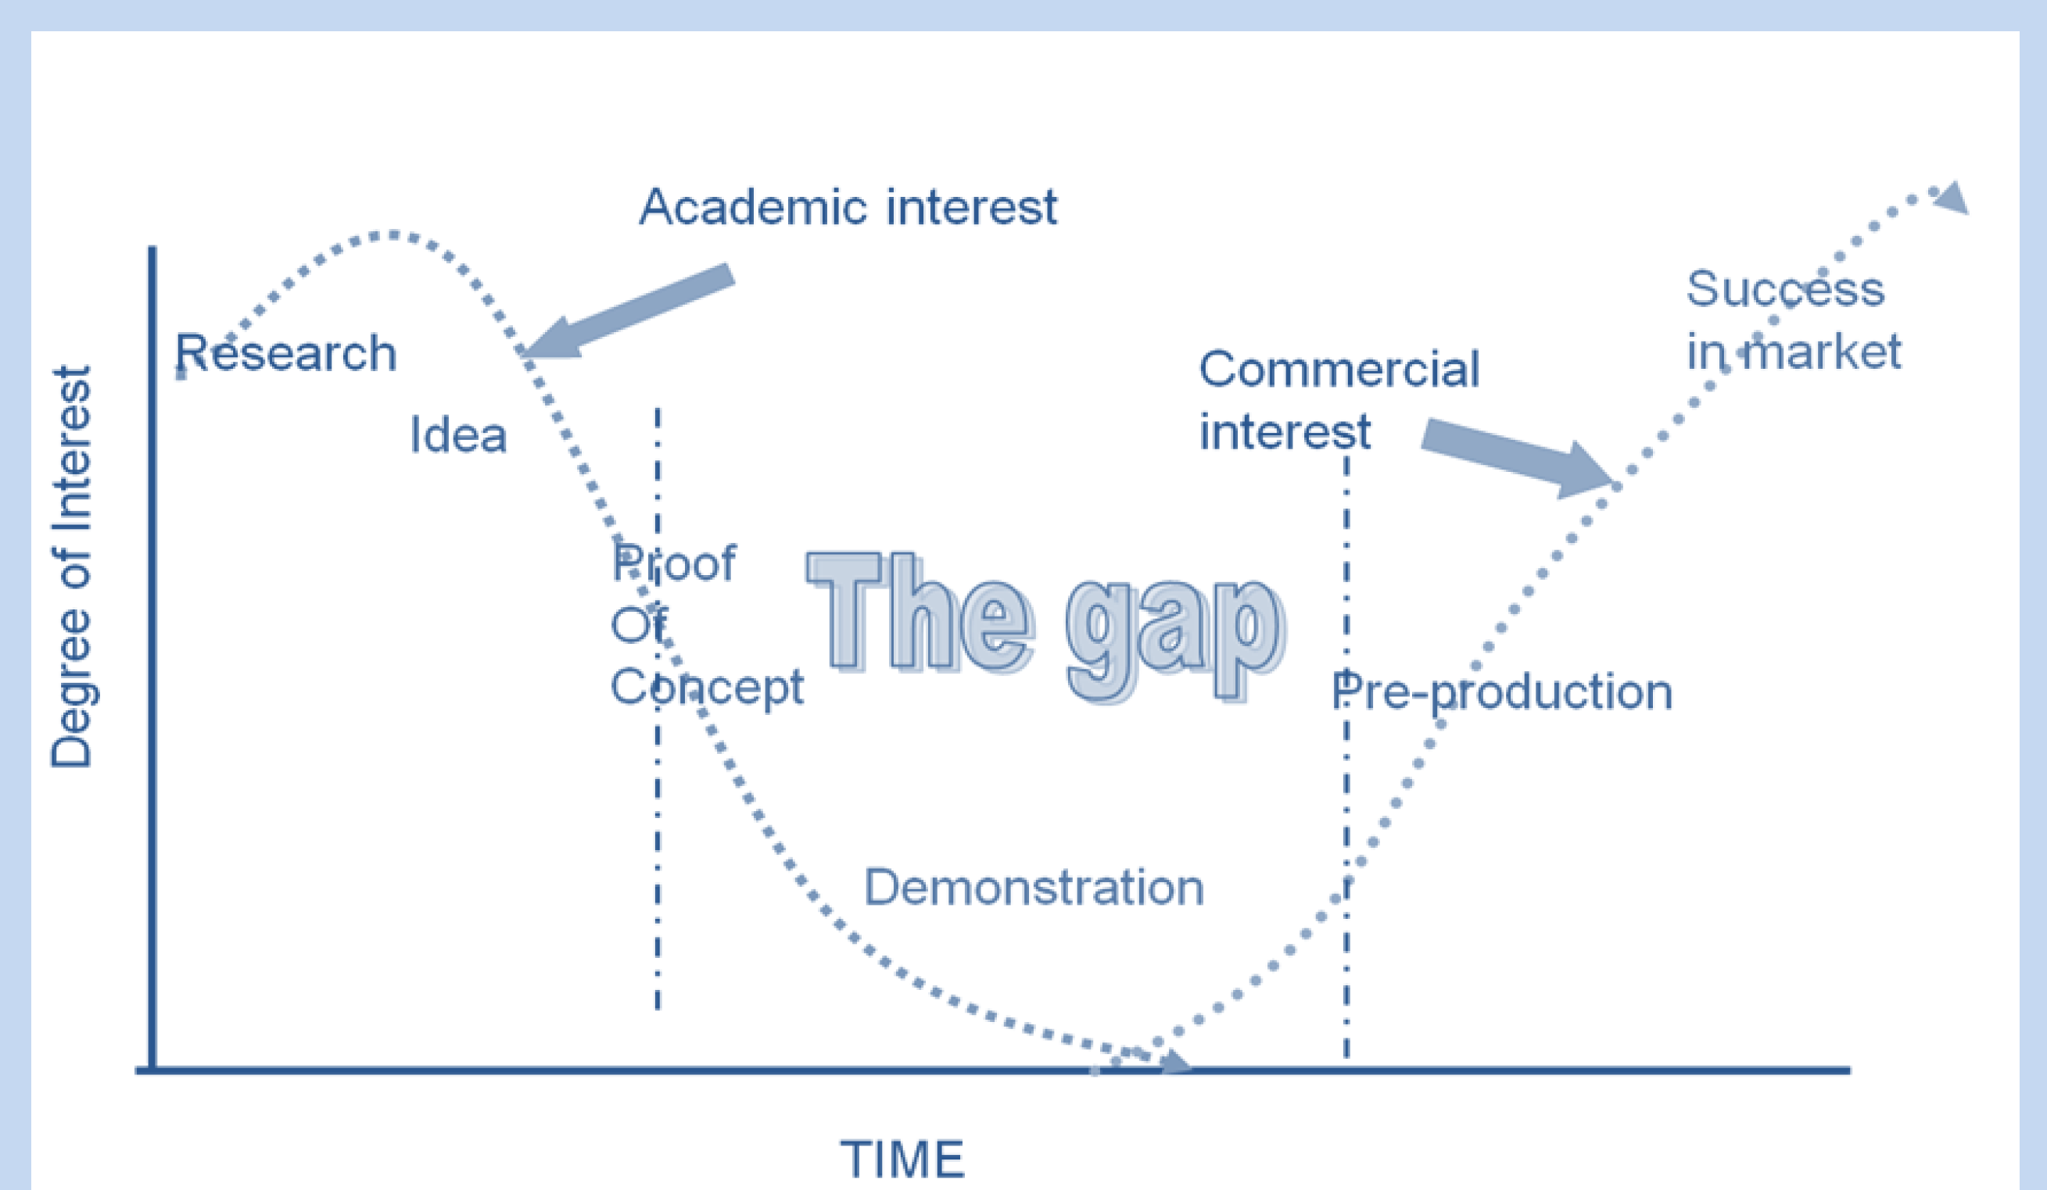


Connector

Slide 10
SCIENCE PARKS

Slide 11
The Entrepreneurial University
Urban universities need to play an important role in the development of their countries
Research carried out at universities need to lead to the creation of knowledge: patents, license and/or creation of technology-based companies
The new university needs to facilitate the establishment of closer links between itself and society

Slide 12
The Entrepreneurial University
The transfer of knowledge and technology along with participation in our technological markets, are activities that are everyday more strategically necessary for universities
Principal reasons :
    Access to global knowledge
    The necessity of universities to finance themselves
    Universities are becoming:
      More competitive
      More centered on quality and in the marketplace
      Directed toward a more strategic agenda

Slide 13
The Entrepreneurial University
Academic Revolution
  En this context, a change is apparent from research based on curiosity to research directed by objectives
  A change toward entrepreneurial initiatives. Universities must develop new businesses just as graduates and postgraduates must be introduced themselves to the commercial world

Slide 14
The Entrepreneurial University:
University Science Parks
University Science Parks are a meeting point between the university and enterprises, between creators and users of knowledge and education
University Science Parks are an instrument for the successful relationship between a university and the local community
University Science Parks could be key instruments in the emerging economic role of the entrepreneurial university

Slide 15
University Science Parks:
Endogenous Advantages
To provide more visibility to the university
The transmittance of an entrepreneurial spirit to the students
The implementation of the concepts of risk and failure in university life
Influence upon academic research
The development of new research projects
The creation of employment opportunities for university graduate. The magnetization of the best students
The generation of economic returns for the university

Slide 16
University Science Parks: Exogenous Advantages
Instrument for regional development based on the importance of knowledge
The creation of new jobs
Help enterprises move toward and remain at the frontiers of knowledge
Augment the competitiveness of businesses by the knowledge value added
Opportunities for contractual research for the university, enterprises, and the local community
To create synergies
To attract qualified people. To equilibrate the balance of brains

Slide 17
Contents
Framework
Barcelona Science Park
STIP – University of KwaZulu-Natal
Conclusions

Slide 18
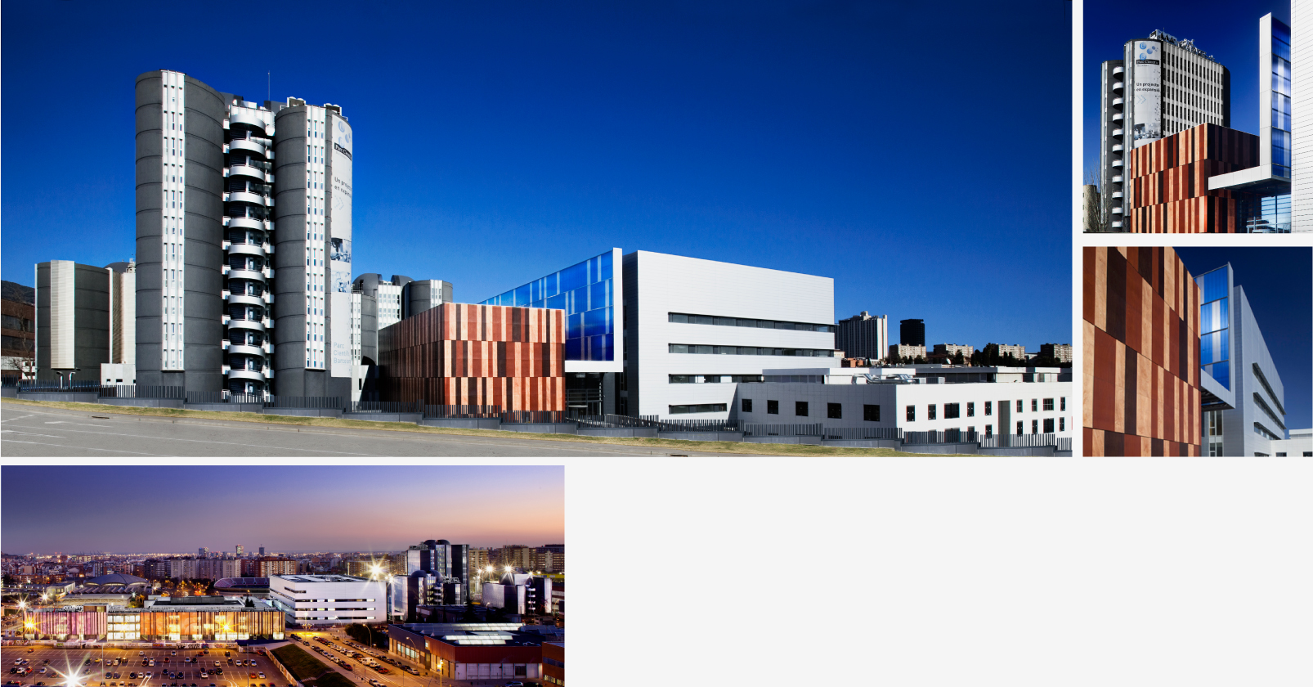
Barcelona Science Park
The Barcelona Science Park is a meeting point for universities, companies and society to foster innovation, mainly in life sciences

Slide 19
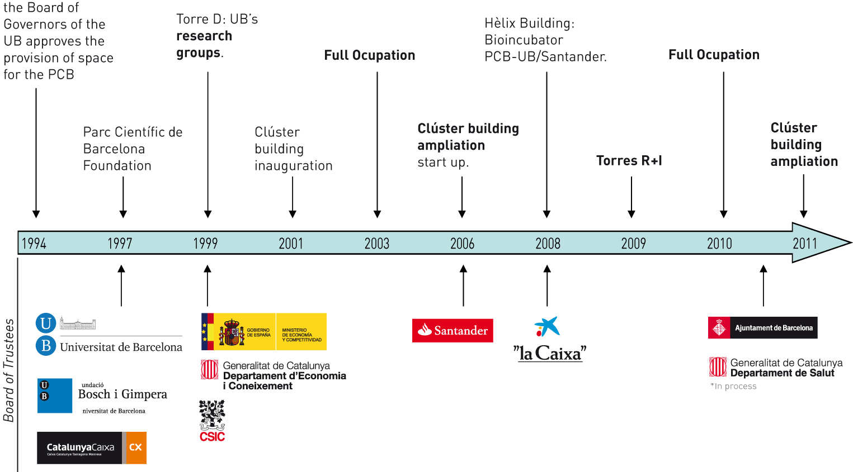
Brief history of the PCB:
Public Foundation
Barcelona Science Park

Slide 20
Barcelona Science Park: Objectives
To foster high-quality research backed with a wide range of technology support
To bring dynamism to relationships between bussiness and university
To drive the creation of start-up companies
To promote the science in society dialogue and the scientific vocations

Slide 21

Barcelona Science Park: Business Model
Public Research
Private Research
Institute for Research in Biomedicine (IRB Barcelona)
Institute for Bioengeenering of Catalonia (IBEC)
Institute for Molecular Biology of Barcelona (IBMB-CSIC)
Multidisciplinary groups
Pharma companies
Chemistry companies
Biotech companies
Other companies of multidisciplinary sectors
Research
Collaborative research
Joint laboratories
Mobility of personnel
Joint ventures
Strategic alliances
Technological platforms (genomics, X Ray, combi chem, proteomics,)
Animal facilities
Common scientific services...
Bioincubator PCB-Santander
Bosch i Gimpera Foundation
AVCRI
Patents Centre
Technological
facilities
Innovation
Science Communication

Slide 22


PCB Community Benefits
International
Research and market
Networking
Location and environment
Access to finance
2012, join the PCB
5 advantages

Slide 23

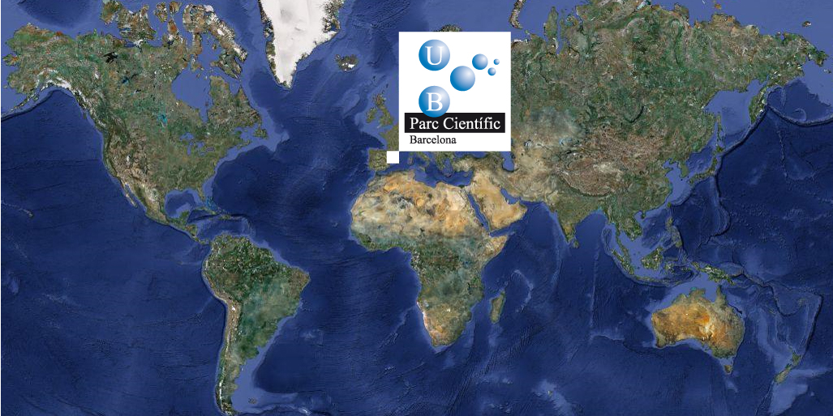
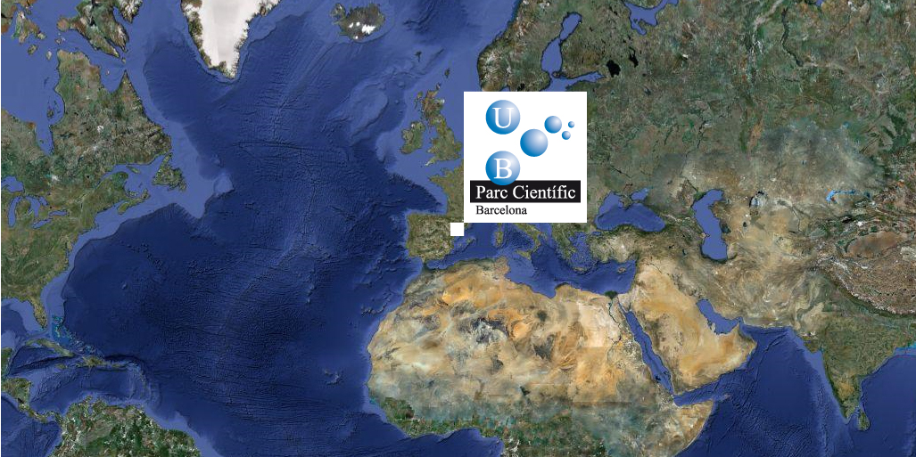
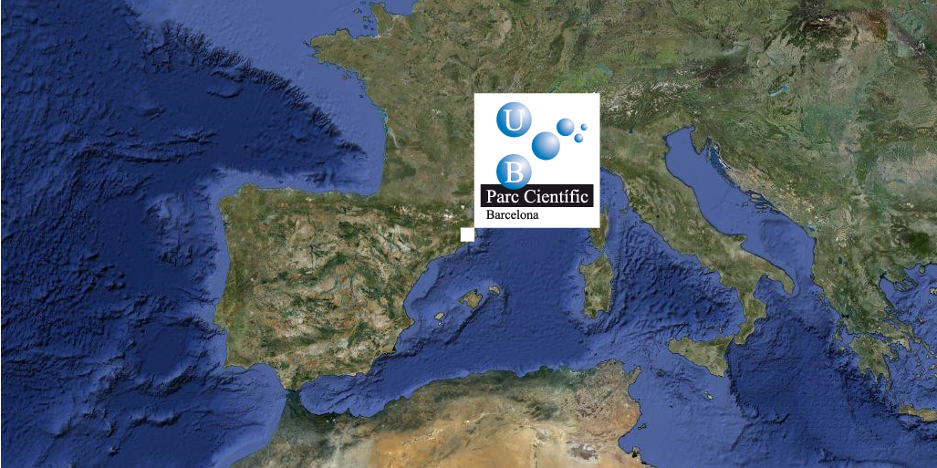
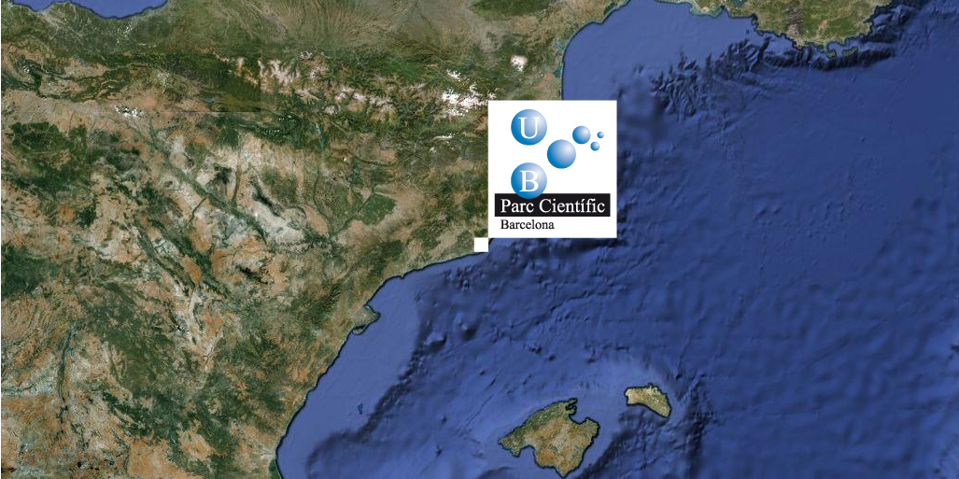
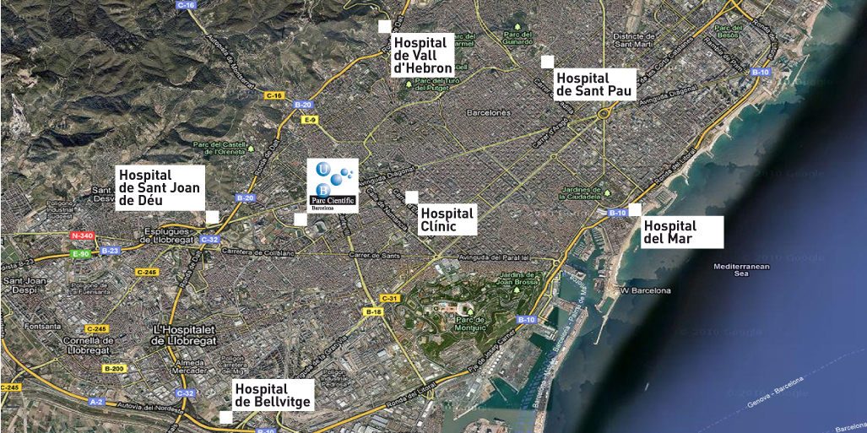
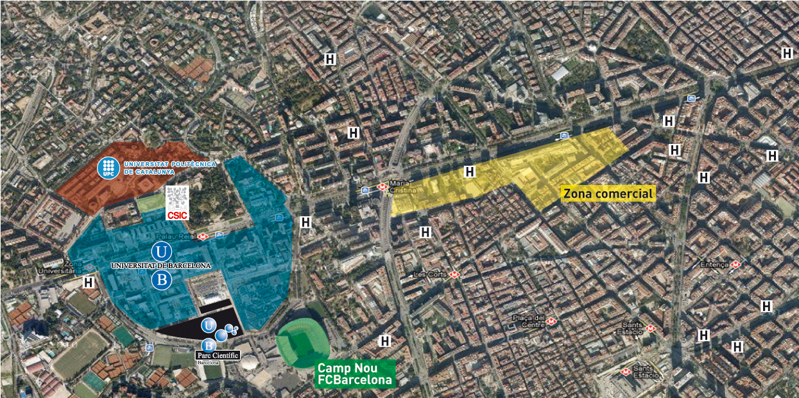
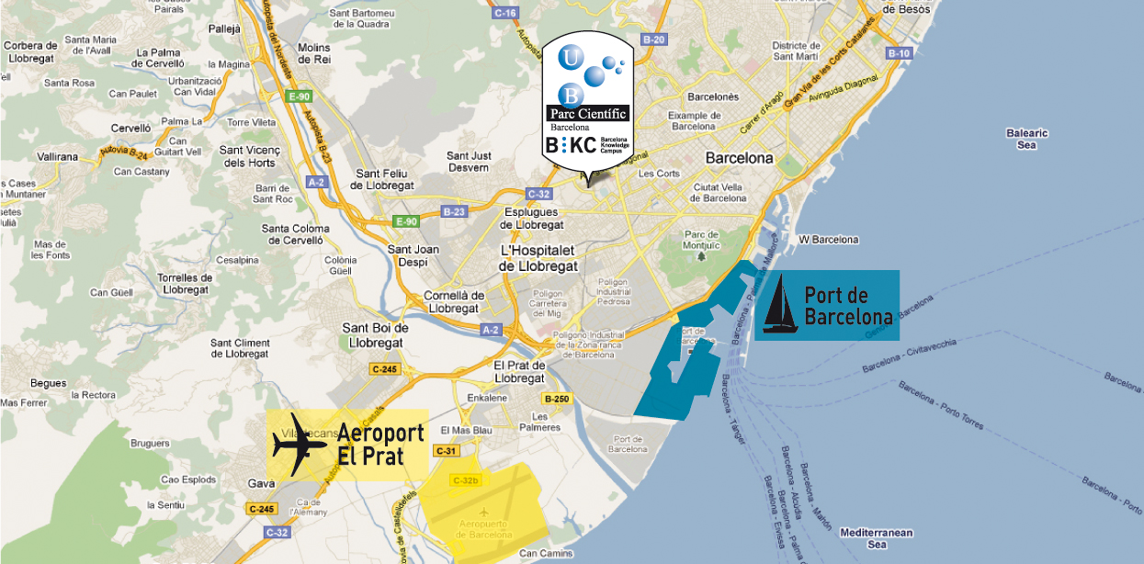

PCB: Location and environment

Slide 24
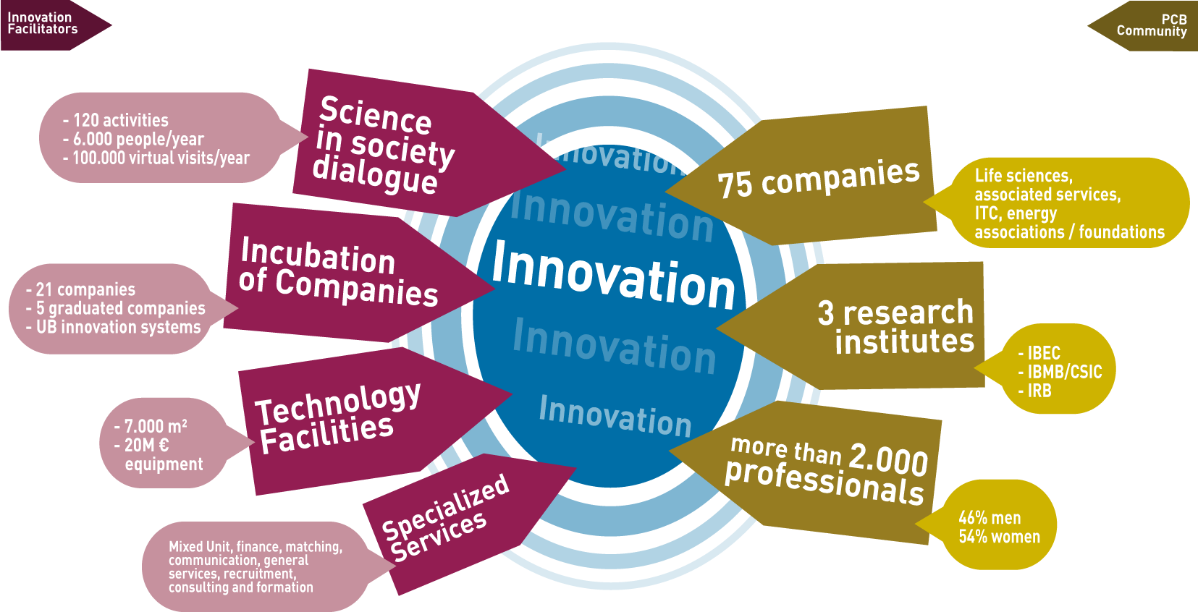
PCB: Research and Market

Slide 25
PCB: International
International networks and agreements
20% of the PCB population is foreign
Access to international opinion leaders
Barcelona Business Ready
Participation in international conferences
Collaboration with internationalization agents:
5 advatages

Slide 26
PCB: Networking
Matching with PCB Community
International networks and agreements
Internal/external contacts
Conferences, fairs, workshops, debates and activities of internal and external networking
Barcelona Business Ready
Windows to innovation
Scientific seminars
Common areas
5 advantages

Slide 27
PCB: Access to finance
Public and private funding project management
Access to non dilutive funding
  Public funding
Access to dilutive funding
  Venture Capital firms located in the PCB and external
  PCB investment

Slide 28
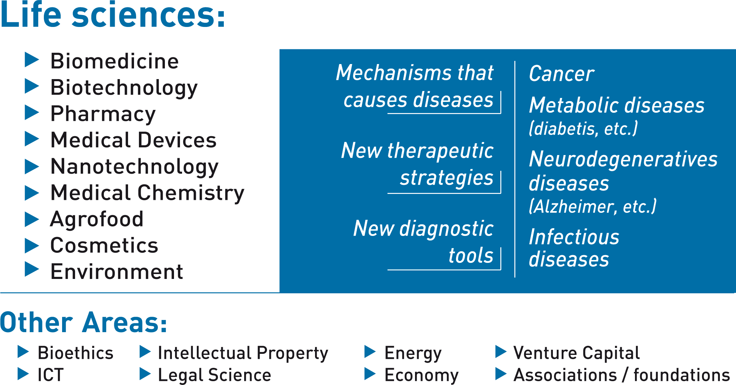
PCB: Innovation Areas

Slide 29
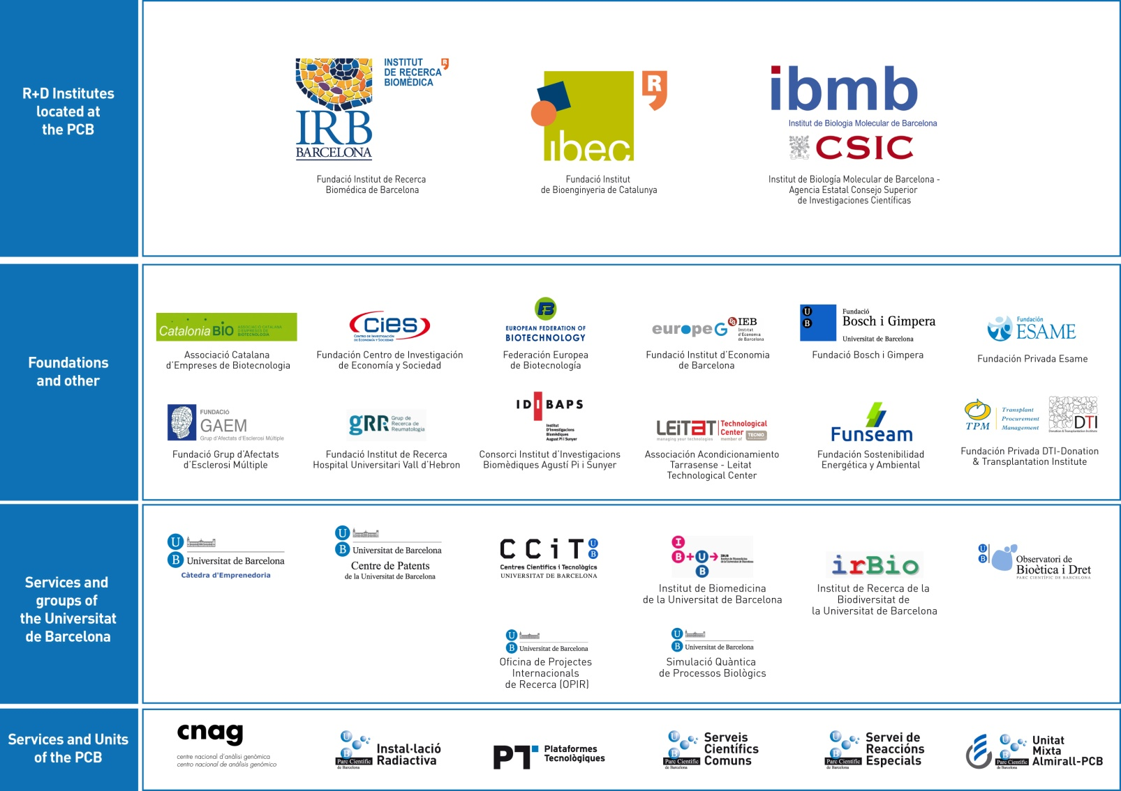
PCB: Institutes & research groups

Slide 30
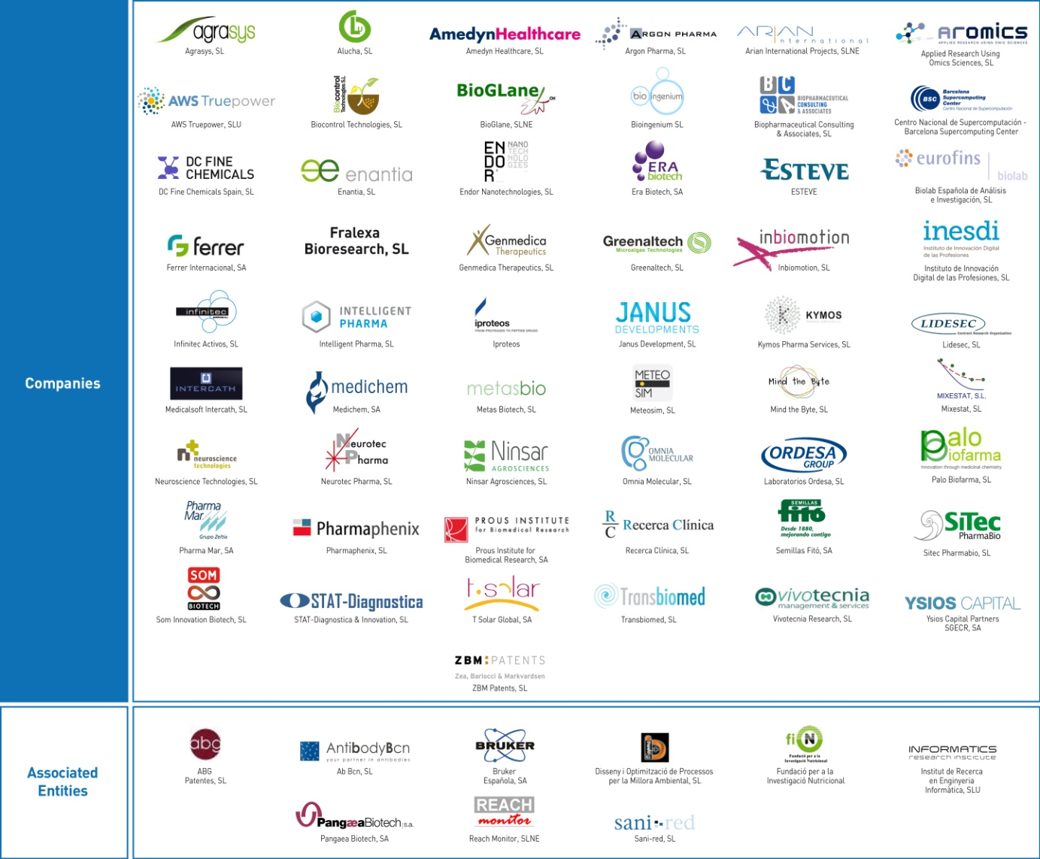
PCB: Companies
75 companies

Slide 31
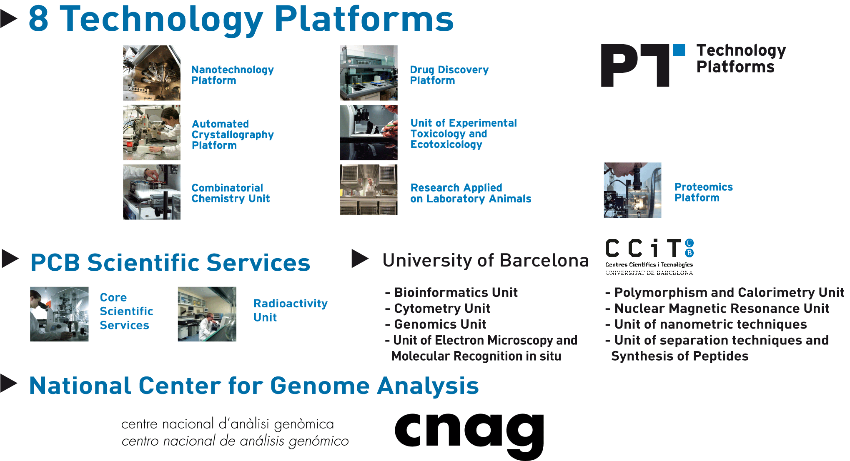
PCB: Technology facilities

Slide 32

The innovation in the PCB: in collaboration with other entities of the UB
Centre for the transfer of knowledge, technology and innovation with the aim to promote the research of the UB
Agency for identifying, assessing, protecting and marketing the industrial and intellectual property generated in the University of Barcelona.
Centre for the research, communication, documentation, training and services in the fields of intellectual property.

Slide 33

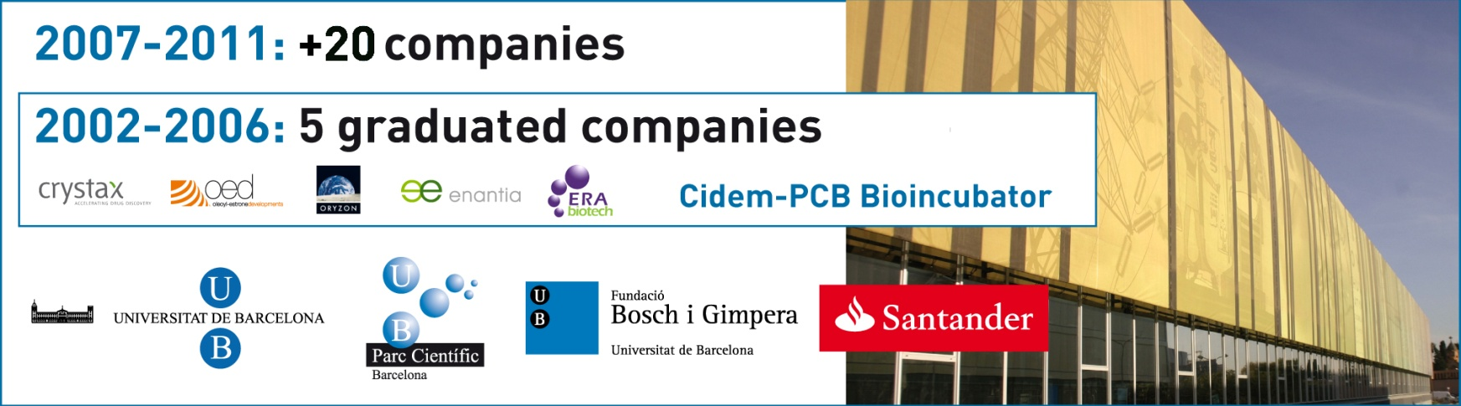
PCB-Santander Bioincubator
Space for the creation of new technology-based companies
Based in a high-level research environment
Provides the scientific and technical infrastructure
Business management consulting
Assistance and financial support
Internationalization and networking
2007-2013: +20 companies
5 advantages

Slide 34
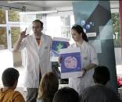
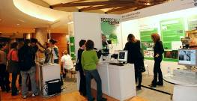
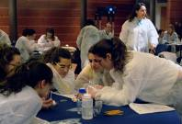
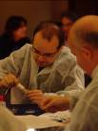

Science in Society Dialogue
Programme “Research in Society”
Fair «Research Live»
Public participation in research projects: «Tutoring for Secondary School Students», «Spend the summer at the Park!»; «Research!»
Visits to the PCB: «Research in Primary Schools», Open day «Doctorate express»
Exhibitions, conferences and debates: «EXPONANO. Smaller than small: debating nanotechnology», «Embryos and the medicine of the 21st Century. What do you think about it?», etc.
With the collaboration of:
5 advantages

Slide 35
Contents
Framework
Barcelona Science Park
STIP – University of KwaZulu-Natal
Conclusions

Slide 36

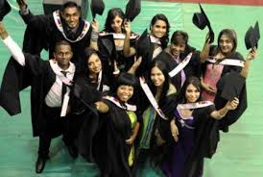

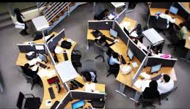
Science & Technology Innovation Park
(STIP)
University of KwaZulu-Natal
Westville Campus

Slide 37
The UKZN Science & Technology Innovation Park (STIP) was established as a result of an initial partnership between UKZN and Eskom.
The partnership is open to other industries and organizations with interest in Science, Engineering and Technology (SET) Research and Innovation.

Slide 38
The main objective of STIP is to foster research for product advancement and innovation through knowledge partnerships
Projects undertaken in the Park are in line with its main theme of Energy and Environment for Sustainable Social Development
Future projects could encompass other fields such as bio-technology and ICT to nurture hi-tech industries in commercialization of innovative ideas and technologies

Slide 39
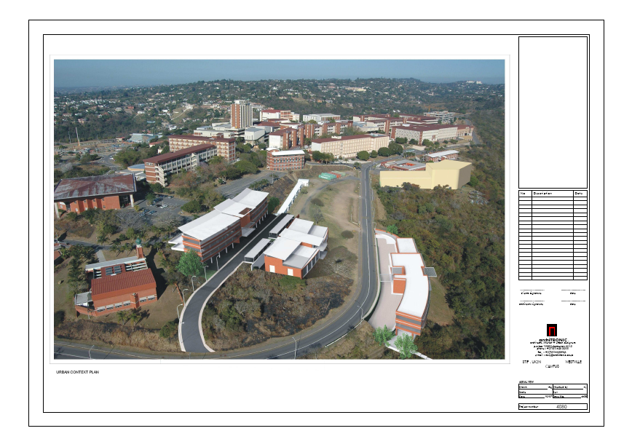
STIP Layout
Key
Colour Code
1.Vibration Research
& Testing Centre
(Existing)
2.Smart Grid Centre
(Newly built)
3.High Voltage Direct Current Centre
(HVDC)- Future
(Smaller lab-existing-6)
4.Energy Research Centre (Future)
5.Main Building (Future)
Existing
Future
6
1
3
5
2
4

Slide 40
Main Focus areas of STIP
Creation of awareness in Science, Engineering & Technology through community outreach.
Research in Centre's such as the Vibration Research & Testing Centre (VRTC), High Voltage Direct Current Centre (HVDC) have been established through partnerships with industry.
Commercialization of innovative research outputs in collaboration with UKZN, Industry & National Organizations.

Slide 41
Contents
Framework
Barcelona Science Park
STIP – University of KwaZulu-Natal
Conclusions

Slide 42
Conclusions
South Africa has to create a world-class research, technological development and innovation cluster, that supports all Africa in moving towards a value-based knowledge society
….applying four basic principles:

Slide 43
Ambition: South Africa should be called to become a key location, reference and lighthouse for the global society and markets
Sustainability: The success implies building a balance, that is adaptable and sustainable in both the short, medium, and long term, between, on the one hand, investments/costs and, on the other hand, ROI/benefits (both tangible and intangible)
“Customer orientation”: It has to find the right match between offer and demand providing direct and explicit answers to its four “customers” (firms, entrepreneurs, academia, and investors) and generating the adequate demand for knowledge-based economy services
Glocalization: Globalization with local flavor. The project should be influenced by the culture, vision, needs, expectations and way of doing things of Africa.
….and addressing targeting value-based knowledge society benefits:

Slide 44
Job Creation
Competitiveness Improvement
Growth in Export Capacities of Innovative Solution and Technologies
Improvement of the Local Innovative Brand
Capacity to Attract Investments from other Countries
Reinforcement of Knowledge and Innovation Regional Clusters
Talent Attraction, Development and Retention
Better Capitalization of R&D Results (patents, licences, spin offs…)
Promotion of the New knowledge-Based Economy
Better Visibility in the Global Market and Society
Public Services Innovation
Improvement of Public Services Quality and Efficiency

Slide 45
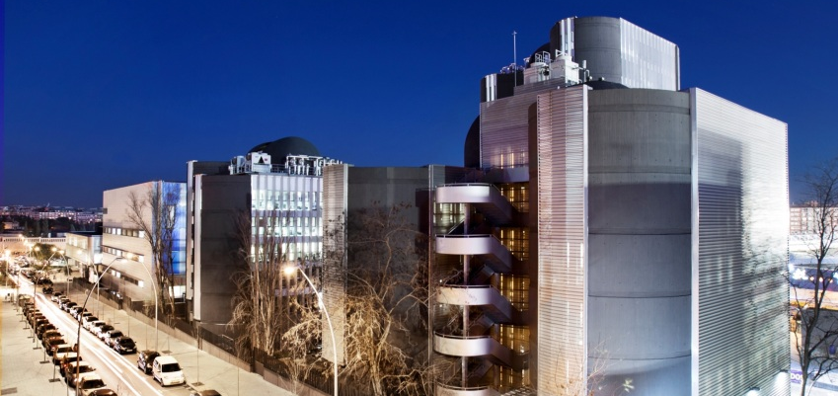
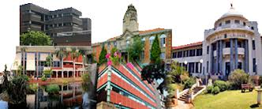
Thank you!
Prof. Fernando Albericio
Mr Pravesh Moodley
Albericio@ukzn.ac.za
Moodleypr@ukzn.ac.za
albericio@ub.edu

