Slide 1
SCIENCE AND TECHNOGY PARKS; AFRICAN EXPERIENCE IASP AFRICA 2013 WORKSHOP
9 April 2013 | Juha Miettinen, ^{CTA and Team Leader, SAIS}

Slide 2
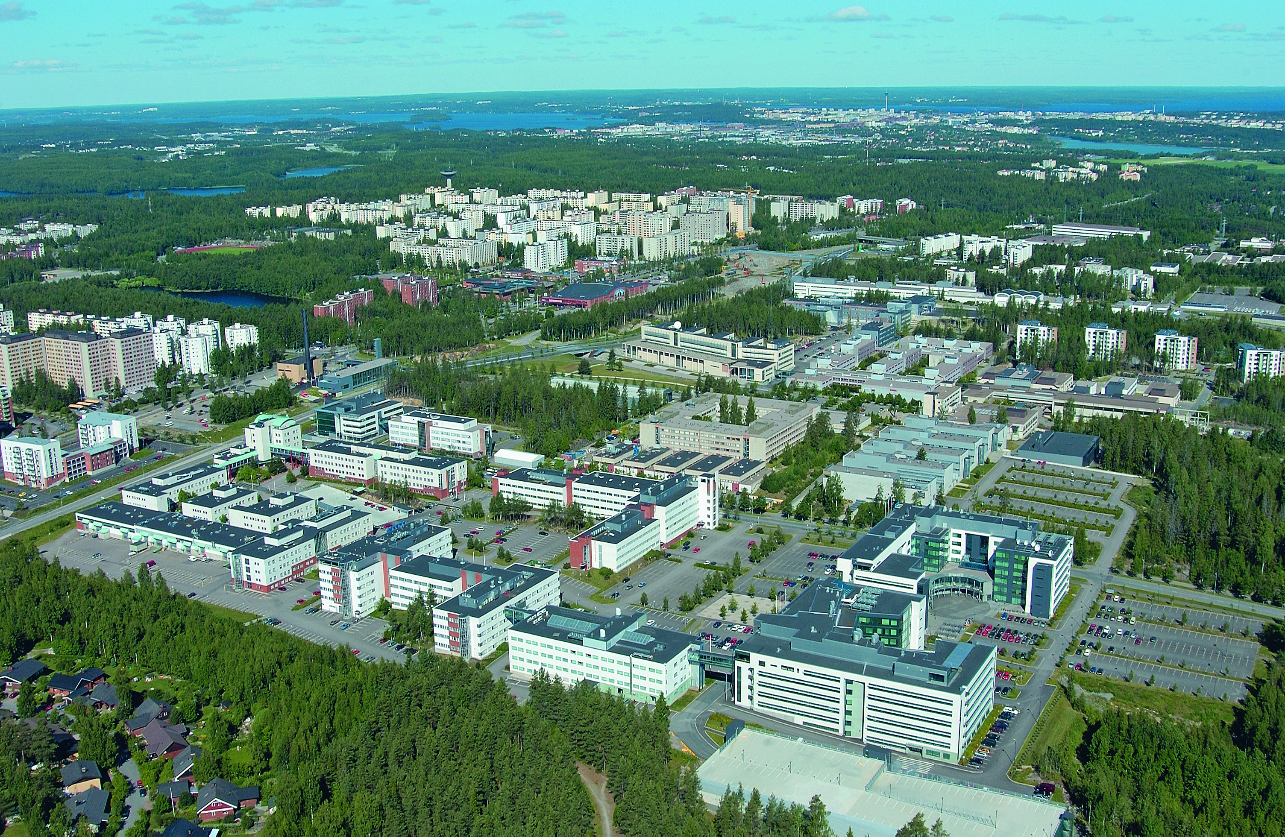

Slide 3
Content outline
SAIS in a nutshell
? What kind of STPs for Africa?
Science and technology (STP) park concept
Prerequisites for STP activities in the region
Practice-based approach
Conclusions, Q and A

Slide 4
SAIS Basic Facts
Project title Southern Africa Innovation Support Programme, (SAIS)
Focus To build capacity and stimulate operational elements
of the systems of innovations and to build practical platforms for implementing innovations so as to positively contribute to the drive for sustainable economic growth and reduction of poverty
Programme Area Botswana (BIH), Mozambique (MICTI), Namibia (NBIC), Zambia (NTBC) and South Africa as a knowledge partner, endorsed by SADC
Duration 4/2011- 3/2015 (four years)
Project Financing Ministry for Foreign Affairs, Finland
Project Budget 6,2 MEUR
Programme Office Windhoek, Namibia

Slide 5
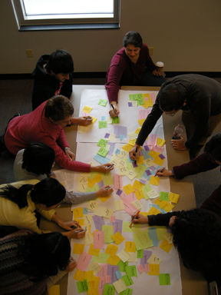
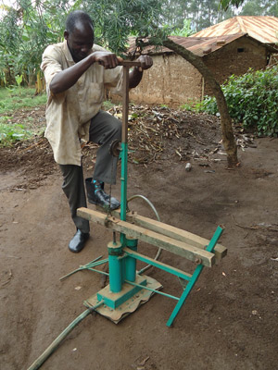
SAIS offering
SAIS is positioning itself as the Southern Cross of Innovation – the bright constellation of innovation in Southern Africa
SAIS wants to strengthen Contacts and Networks on national, regional and international levels
Wide-range of capacity building activities on innovation related themes
Adapting replicable initiatives across countries
‘Seed Money’ Financing for setting and
ramping up joint projects

Slide 6
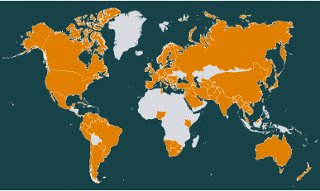
STP definition
Science parks offer a high-quality operational environment for technology-oriented companies. The main tasks include the establishment, acceleration and internationalization of business activities in close contact with universities. Science parks offer business development and networking services,plus synergy and image benefits.
IASP: 15 members from Africa out of 400+ members
Source: IASP webpage

Slide 7
BUG approach and STPs
Government
STPs
Business
Universities

Slide 8
Prerequisites for STP activities in the region
Scientific output and production quite thin
Scarcity of new applicable / commercialized technologies
Innovation and collaboration culture not very well developed
(New) Knowledge-based and technology-oriented companies do not emerge that much
Scarce skills base for knowledge-based enterprises to e.g. set up R&D labs ->one cannot attract multinationals without unique skills set
We have to find another approach and route?

Slide 9
BUGC approach
BUSINESS
UNIVERSITY
African Innovation
Parks/Hubs
LOCAL MARKETS
CIVIL
SOCIETY
GOVERNMENT
Interplay and interconnections between different players in nurturing innovation ecosystem
Notes:
Too complicated??

Slide 10
Innovation hubs for Africa
Still some focus on ‘traditional’ STPs as knowledge-economy flagships
Innovation Hubs should not predominantly be science-driven and university-based /driven
Not government driven, but with a balanced ownership structure
Practice-based innovation approach: solutions for the community and local market
Multipolar / scattered model with many innovation cells rather than one/few huge complex(es)
Small units close to the community with strong community involvement
Co-creation spaces, open innovation approach

Slide 11
Summary
New STP concept(s) needed for Africa – not that much science-led; small-scale experimenting and piloting starting from the content rather than concrete
Practice-based innovation approach; near the communities
Scattered network of Innovation hubs rather than master STPs
STP issues have been one of the focus areas within SAIS and SAIS is willing to come to the party also in the future

Slide 12
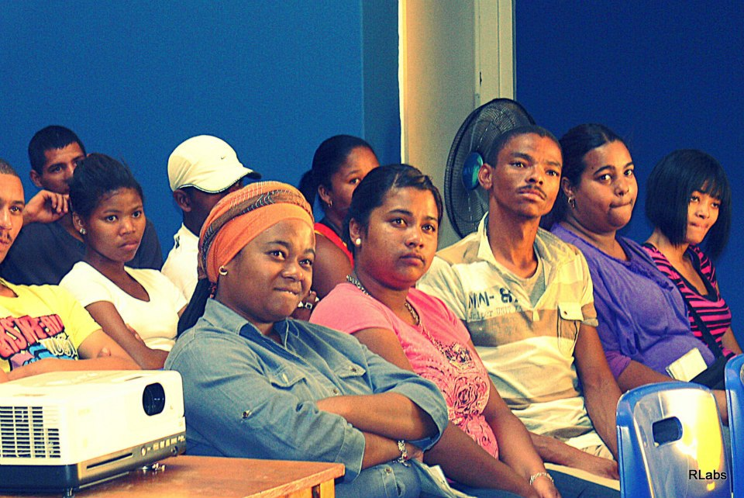
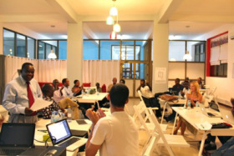
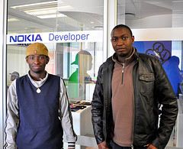
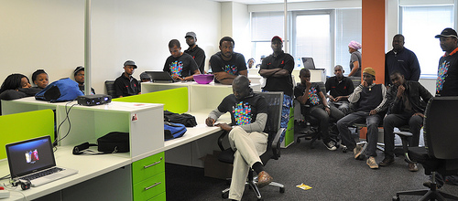
I thank you for your attention

